Slide 1
Title of Presentation
Name of Presenter
Date

Slide 2
List of contents
Start with a slide on the list of your contents. Here are some example bullet points
Introduction/Motivation
Experimental Method
Discussion of literature results
Summary and Outlook
Notes:
Introduction/Motivation: What is the topic and why is this interesting? Historical context?
Experimental Method: Basic principle, Challenges
Discussion of literature results: Introduction of specific material classes, Results of experiments under strain etc.
Summary and Outlook

Slide 3
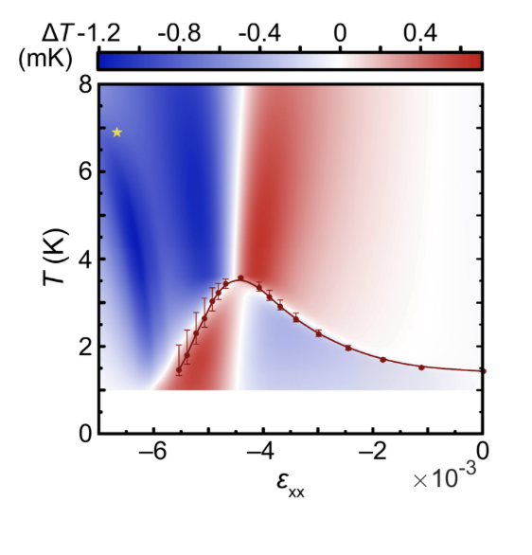
Introduction
Example for Reference Style
Li et al., Nature 607, 276–280 (2022)

Slide 4
Some further recommendations
Slides should not contain too much text. Write no sentences, only essential words.
Use figures if possible and tables if necessary to present complex data.
Keep graphs simple. Take out the detail that you are not going to mention during your talk.
To facilitate reading, use a large and clear font
Keep the “flow” of your talk in mind: Always consider the words you use when transitioning from one slide to the other.

