Slide 1
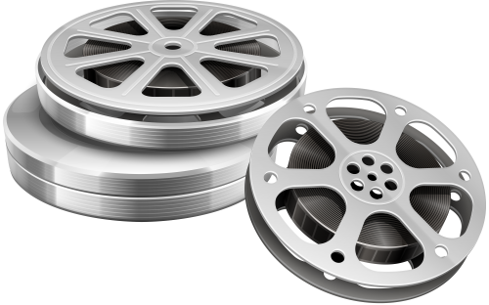
What Makes A Movie?
Structural Elements

Slide 2
Structural Elements
Frame, Shot, Scene and Sequence are the fundamental building blocks of any film or video
They build upon each other (e.g. a scene consists of one or serval shots)
All four of these elements are important for both the filming and the editing process

Slide 3
Structural Elements
Movie
Sequence
Scene
Scene
Sequence
Scene
Scene
Scene
Shot
Shot
Shot
Shot
Shot
Shot
Shot
Shot
Shot
Shot

Slide 4
Frame
one of the many still images which compose the complete moving picture
The term may also be used more generally as a noun or verb to refer to the edges of the image as seen in a camera viewfinder or projected on a screen –> something is “in frame”

Slide 5
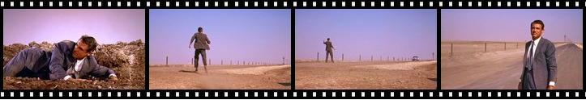
Frame
The term is derived from the film strip. Each image on such a strip looks rather like a framed picture
When the moving picture is displayed, each frame is flashed on screen for a short time and then immediately replaced by the next one -> Illusion of “moving pictures”

Slide 6
Shot
one length of continuous action
  in Production: created the moment you turn the camera on (begin recording) until the moment you turn it off
  in Editing: the footage (recording of a particular event) between two edits or cuts in the video material
can be as short as a single frame or it can be many minutes long
During a shot the camera can stay static or move around
The term derives from the old hand-cranked cameras, which sounded similar to the hand-cranked machine guns of that time

Slide 7
Scene
the action that takes place at a certain place and time in the story
can be composed of one shot or any number of shots
Many times a scene will start with a master shot which captures the entire scene
In a lot of movies or videos you will see parallel scenes where action is going on in two different locations at the same time

Slide 8
Scene
The division of the movie or video into scenes is planned out in the video production script
Scenes are not necessarily shot in order. They will be put in the proper sequence in the post-production
Scenes are usually serially numbered to keep track of them while filming

Slide 9
Sequence
number of scenes forming a distinct unit in the film
or where the action continues or progresses along each of the scenes
is usually connected either by continuity of location or time or both
ends when the subject matter changes

Slide 10
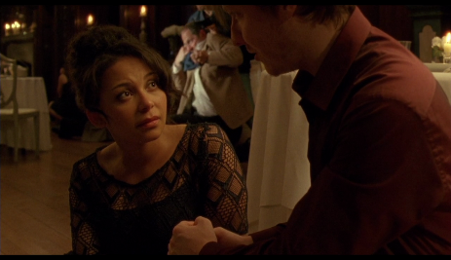
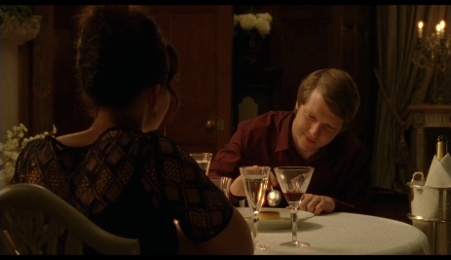
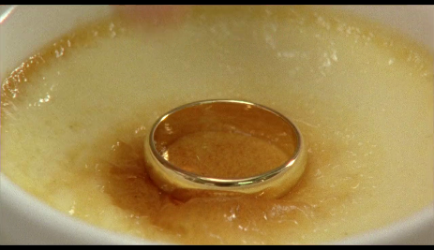
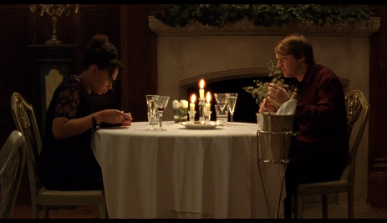
Example
Short Film: The Proposal
Sequence: in this case the whole film is one sequence
Scenes: 1) The Ring gets put into the dessert;
2) Couple at table (Proposal and Robbery)
Shots: e.g. ring in dessert, frontal view of table… https://www.facebook.com/omeletocom/videos/the-proposal-comedy-short-film-omeleto/10155877382934494/

Slide 11
What Makes A Movie?
Sound and Images

Slide 12
The Hybridity of Movies
Movies are multicodal and multimodal
  Multicodal -> medium appeals to multiple sensory channels
    (visual, auditory)
  Multimodal -> medium employs multiple semiotic systems
    (pictures, written and spoken language, numbers, gestures, facial expressions, notes, fashion...)
But: Movies are experienced as an “organic unit” rather than a discontinuous conglomerate of random sign systems

Slide 13
Multicodality
Movie
Auditory Channel
Visual
Channel
Sound
Images

Slide 14
Sound
Addresses the auditory channel
Functions:
  Narration
  Synthesizing (turn movie into an organic unit)
  Referencing (e.g. places or characters)

Slide 15
The Auditory Channel
Auditory Channel
Kind
Point of origin
Voice
Music
On-Screen
Off-screen
Earshot
Commentative
Noise
See: Heiß, Nina: Erzähltheorie des Films. Film-Medium-Diskurs, Band 38. Würzburg: 2011, S.39, Abb.8.

Slide 16
Voice
On-screen: character dialogue or monologue
Off-screen:
  diegetic – in earshot (for example: phone calls)
  commentative – voice-over
On-screen voices are usually recorded while filming whereas Off-screen commentaries are edited in later
The different types can “fade” into one another (for example: an off-screen narrator is eventually seen telling the story on screen)

Slide 17
Off-screen commentary
Can‘t be heard by the characters on screen
Typical Usages are:
  Voice of a Narrator
  Characters reading or writing text passages
  Characters talking in a montage

Slide 18
The Auditory Channel
Auditory Channel
Kind
Point of origin
Voice
Music
On-Screen
Off-screen
Earshot
Commentative
Noise

Slide 19
Music
Score & Songs
What‘s the “Soundtrack”
  Collection of songs used in the movie?
  Or: Score and Songs together make the soundtrack?
  The track that features the sound -> Voices, Noises and Music

Slide 20
Score
Usually instrumental
In most cases extra-diegetic/commentarial
  Can‘t be heard by the characters
Forms a (unified) whole (recurring motifs, consistent music style, same instruments) -> same composer
Specific Themes for certain characters, places or situations
    (“Imperial March“ -> Darth Vader; “Concerning Hobbits“ -> The Shire)

Slide 21
Songs
Usually pre-existing songs by various artists
Can be diegetic or extra-diegetic
Diegetic music
  Also called “source music” (because the source of the music can be found on-screen)
  Can be heard by the characters in the movie
Non-diegetic/Extra-diegetic music
  Doesn‘t come from a source seen on-screen
  Commentative

Slide 22
Songs
Example:
song playing on the radio -> diegetic
song accompanying a montage -> extra-diegetic
cross-over diegesis (blending/transforming a sound or piece of music from one spectrum of diegesis to another )
    Example: seemingly extra-diegetic music suddenly stops when a character removes their headphones

Slide 23
Functions of Music
Atmospheric
  Music can enhance the mood
    This goes for both diegetic and extra-diegetic music
  Music can also stand in direct opposition to the visual sphere of the movie
    Example: Children playing on a sunny street to sinister score music
    -> coming threat, dark secrets?
As viewers we tend to trust the music more than the pictures

Slide 24
Functions of Music
Describing a character‘s emotional state
Referencing characters or places via their theme music
    Characters and places don’t even have to be present but can also be remembered, talked about etc.

Slide 25
The Auditory Channel
Auditory Channel
Kind
Point of origin
Voice
Music
On-Screen
Off-screen
Earshot
Commentative
Noise

Slide 26
Noise
Much like music, noises can be diegetic or non-diegetic and can be coming from a source on- or off-screen
Most often story relevant noises are edited in or at least enhanced during post productions -> Sound Effects
Most noises are only perceived subconsciously
But: Total absence of noise would be noticeable
-> Silence can be a powerful stylistic device as well
Therefore a special room tone recording can be made to help post production

Slide 27
Multicodality
Movie
Auditory Channel
Visual
Channel
Sound
Images

Slide 28
Images
Addresses the visual Channel
Encompasses not just “pictures” but also facial expressions, written words etc.
Important is what is shown (Nature of Image) and how it is shown (Treatment of Image)

Slide 29
The Visual Channel
Visual Channel
Nature of image
Treatment of image
Prop
Location
Cinematography
Editing
…
Actor
Appearance
Performance
…
See: Heiß, Nina: Erzähltheorie des Films. Film-Medium-Diskurs, Band 38. Würzburg: 2011, S.39, Abb.8.

Slide 30
The Visual Channel
Editing
Type
Rhythm
Straight cut
Fade

Slide 31
Editing
Shots are selected from the raw footage and combined into sequences to create a coherent end product
Function:
  Organizing the narrative structure
  Relating shots to each other
  Guide the audience’s attention

Slide 32
Editing
The Meaning of a clip can change depending on the order of shots that are cut together
Putting two shots together can suggest connection or emphasis contrast
We distinguish between Continuity and Non-Continuity
Creates new meaning that transcends the meaning of the induvial shots

Slide 33
Continuity
Cutting shots to tell a story with narrative continuity
Creating realism – construction not perceived as such
Implying a spatial relationship from shot to shot and ensuring a smooth flow
Usually within a scene
Examples: Eyeline Match, Match on action/Continuity Cut (continuation of an action in the next shot)

Slide 34
Non-Continuity
Continuity is broken
Construction becomes more apparent
Connection between the two shots can be metaphorical
    Example: Shot of a character getting stabbed -> cut to: Artist spattering red paint onto a canvas
e.g. Match Cut (cut between visually similar shots), Thematic Cut, Cross Cut (going back and forth between two different actions)

Slide 35
Montage
Several meanings
In German: Montage = Editing
In Soviet filmmaking of the 1920s, “montage” was a method of juxtaposing shots to derive new meaning that did not exist in either shot alone.
In classical Hollywood cinema, a “montage sequence” is a short segment in a film in which narrative information is presented in a condensed fashion

Slide 36
Montage
used to advance the story
Often to suggest the passage of time
Often accompanied by song
Classic subjects of montages: characters growing up, training montage, shopping/make-over montage

Slide 37
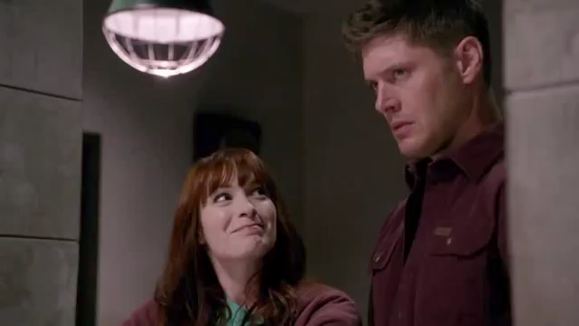
Montage
“Pac-Man Fever” – Supernatural 8.20 // https://www.youtube.com/watch?v=NEIxxTdoY3M

Slide 38
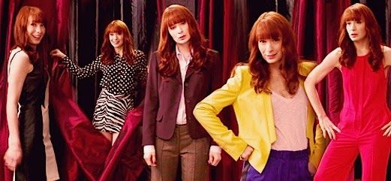
Montage
Narrative information in
condensed fashion -> we don’t see her change
every time
Longer passage of time / Change
Tongue-in cheek breaking of the 4th Wall -> character is
not aware that she is in a TV-Series but wants to act
out TV/Movie Tropes
cross-over diegesis
of the song

Slide 39
Other Commonly Used
Editing Techniques
Eyline Match -> Consist of a shot of a certain character followed by a shot of something that the character sees (or vise versa)
Shot-Reverse-Shot -> alternating shots of two characters looking at each other - most commonly used for dialogues
    Not necessarily showing the speaker
    Can also show reactions from the listening party

Slide 40
Other Commonly Used
Editing Techniques
Sharp contrasts: From gross to tasty; from extreme to mundane
Immediately refuting characters’ assessments
    Example:
    “I’m sure he’s is fine.” –> cut to: Character not being fine at all
    “Nothing will go wrong.” –> Chaos

Slide 41
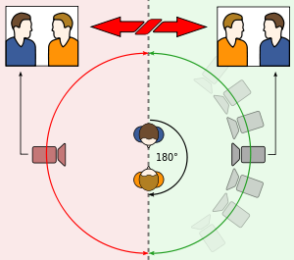
Editing Conventions
Longer scenes should start with a Master/Establishing Shot (shows setup in its entirety)
If camera changes position between shots it should be by at least 30 degrees
180-degree rule (an imaginary axis
connects the characters –
camera should be kept on
one side of this axis

Slide 42
Transitions
Straight Cut
  Most common
  Just two shots set back to back
Fade in/Fade out
  The preceding shot fades into black from which the following shot emerges
Dissolve/Cross fade
  The preceding shot merges into the following shot

Slide 43
Transitions - Functions
Uphold continuity – usually with straight cut
Imply passage of time or change of location
Imply special connection between two shots
    Example: Character sleeping in bed – cross fade into the next shot might suggest that we’re entering the characters dream

Slide 44
The Visual Channel
Editing
Type
Rhythm
Straight cut
Fade

Slide 45
Pace & Rhythm
Depends on Shot Duration (how long does a shot last before it’s replaced by the following one)
The duration of a shot will usually reflect the narrative context
  Short shot duration conveys action and urgency (e.g. chase sequence, battle scene)
  Long shot duration suggests intensity and intimacy and allows us to focus on facial expression and mise en scene (e.g. emotional scenes, meaningful conversation between lovers)

Slide 46
The Visual Channel
Visual Channel
Nature of image
Treatment of image
Prop
Location
Cinematography
Editing
…
Actor
Appearance
Performance
…

Slide 47
The Visual Channel
Cinematography
Lighting
Colour
Camera
Mise-en-scène
Distance
Angle
Movement

Slide 48
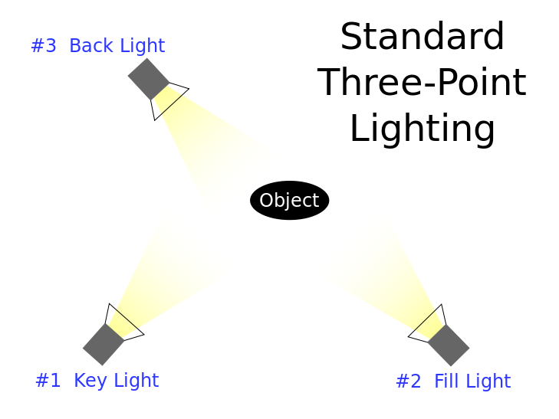
Lighting
Different Lighting techniques can be used to create
meaning
Commonly known lighting techniques:
  Three-Point-Lighting, consisting of
    Key Light – aims at the subject, brightest
    Fill Light – softer light opposite the key light
    Backlight – behind the subject

Slide 49
Lighting
Fill Light: Reduces the shadows caused by the main source of illumination.
Key Light
  High Key – High proportion of fill light to key light
    Brighter picture, often used in comedies or musicals
  Low Key – Low proportion of fill light to key light
    More shadowy, perfect for mysteries and horrors
  High and Low Key can be combined
    For example: Character leaves sunny street to enter a dark bar

Slide 50
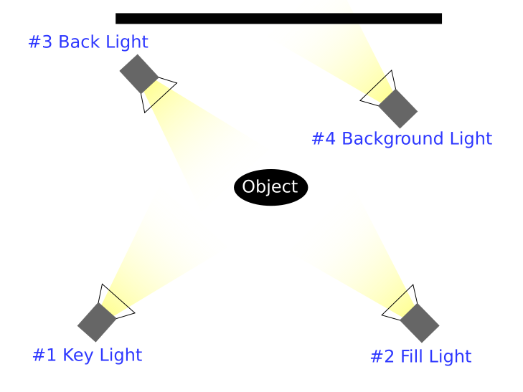
Lighting
  Four-Point-Lighting
    Basically three-point set-up plus a Background Light
    Background Light is behind the
    subject and pointed at the
    background
    Adds distance between subject
    and background
    Adds a sense of depth

Slide 51
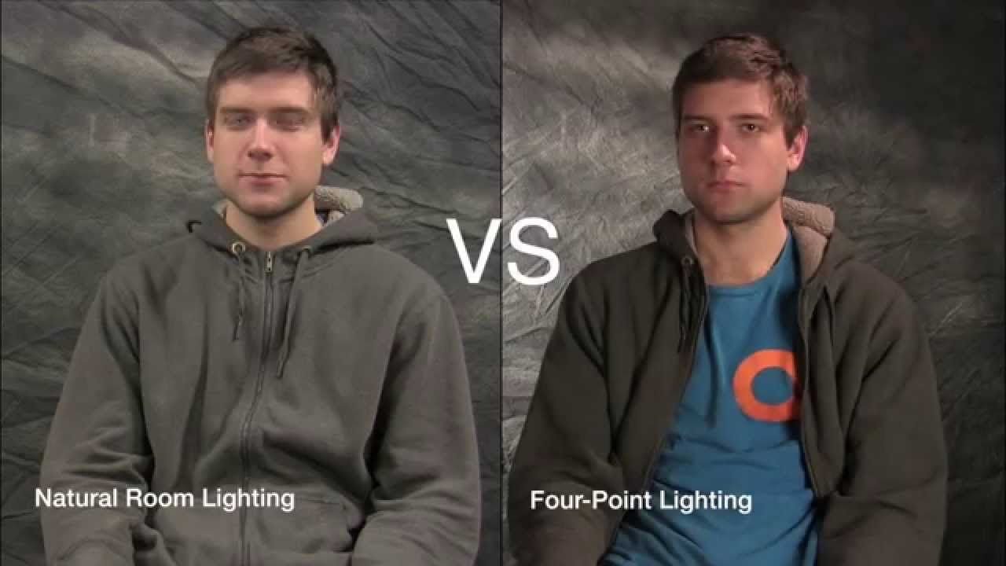
Lighting

Slide 52
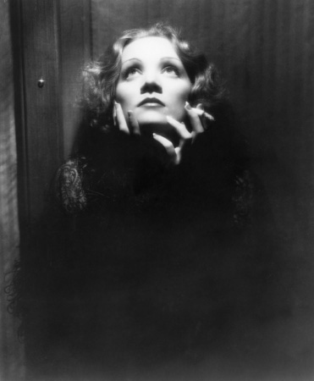
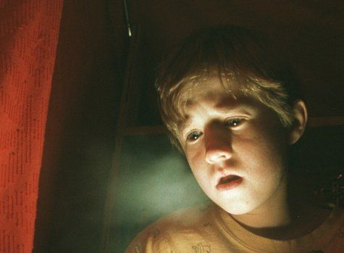
Lighting
  Top Lighting – upper areas of subject are lit by light from above
  Under Lighting – Lighting from below the subject

Slide 53
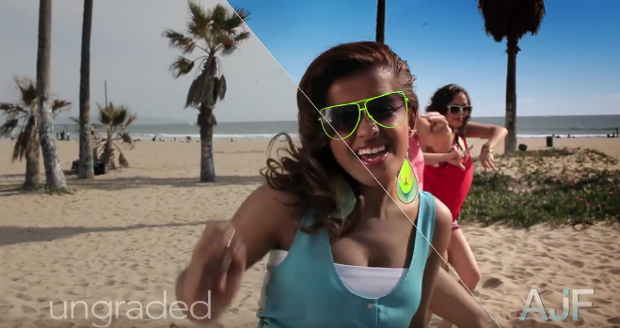
Colour
Colour can affect us emotionally, psychologically and even physically. Colour in film can build harmony or tension within a scene.
Colour grading is the process of altering and enhancing the colour of a motion picture electronically, photo-chemically or digitally.
Colour grading encompasses both color correction and the generation of artistic color effects.
Mostly done in post production

Slide 54
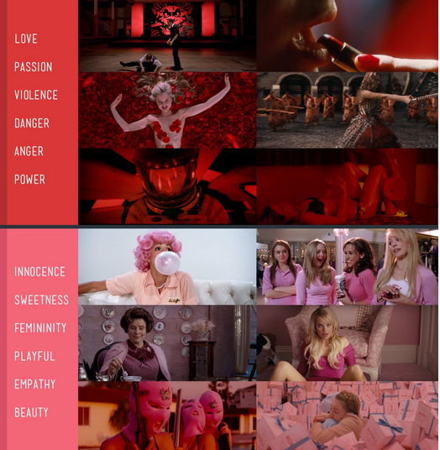
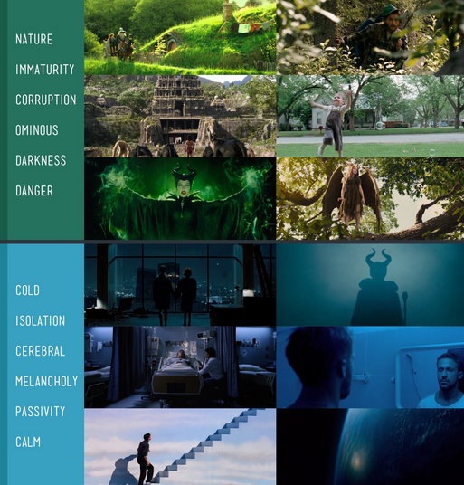
Colour

Slide 55
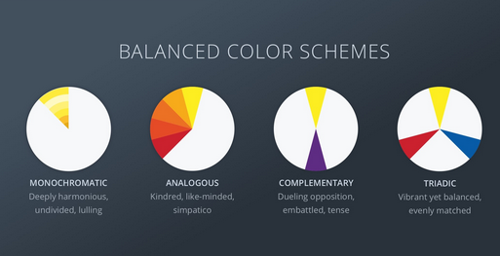
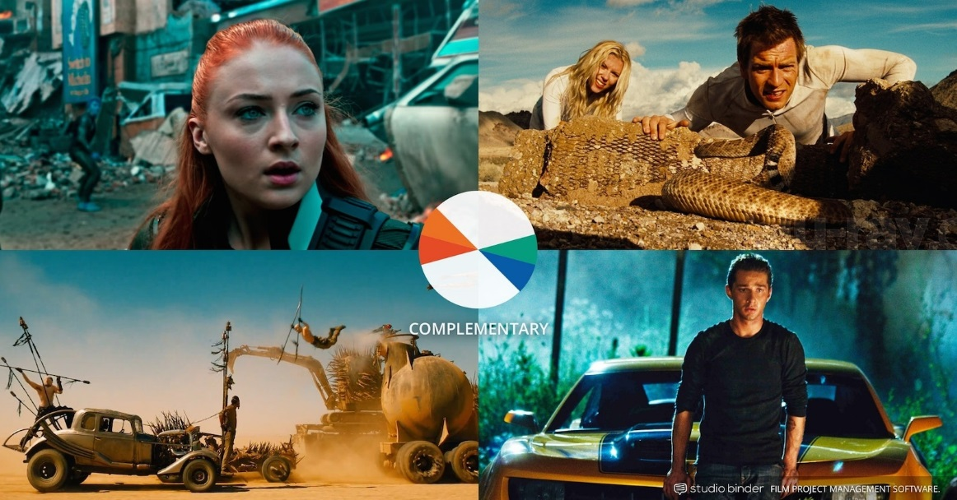
Colour

Slide 56
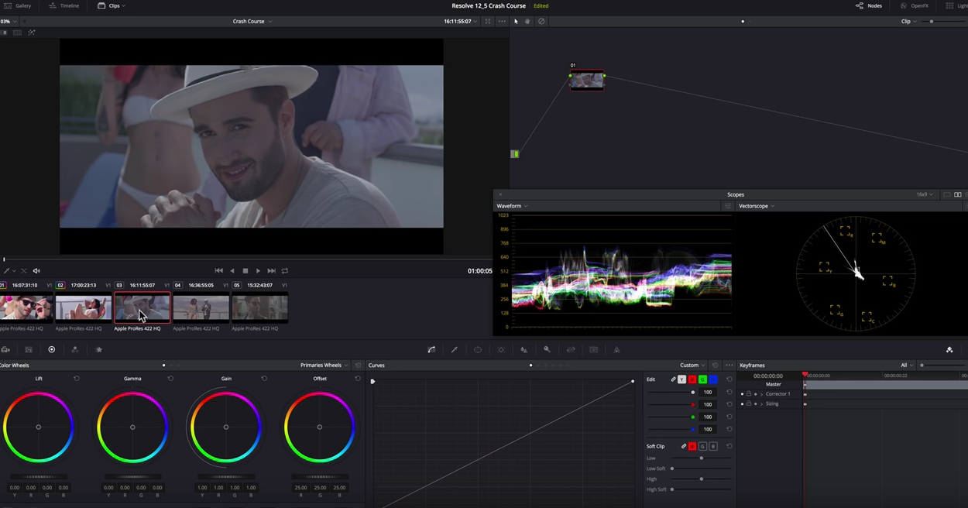
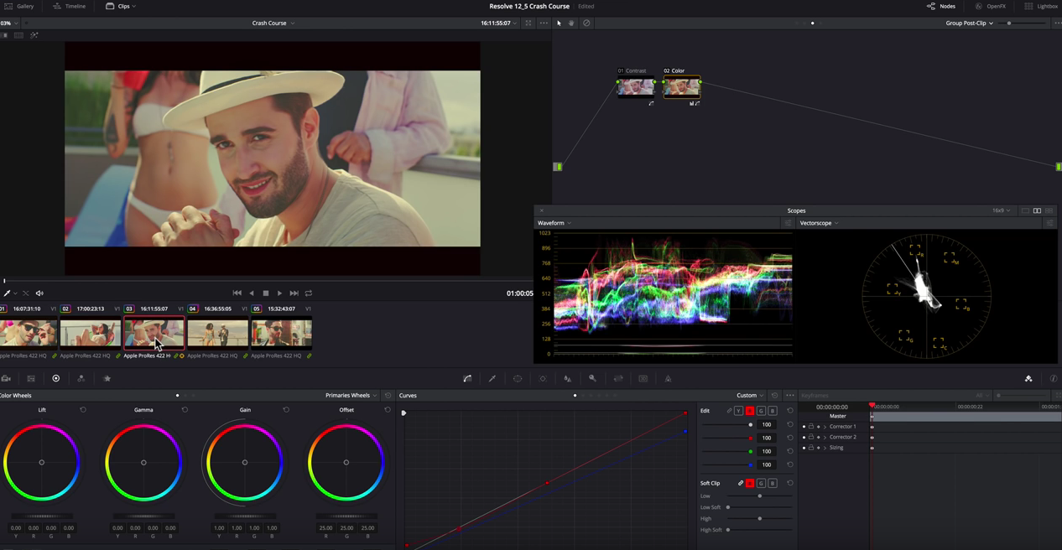
Colour Grading
Software Tip:
DaVinci Resolve
(free version)
https://www.youtube.com/watch?v=ojjfhCrjDus

Slide 57
The Visual Channel
Cinematography
Lighting
Colour
Camera
Mise-en-scène
Distance
Angle
Movement

Slide 58
Camera
Is the eye of the narrator. The window through which we watch the narrated world
How we see this world depends on Camera Distance, Angle and Movement

Slide 59
Distance
Extreme Long/Wide Shot (scenery)
Long Shot (full body)
Medium Long Shot (knees to head)
Medium Shot (waist to head)
Medium Close-up (shoulder so head)
Close-up (the face)
Extreme Close-up (single detail)
Source: https://www.asu.edu/alti/ltlab/tutorials/video/basics/type5_mcu.htm

Slide 60
Extreme Long Shot (ELS)
  Also known as extreme wide shot (EWS).
  Provides context for your scene
  Covers a wide area
  e.g. establishing shot at the start of a scene

Slide 61
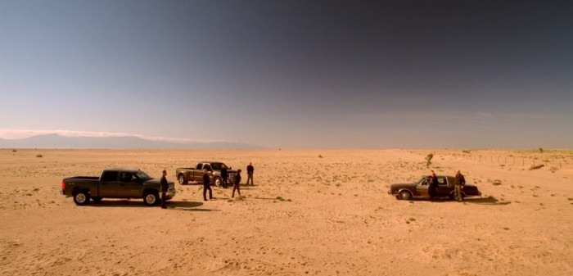
Extreme Long Shot (ELS)

Slide 62
Long Shot (LS)
  Also known as full shot (FS)
  Frames the whole figure of your subject, from the head to the toes
  Places the subject in relation to the environment and the people around it
  The point of the focus is the subject but the environment is also visible
  Shows action rather than emotion

Slide 63
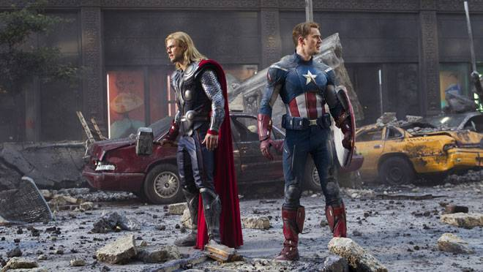
Long Shot (LS)

Slide 64
Medium Long Shot (MLS)
  Also known as a three-quarters shot.
  Frames the whole subject from the knees up.
  An intermediate shot between the long shot and the medium shot.
  Shows the subject in relation to the surroundings.
  May be used when you have 2 or 3 persons in the frame.

Slide 65
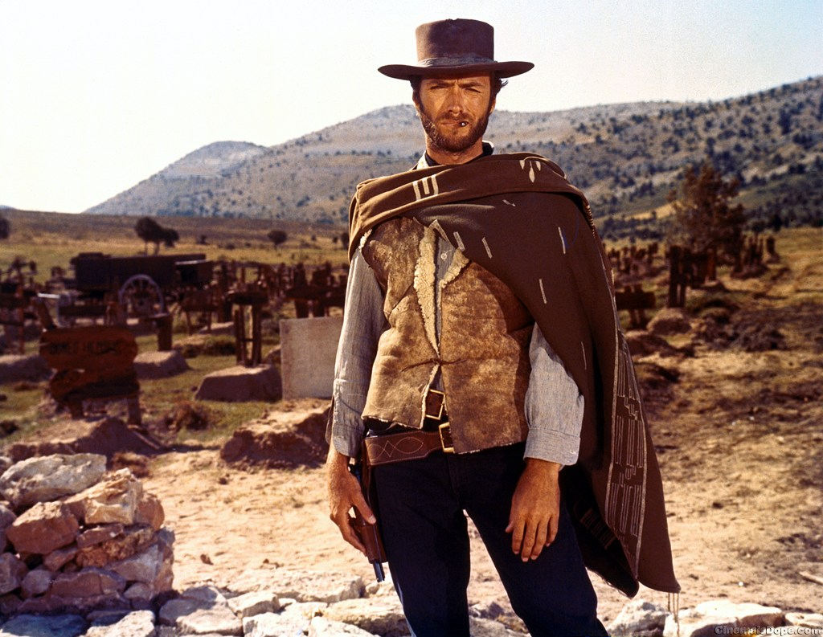
Medium Long Shot (MLS)

Slide 66
Medium Shot (MS)
  Also known as the waist shot.
  Frames the subject from the waist up.
  Commonly used in interviews.
  Directs the viewer to the subject.

Slide 67
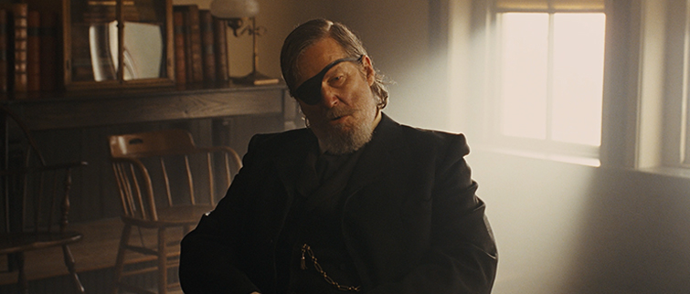
Medium Shot (MS)

Slide 68
Medium Close-up (MCU)
  Frames a subject's head and cuts off around mid-chest.
  The focus is on the subject.
  Reveals only a little of the surroundings.
  Shows the facial expressions of the subject.
  Commonly used for interviews in documentaries and news programs.

Slide 69
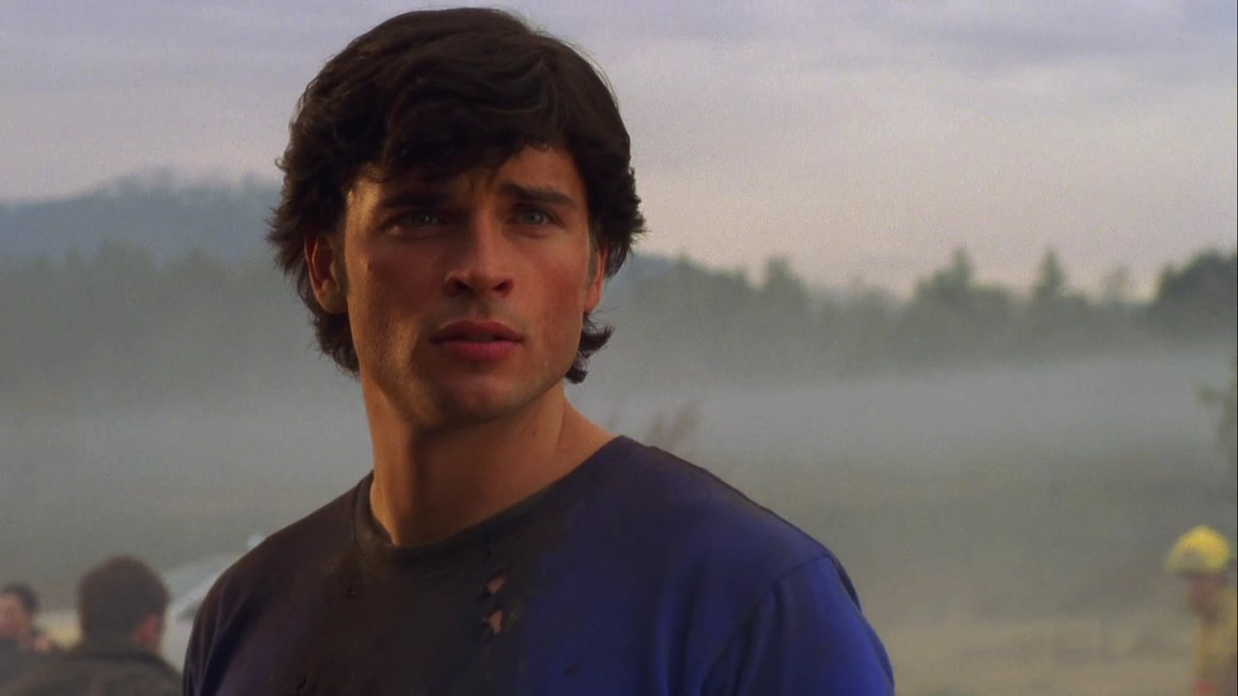
Medium Close-up (MCU)

Slide 70
Close-up (CU)
  Frames a subject's face and cuts off mid-neck, showing the face and entire head.
  The subject fills almost the entire frame.
  Captures facial expressions and emotions.

Slide 71
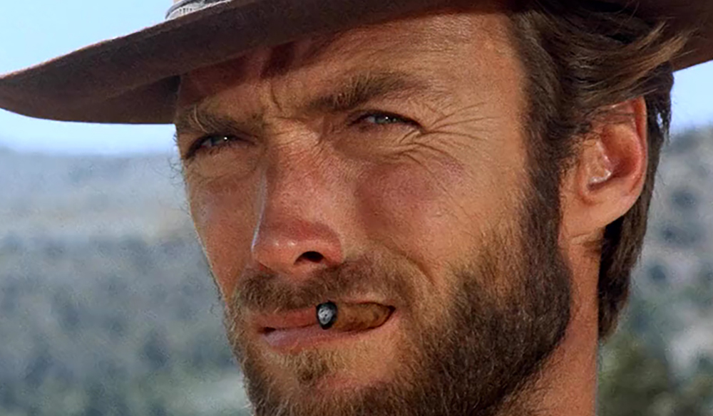
Close-up (CU)

Slide 72
Extreme Close-up (ECU)
  Frames just the person's facial features.
  Frames only a portion of the subject.
  Shows the person's emotions.
  Shows important objects up close.

Slide 73
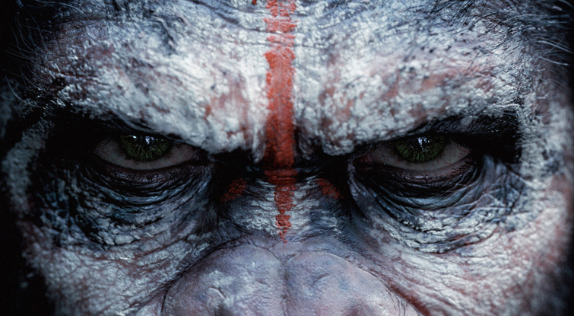
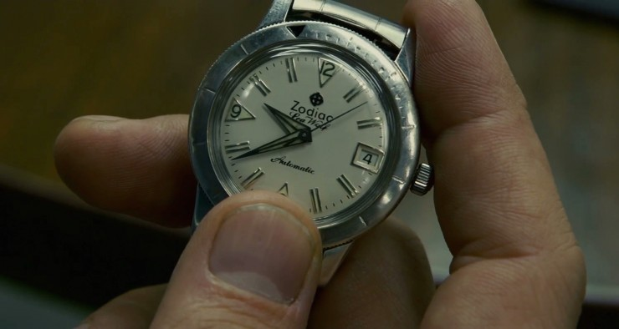
Extreme Close-up (ECU)

Slide 74
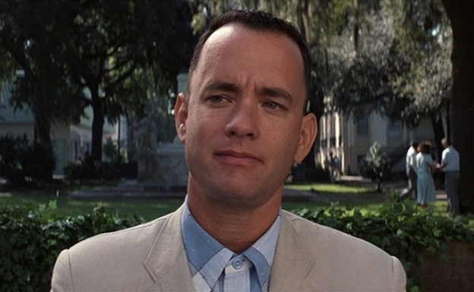
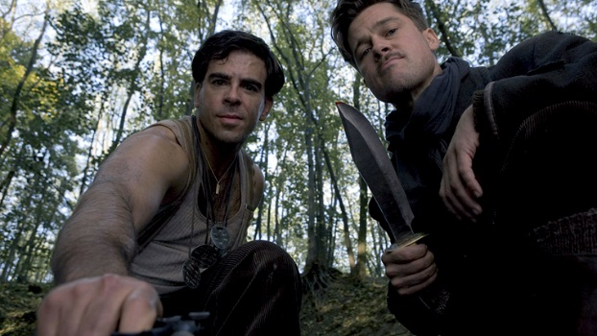
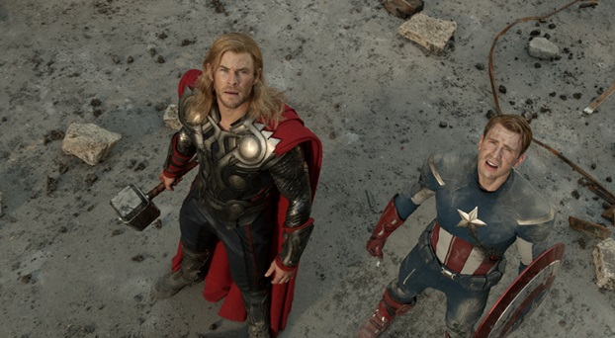
Angle
Eye Level
  camera is placed at the subject’s height; neutral
Low-Angle
  Increased sense of verticality, heightens the importance of the subject -> power, authority
High-Angle
  Reduces size and importance of the subject, can be cut together with Low-Angle Shots

Slide 75
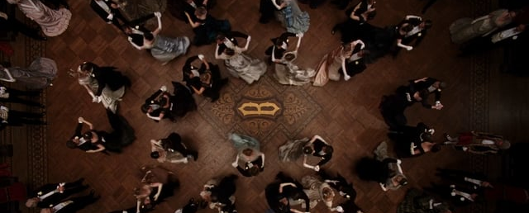
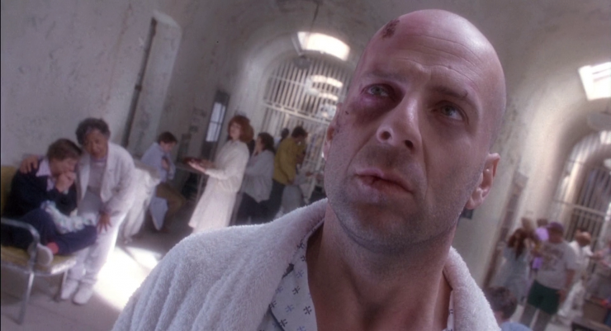
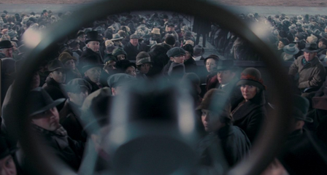
Angle
Bird’s-Eye View
  Overview, directly from above
Dutch Angle/Dutch Tilt/Canted Angle
  Camera is titled, suggests tension, dynamic or disorientation
Point of view - POV
  camera incorporates a character’s eyes.

Slide 76
Movement
Tilt: Moving the camera’s lens up or down while keeping its horizontal axis constant.
Pan: Moving the camera lens to one side or another
Zoom: Changing the focal length of the lens to make the subject appear closer or further away in the frame.
Pedestal: Moving the camera up or down without changing its vertical or horizontal axis.

Slide 77
Movement
Dolly/Push: push-in/push-out means step towards/away from the subject with the camera keeping the zoom the same.
Truck: Trucking is like dollying, but it involves motion left or right. Truck left means “move the camera physically to the left while maintaining its perpendicular relationship.“ (Not to be confused with panning)
Handheld Shooting subjective camera

Slide 78
The Visual Channel
Cinematography
Lighting
Colour
Camera
Mise-en-scène
Distance
Angle
Movement

Slide 79
Mise-en-scène
refers to everything that appears before the camera and its arrangement—composition, sets, props, actors, costumes etc.
Composition: positioning and movement of actors, as well as objects, in the shot
Set Design: the setting of a scene and the objects (props) visible in a scene

Slide 80
Mise-en-scène
Density: How much visual information is packed into the image?
Framing: Do characters have room to move around?
  Shots where characters are placed at the edges of the frame and have little room to move around are considered tight
  Longer shots where characters can move around are considered loose and tend to suggest freedom (or loneliness)
Mise-en-scène also includes aspects of lighting and coloring

Slide 81
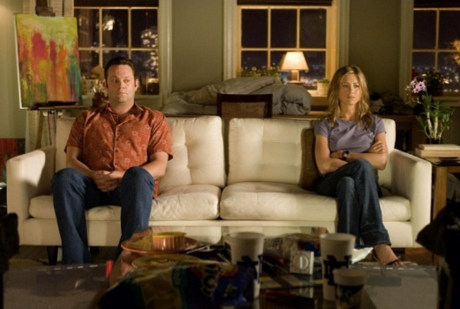
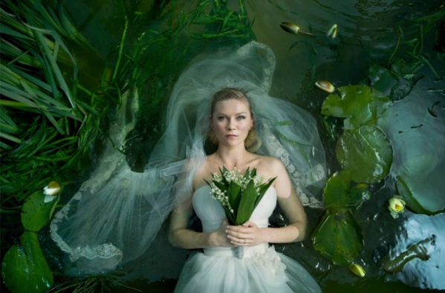
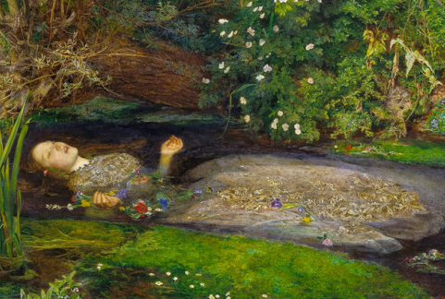
Mise-en-scène
Tells a story, evokes an atmosphere, gives information
Can reference a painting, photography or other movie
Can be analyzed using methods of pictorial science
Melancholia (2011) | Ophelia by John Everett Millais

Slide 82
Websites: Film Analysis Vocabulary
( a selection)
https://filmanalysis.yale.edu/
http://www.schuleplus.de/Englisch/films/filmanalysis-language.htm
http://www.jochenenglish.de/vocab/film_analysis.pdf
https://www.filmsite.org/filmterms1.html

