Slide 1
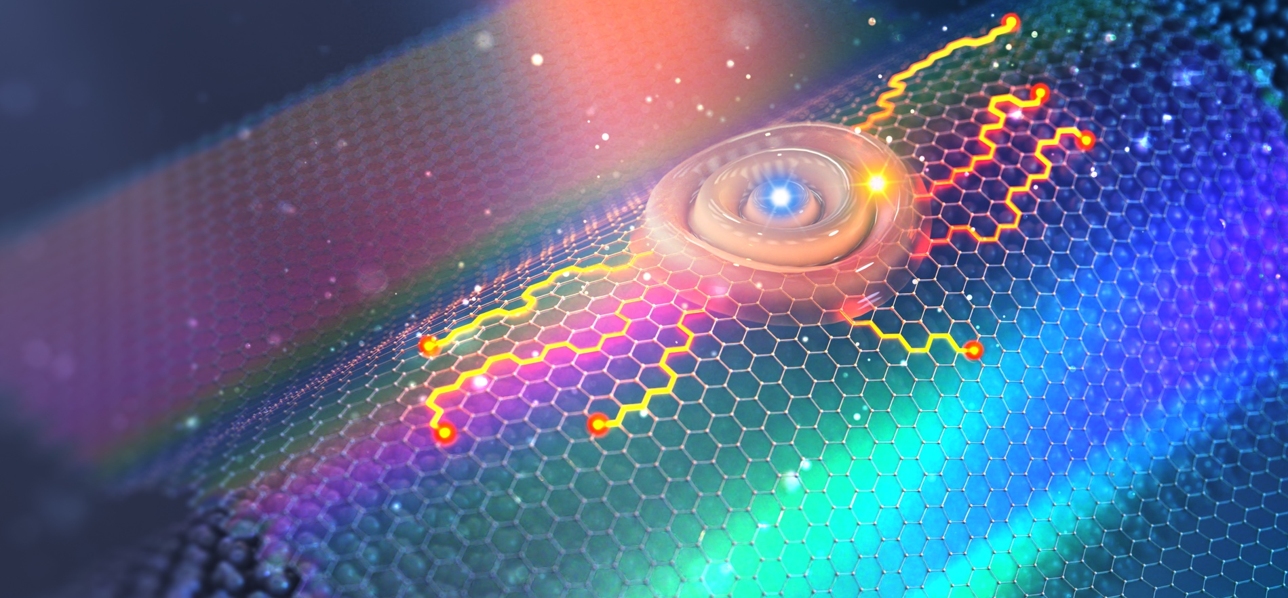
Two-dimensional nanomaterials
Lecture course, summer 2024
Prof. Alexey Chernikov
Institute of Applied Physics

Slide 2
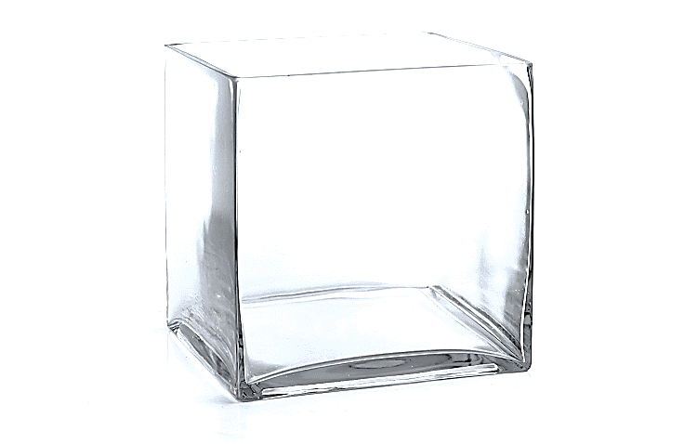
Consequences of quantum mechanics
Key paradigm of nanotechnology
!
?
??
Electronic structure changes with size
Energy
Quantum particle in a box
Particle behaves like a wave

Slide 3
Consequences of quantum mechanics
Key paradigm of nanotechnology
….in many flavors
Electronic structure changes with size
and shape
quantum well
quantum dot
quantum wire

Slide 4

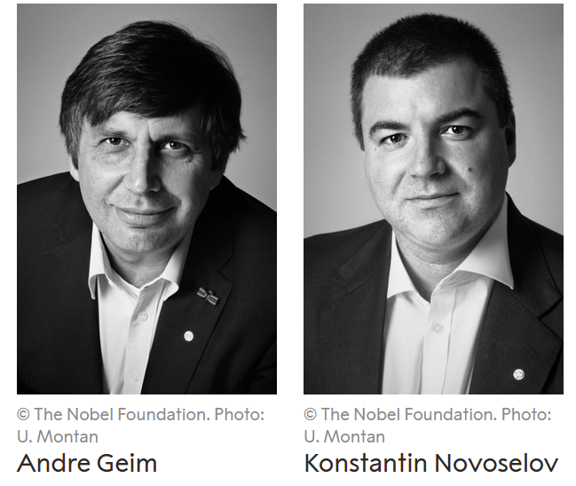
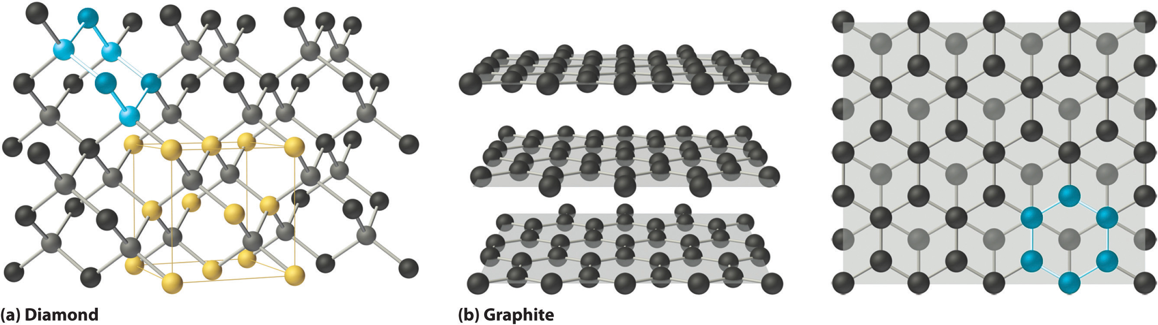
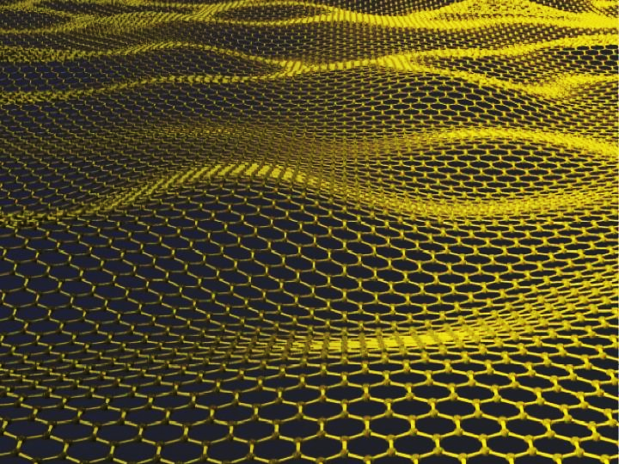
How small can material dimensions be?
Nobel Prize in Physics 2010
As small as one atom !
Weakly bound layers
"for groundbreaking experiments regarding the two-dimensional material graphene."

Slide 5
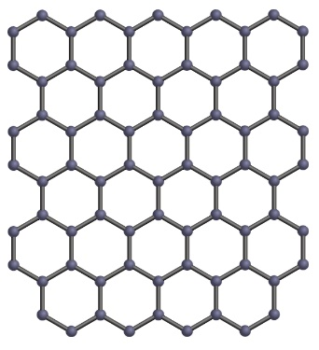
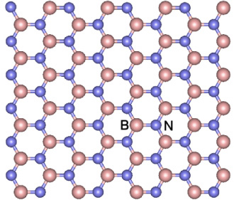
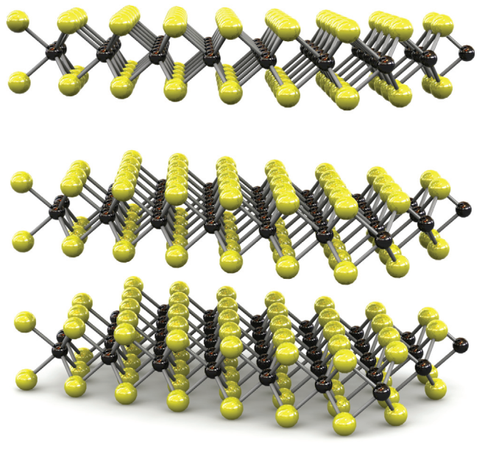
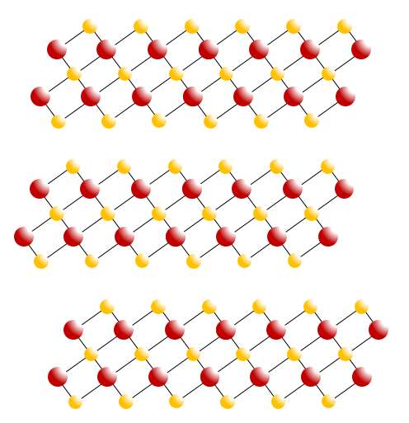
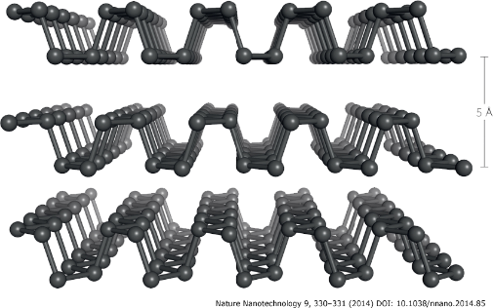
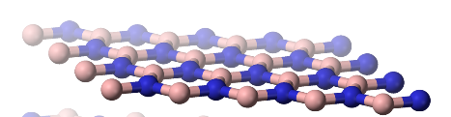
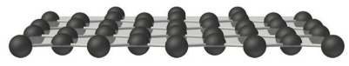
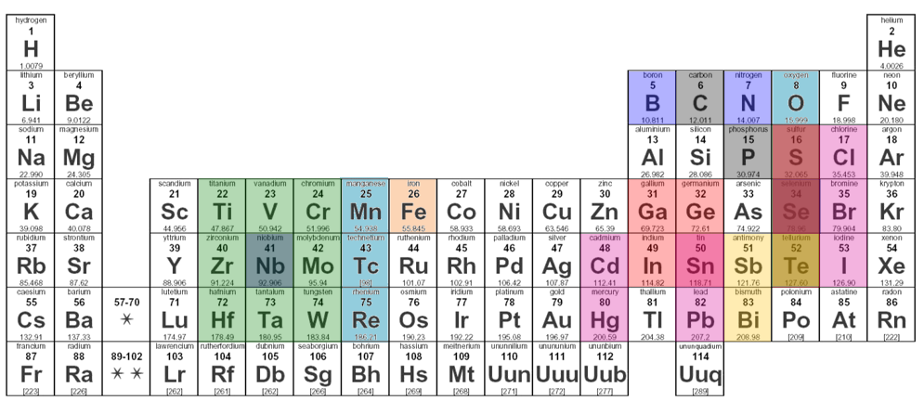
Rich family of 2D materials
Transition-metal
dichalcogenides
semiconductors (VIS)
Black phosphorous semiconductor (NIR)
Bismuth tri-selenide
topological insulator
Graphene
semimetal
Boron nitride insulator
Superconductors
Magnetic materials
Hybrid perovskites
…
Novoselov et al., PNAS 102, 10451 (2005)
Geim & Grigorieva, Nature 499, 419 (2013)
Nicolosi et al., Science 340, 1226419 (2013)
100’s of potentially interesting 2D materials

Slide 6
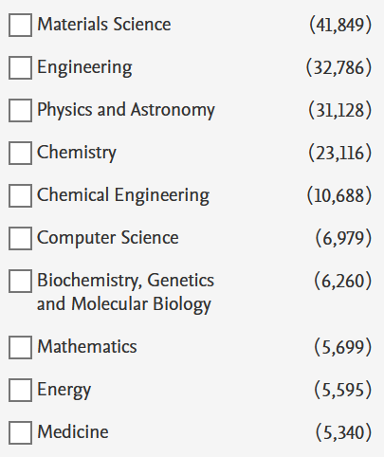
Highly active, interdisciplinary field
Simple search for “2D materials”
Subject areas

Slide 7
Lecture focus & structure

Slide 8
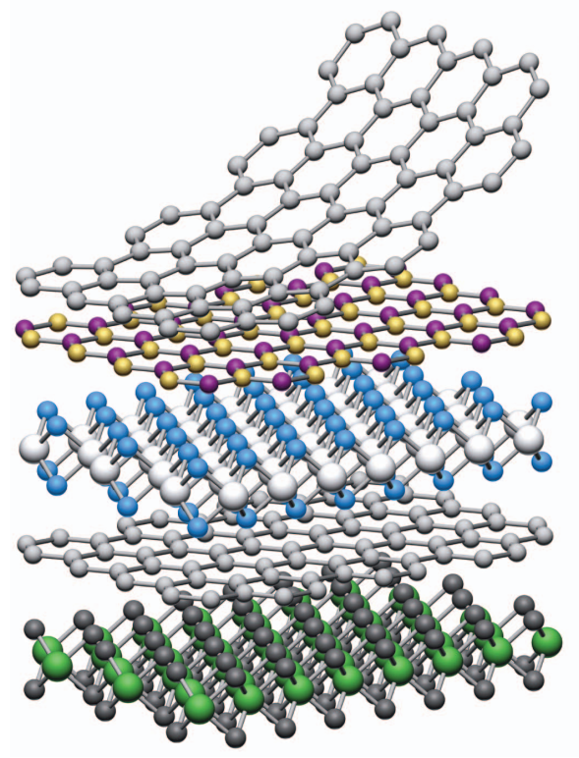
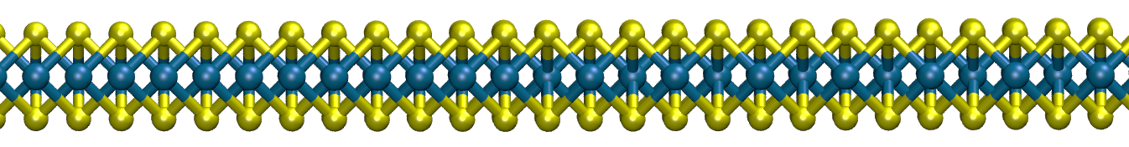
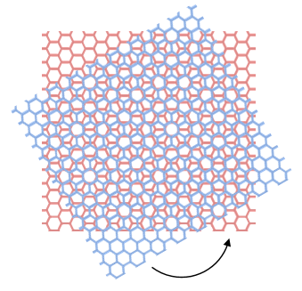
What we will learn & explore
How can materials be less than three-dimensional
Which types of two-dimensional (2D) materials do exist
2D semiconductors - materials for optics and electronics
What are the consequences of strong interactions in 2D
How can one experimentally study these materials
What about tunability by external means
How does transport of correlated states works
Can we combine different 2D materials into heterostructures? (spoiler: yes!)
Are there unique phenomena that can be studied? (also yes!, Moiré physics)

Slide 9
Our plan together
We will meet, I will prepare and explain, but we will also discuss together
We will have an additional lecture seminar at the end of semester with individual talks
We will conclude the lecture course with an oral exam
All details are found on the OPAL webpage
For any questions, explanations, clarifications, please contact me at alexey.chernikov@tu-dresden.de

