Slide 1
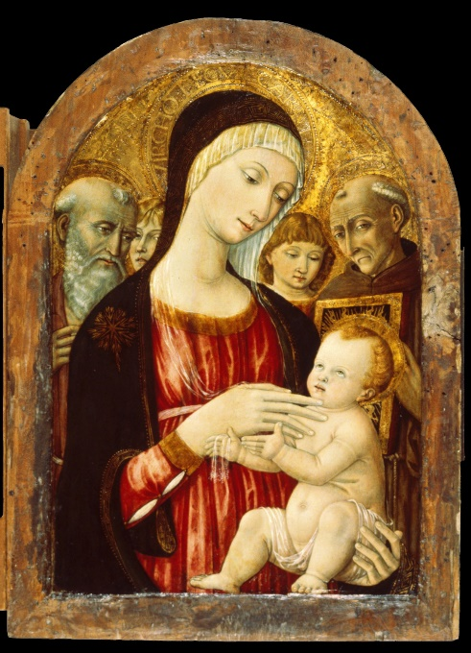
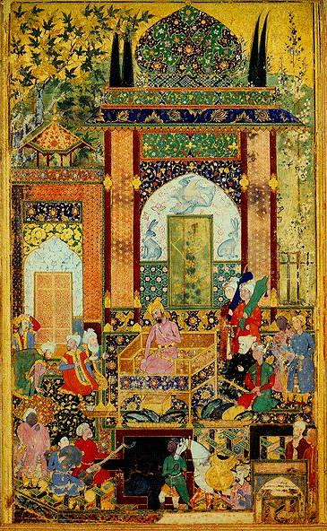
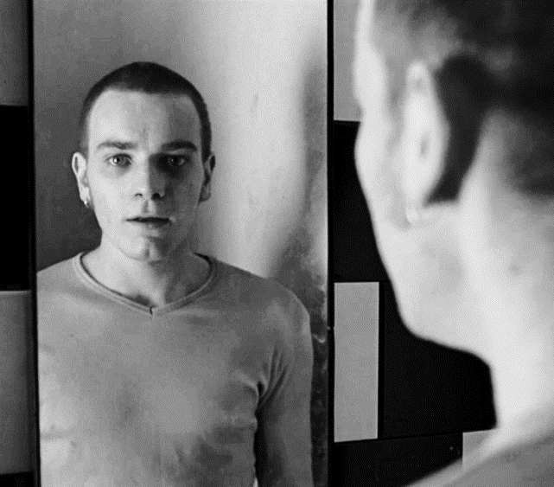
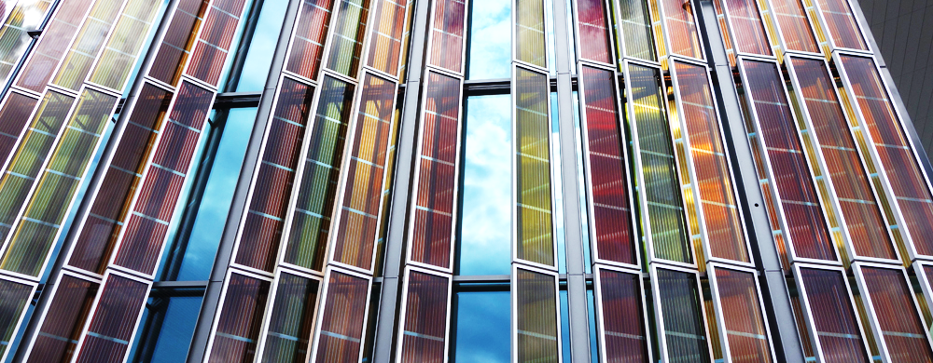
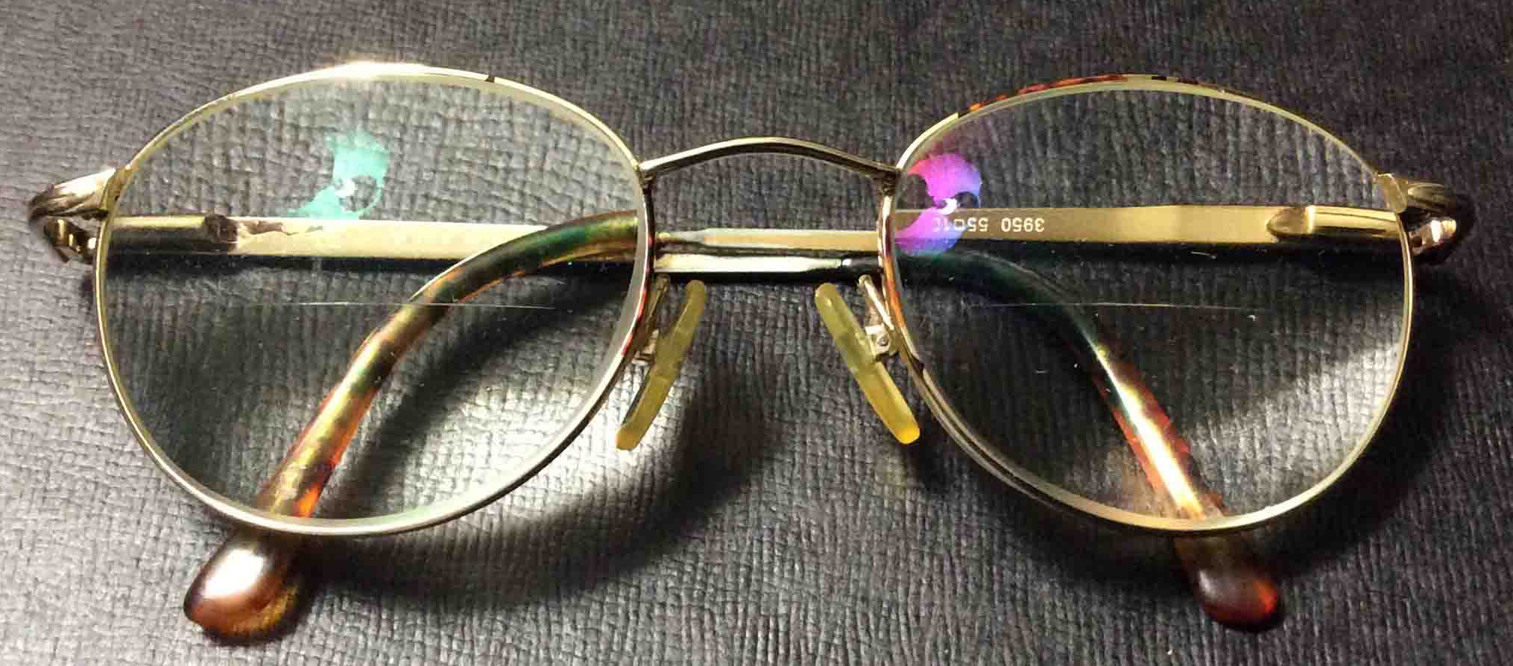
Examples of applications of thin films (still 3D)
Mirrors
Art - thin layers of paint / gold
Matteo di Giovanni, (ca. 1470)
Solar panels
Danny Boyle (1996)
Farrukh Baig, (1589)
Optical coatings
www.tomstek.us
Catherine Bolle (2010)

Slide 2
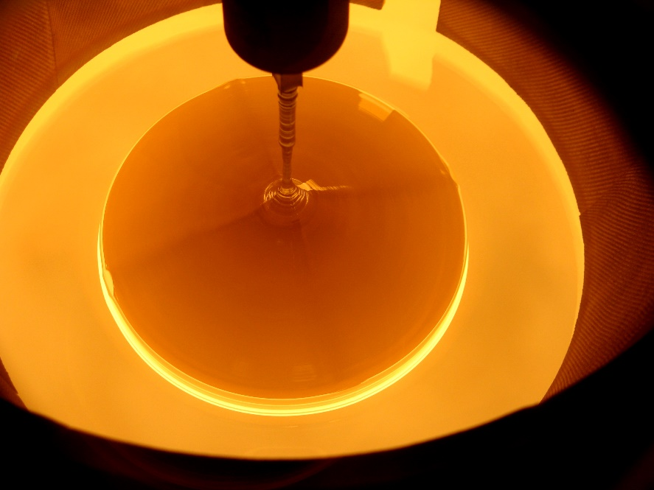
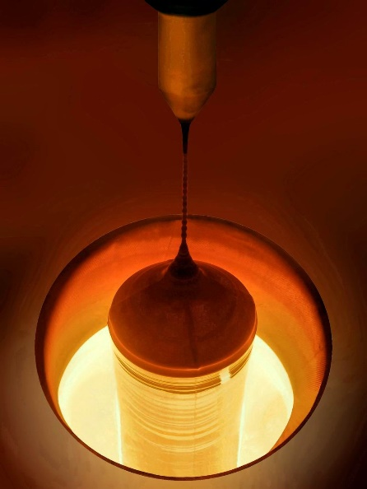
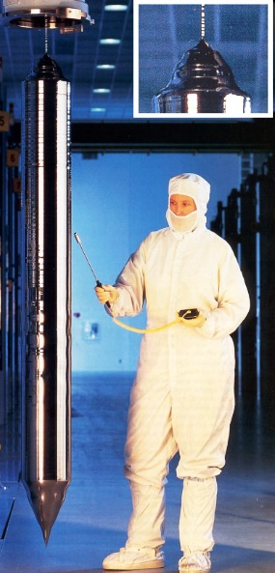
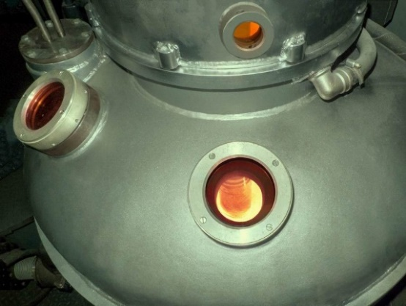
Conventional fabrication of 3D crystals
www.450mm.com
www.m-carbo.ru
Smithsonian, 30, 10 (2000)

Slide 3
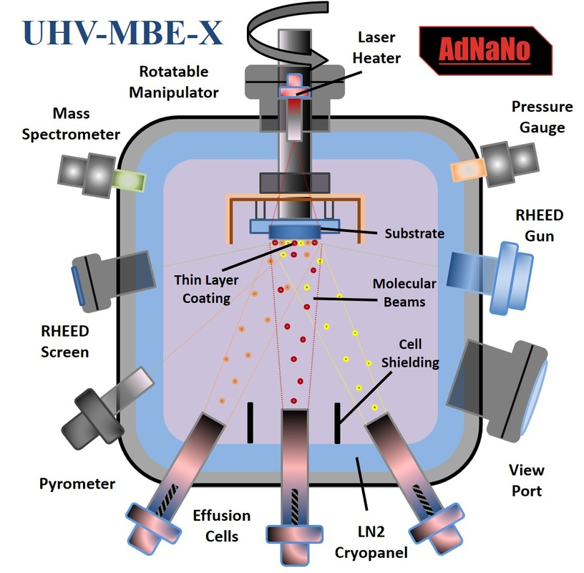
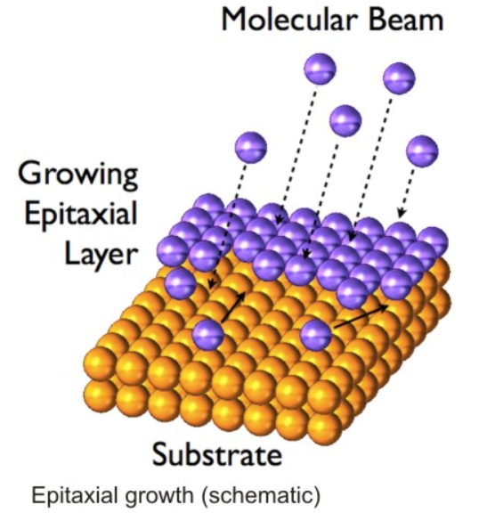
Epitaxial growth of quantum wells
Layer-by-layer deposition
Molecular beam epitaxy (MBE) schematic
https://www.adnano-tek.com/molecular-beam-epitaxy--laser-mbe.html
https://mlz-garching.de/mbe
…many other methods exits

Slide 4
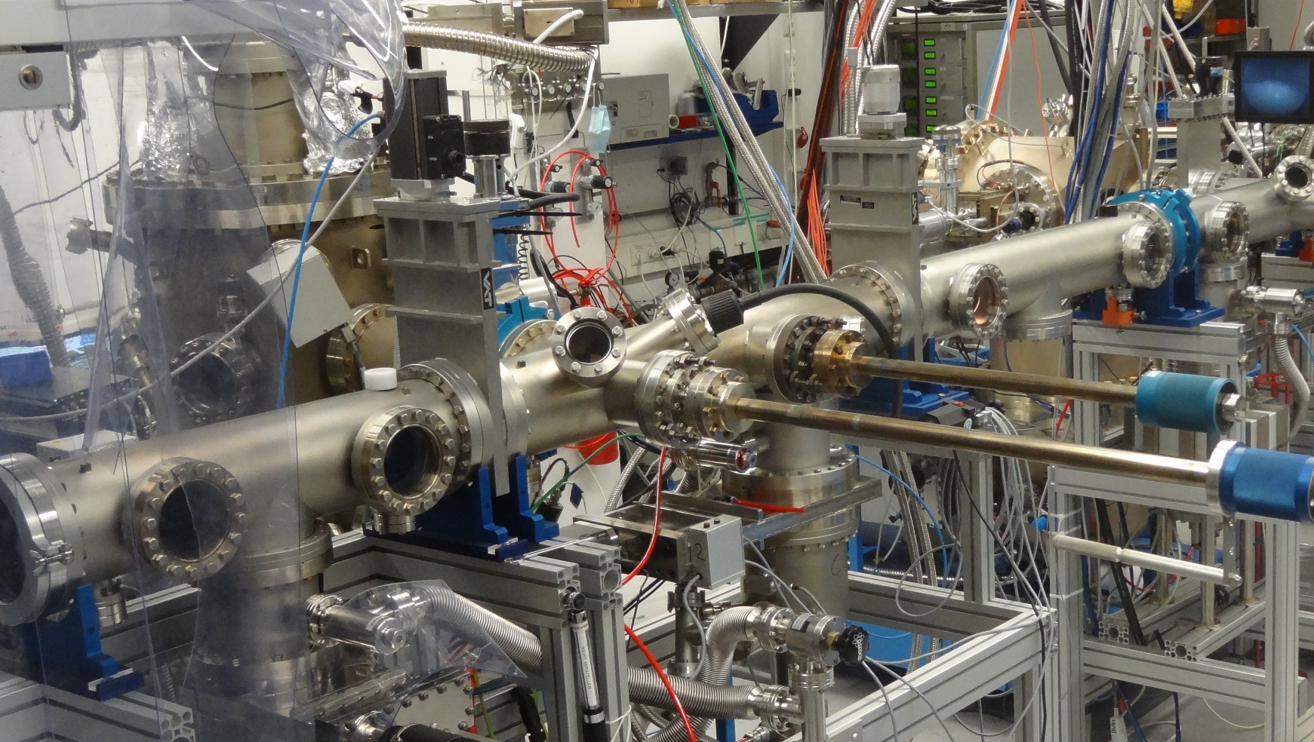
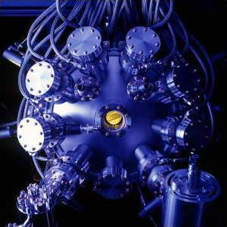
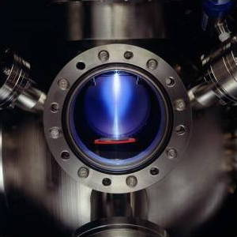
Epitaxial growth of quantum wells
…how it can look like
Jim Yost, US DOE/NREL
MBE Cluster in Regensburg
(Dominique Bougeard)

Slide 5
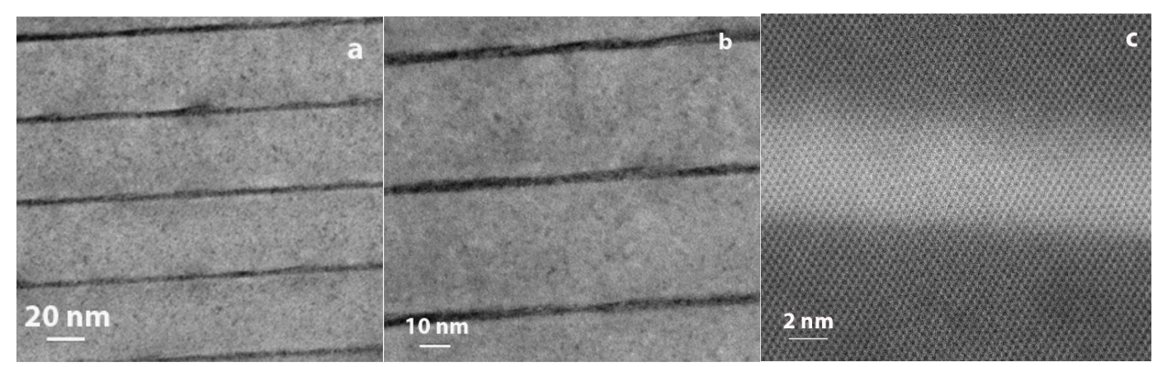
Quantum well structures
Transmission electron microscope images of GaAs-based quantum wells
Barrier
Barrier
Quantum well
Quantum well
Barrier
Barrier
V. Kanzyuba et al. Microsc. Microanal. 22 (Suppl 3), 2016

Slide 6
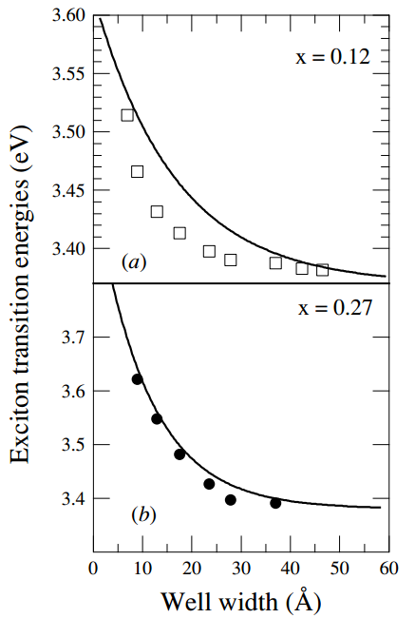
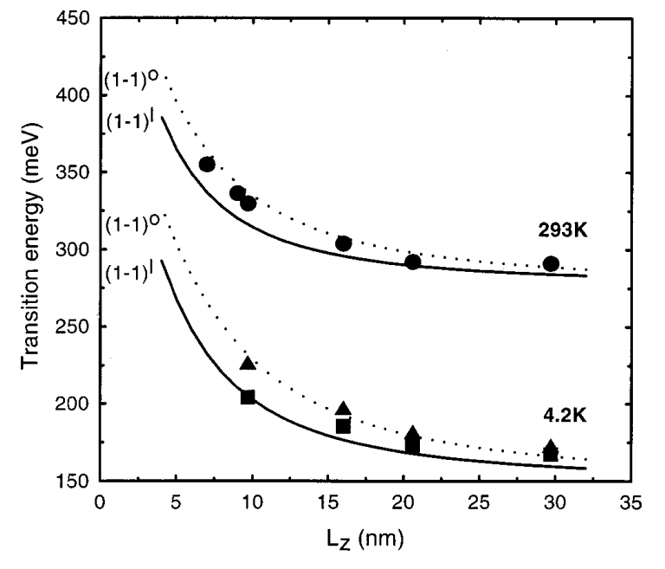
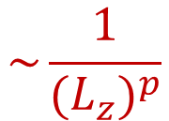
Quantum confinement effect
ZnO / ZnMgO quantum wells
PbSe / PbSrSe quantum wells
Increase of the electronic transition energies
$$\sim \frac{1}{{{(L}_{z})}^{p}}$$
H. Z. Wu et al. Appl. Phys. Lett. 78, 2199 (2001)
T. Makino et al. Semicond. Sci. Tech. 20, 78 (2005)

Slide 7
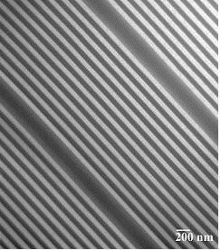
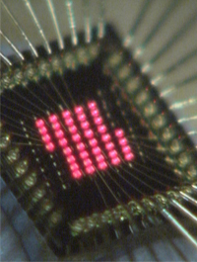
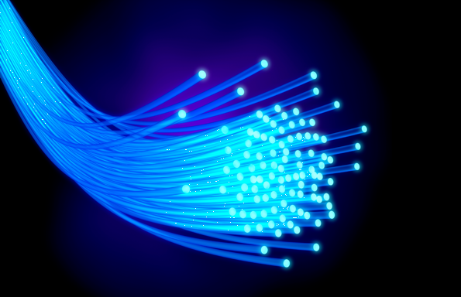
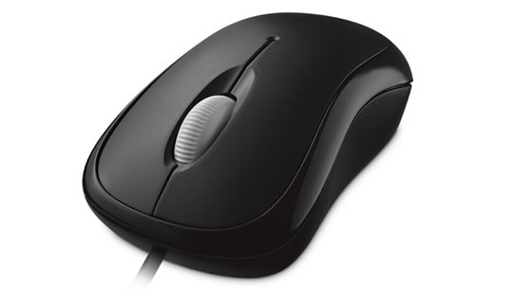
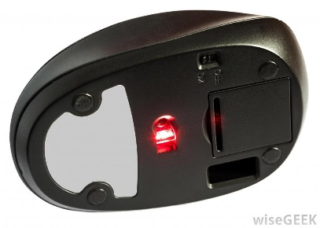
More complex multi-quantum well structures
Ultra-small lasers
Lasers for telecommunication
www.ricoh.com
A. Khan, www.psu.edu
…used here as well
Vertical-Cavity Surface-Emitting Laser (VCSEL)
based on quantum wells
D. Mathes and R. Hull
http://vcsel.mntl.illinois.edu/projects/crvcl/
www.microsoft.com
www.wisegeek.com

Slide 8
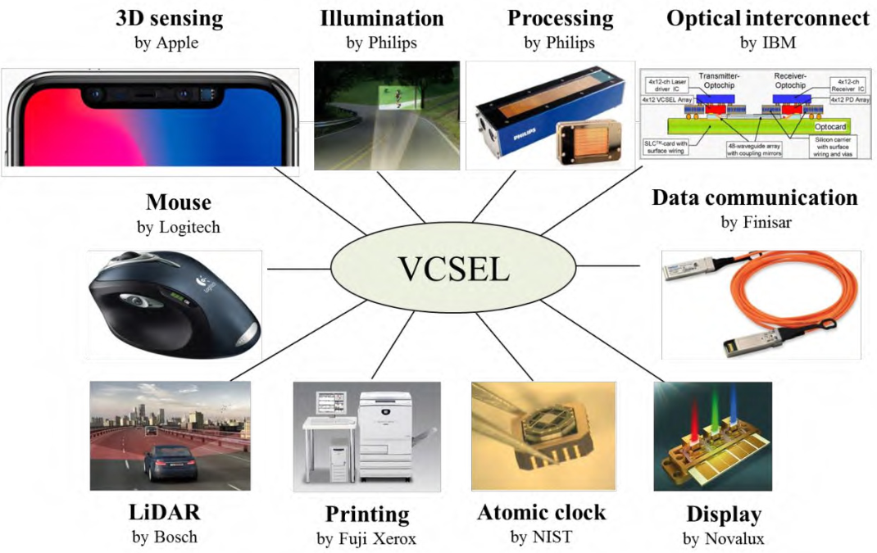
Exemplary applications of quantum-well-based lasers
Vertical-Cavity Surface-Emitting Laser (VCSEL)
based on quantum wells
Y. Cao, Journal of Physics: Conference Series 1653, 012001 (2020)
doi:10.1088/1742-6596/1653/1/012001

Slide 9

Appendix - graphical solution of an equation
$tg {(q}_{n}L)=$ $\frac{\sqrt{S^{2}−{(q_{n}L)}^{2}}}{q_{n}L}$
To solve:
Recipe:
1. Draw this
2. Draw that
3. Look where they cross

Slide 10
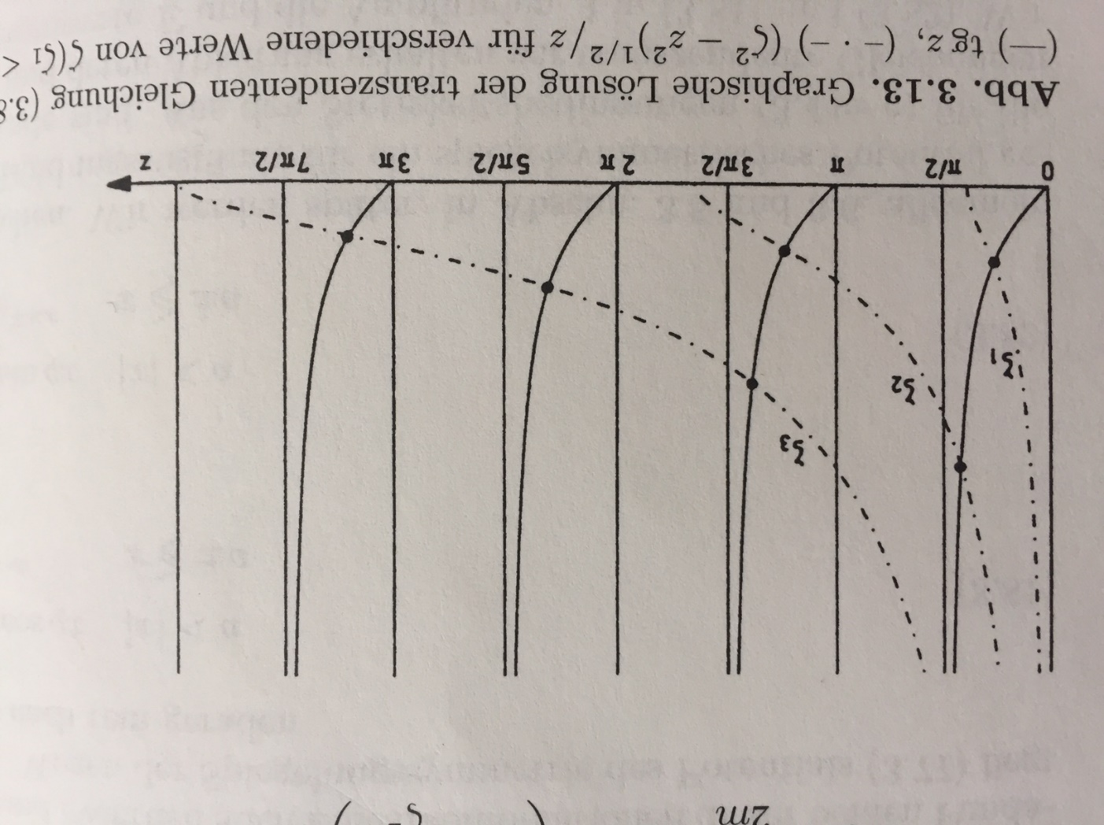
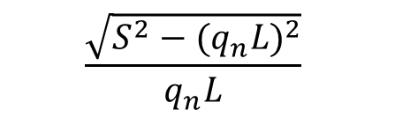


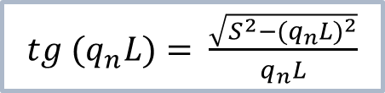
Example
Particle in a quantum well with finite barriers
$$\frac{\sqrt{S^{2}−{(q_{n}L)}^{2}}}{q_{n}L}$$
$$tg {(q}_{n}L)$$
“Quantenmechanik”, Schwabl
Even solutions
$tg {(q}_{n}L)=$ $\frac{\sqrt{S^{2}−{(q_{n}L)}^{2}}}{q_{n}L}$
$$z={(q}_{n}L)$$
For three different well strengths: S₁ < S₂ < S₃

Slide 11
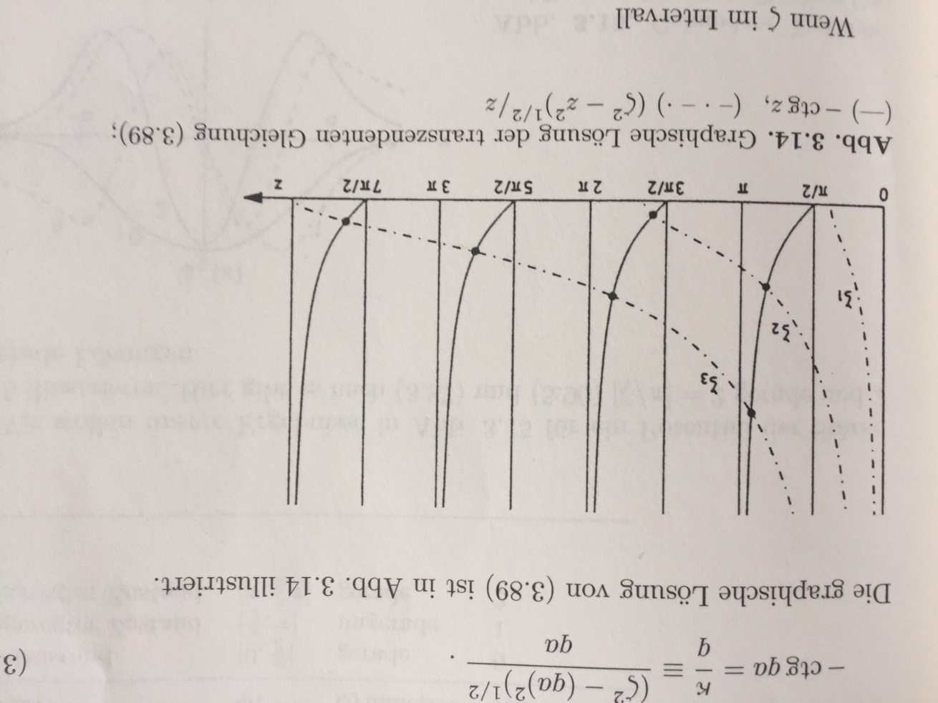

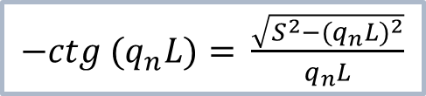
Example
Particle in a quantum well with finite barriers
$$\frac{\sqrt{S^{2}−{(q_{n}L)}^{2}}}{q_{n}L}$$
$$−ctg {(q}_{n}L)$$
“Quantenmechanik”, Schwabl
Odd solutions
$−ctg {(q}_{n}L)=$ $\frac{\sqrt{S^{2}−{(q_{n}L)}^{2}}}{q_{n}L}$
$$z={(q}_{n}L)$$
For three different well strengths: S₁ < S₂ < S₃

Slide 12
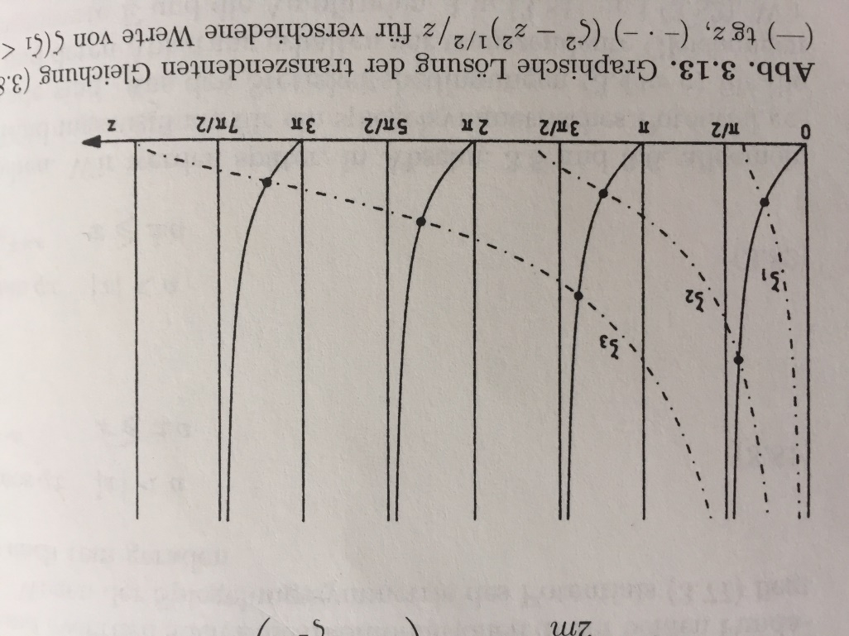
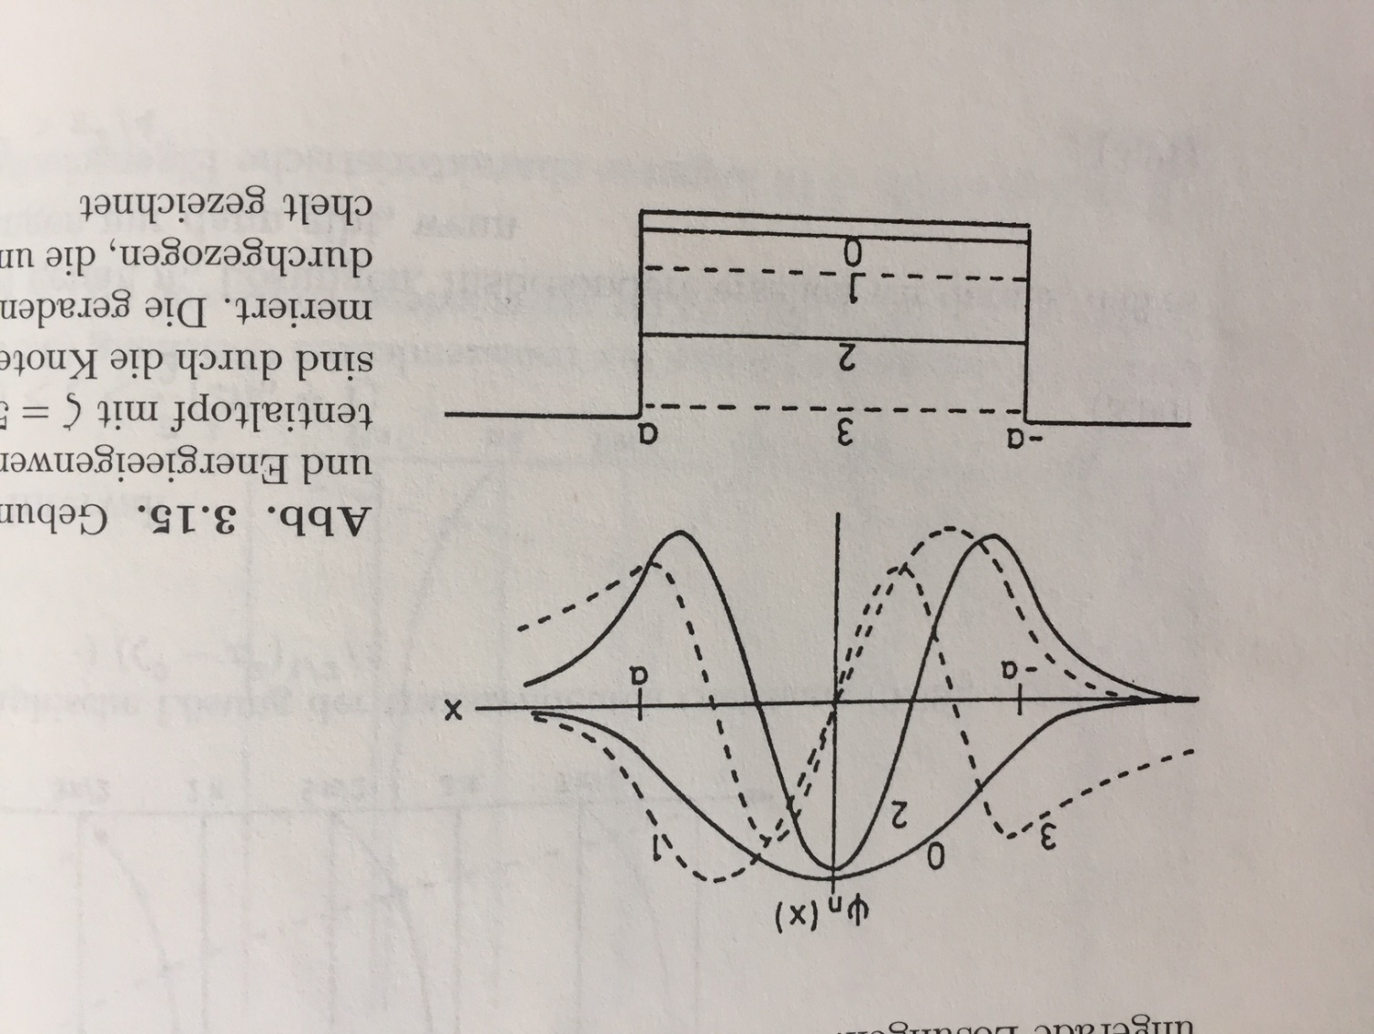
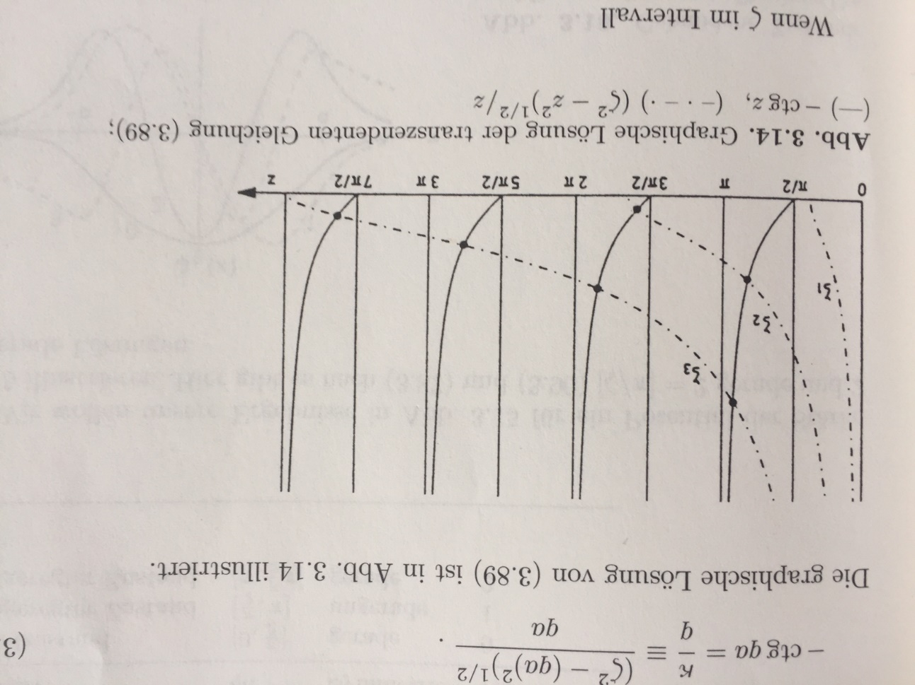
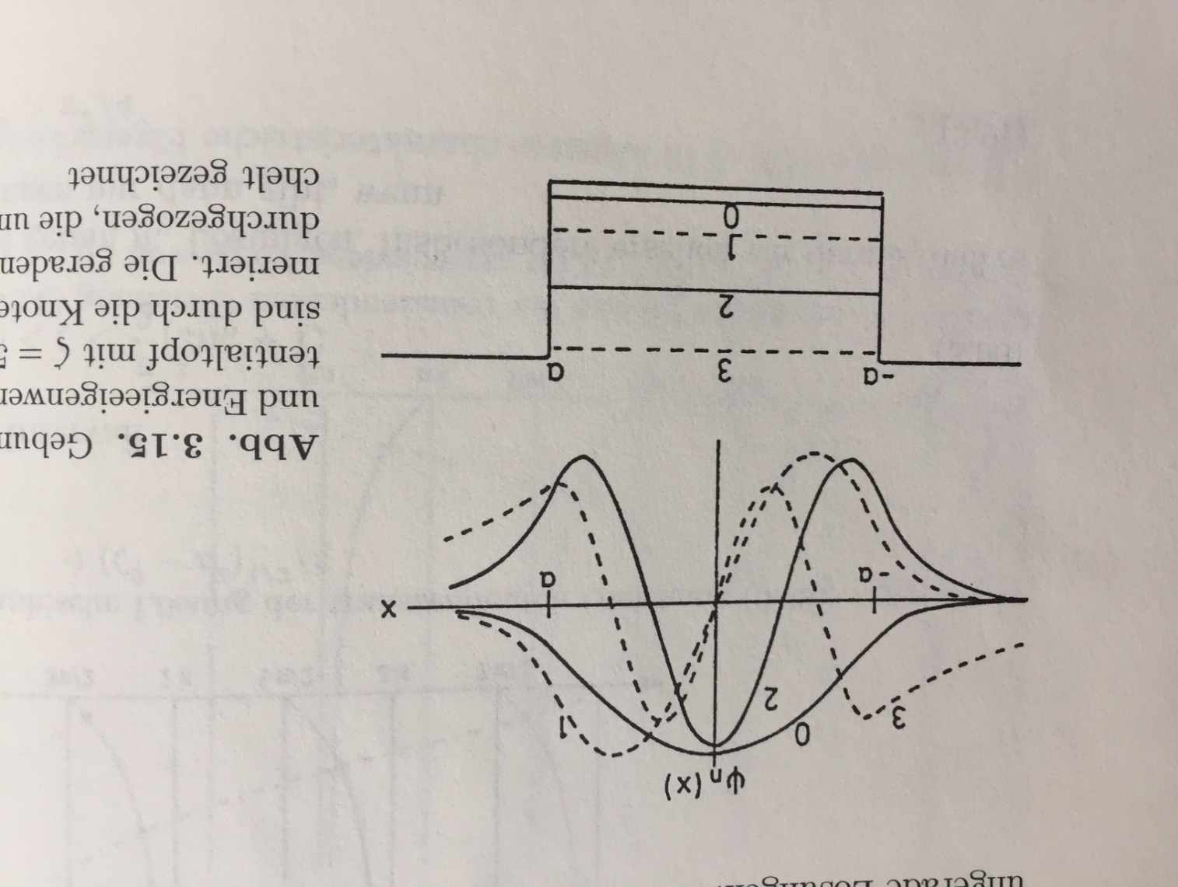

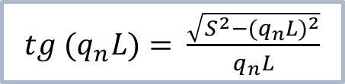

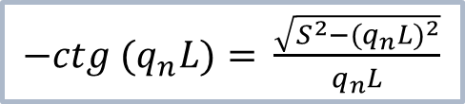

Example
Particle in a quantum well with finite barriers
Even solutions
Solutions for S₂
$tg {(q}_{n}L)=$ $\frac{\sqrt{S^{2}−{(q_{n}L)}^{2}}}{q_{n}L}$
Odd solutions
-L
L
$−ctg {(q}_{n}L)=$ $\frac{\sqrt{S^{2}−{(q_{n}L)}^{2}}}{q_{n}L}$
V₀
“Quantenmechanik”, Schwabl
$$z={(q}_{n}L)$$
$$S≔\sqrt{2mV_{0}}\frac{L}{ℏ}$$
For three different well strengths: S₁ < S₂ < S₃

