Slide 1
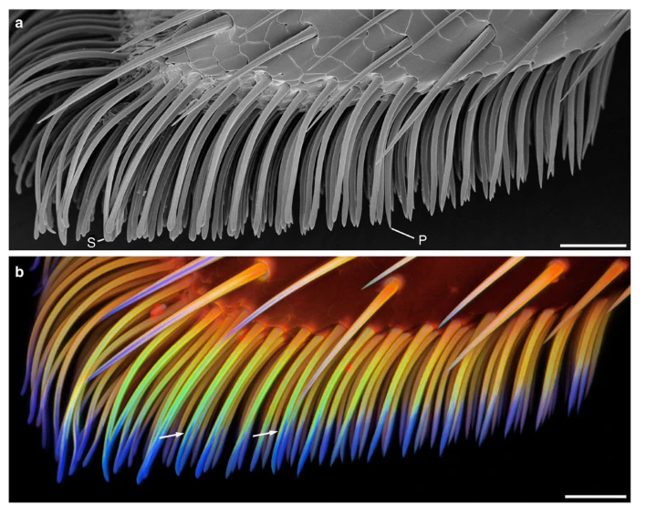
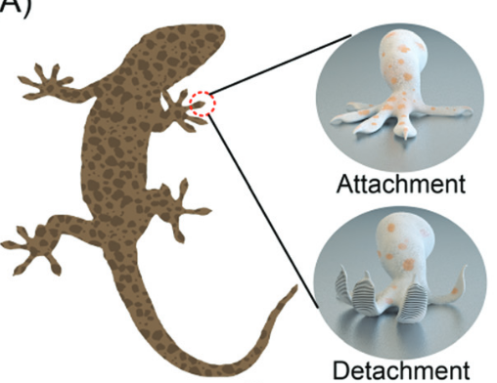
Van der Waals forces in nature
Insects’ adhesive pads
Gecko effect
H. Peisker et al. Nature Commun. 4, 1661 (2013)
H. Tian et al. : Soft Matter 16, 5599 (2020)

Slide 2
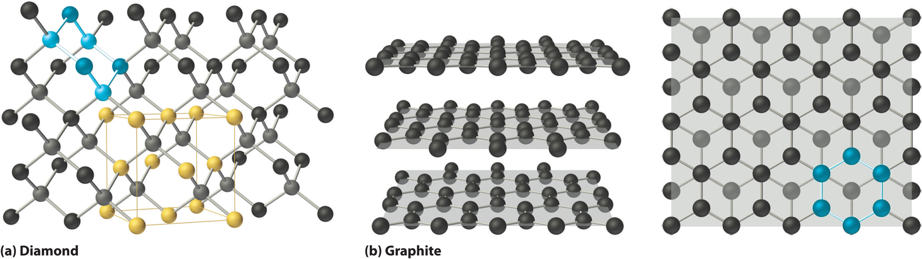
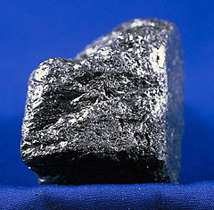
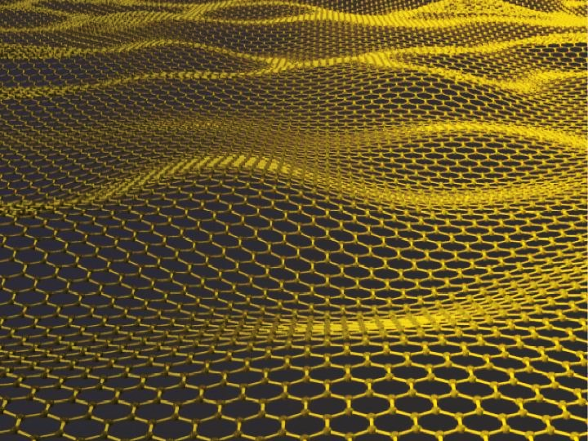
Van der Waals crystals
V. Nikolosi, Science 340, 1226419 (2013)

Slide 3
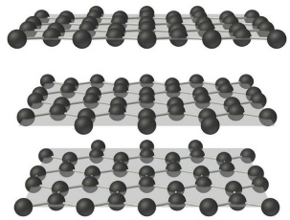
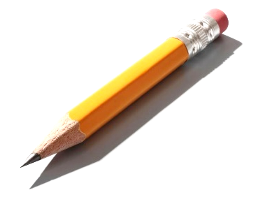
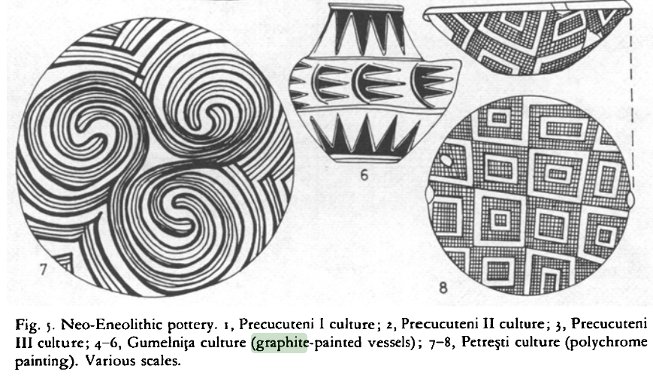
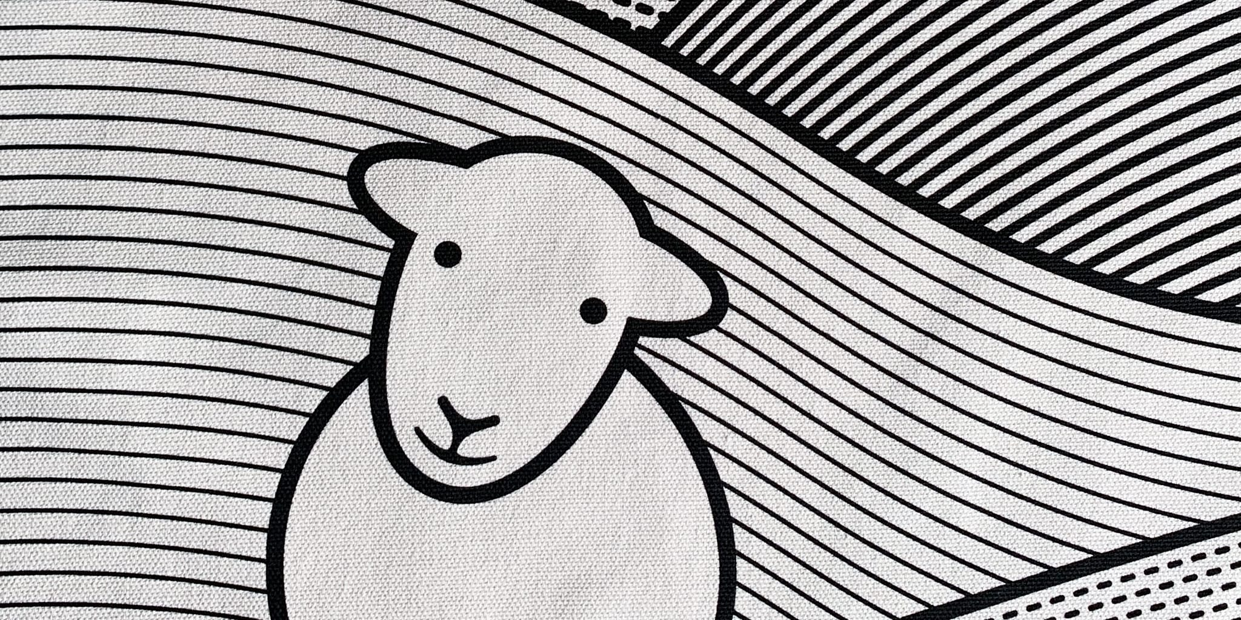
Graphite is well known for centuries millennia
Graphite paint - 4’000 BC
Marked sheep – 1500 AC
https://www.herdy.co.uk
J. Boardman “The Cambridge ancient history”, Vol. 3. P. 31—69 (2008)

Slide 4
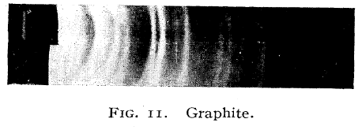
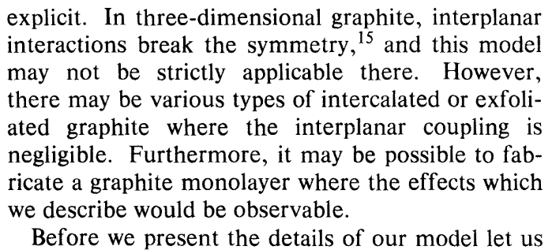
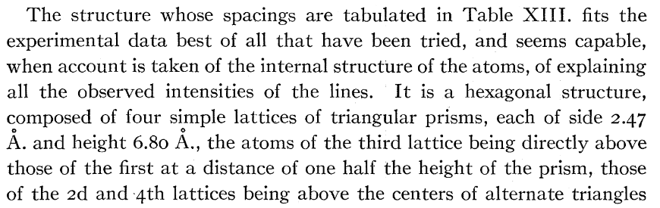
Crystal & electronic structure
Structure from X-ray diffraction
Predictions of Dirac cone
G. W. Semenoff Phys. Rev. Lett. 53, 2449 (1984)
A. W. Hull, Phys. Rev. 10, 661 (1917)
+ a number of possible observations & discussions prior to more recent Geim & Novoselovs work
P. Debije, P. Scherrer, Physikalische Zeitschrift 17, 277 (1916)

Slide 5
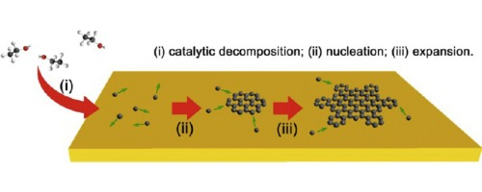

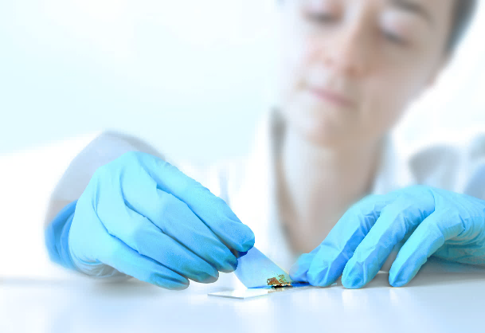
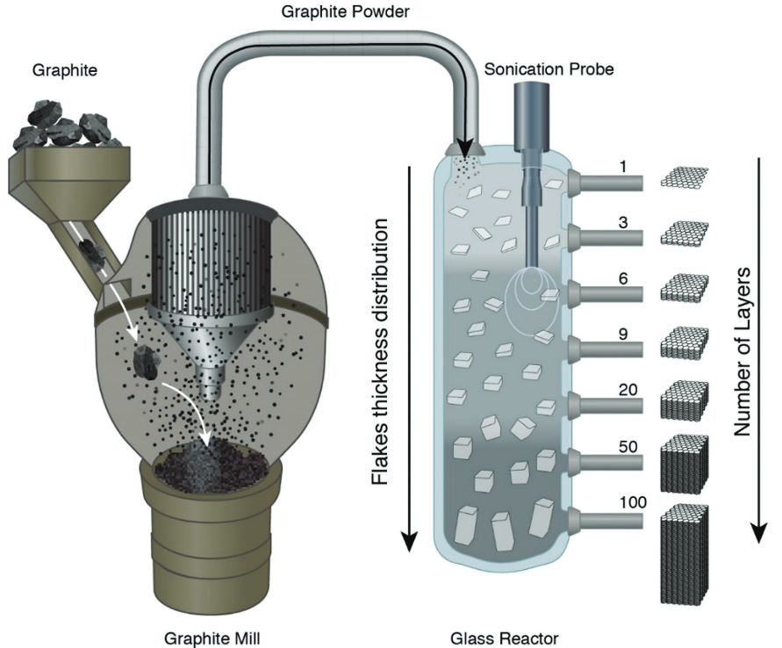
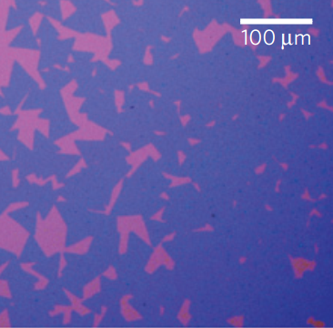
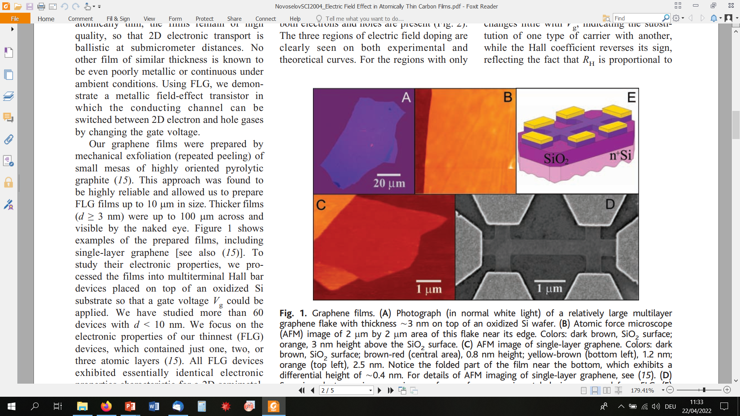
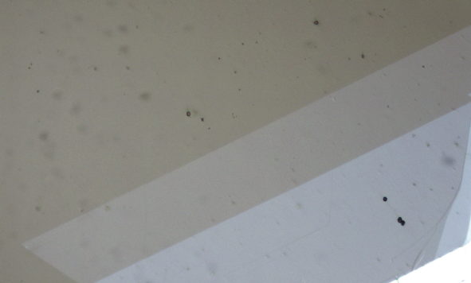
Making monolayers
Mechanical exfoliation
Chemical vapor deposition (CVD)
Liquid exfoliation
25 mm
X. Chen Synth. Metals 210, 95 (2015)
Y. Zhang Acc. Chem. Res. 10, 2329 (2013)
100 μm
A. P. Kauling Adv. Mater. 30, 1803784 (2018)
K. Novoselov, Science 306, 666 (2004)
Van der Zande, Nature Mater. 12, 554 (2013)

Slide 6
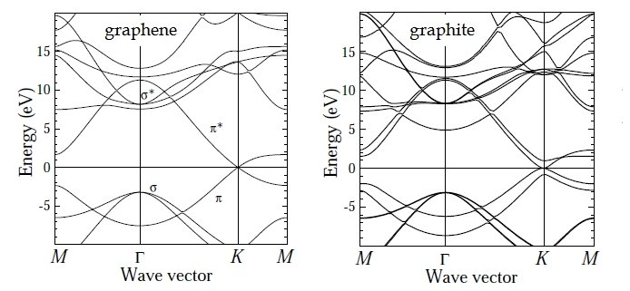
Electronic structure: graphene vs. graphite
Linear dispersion (Dirac cone)
Parabolic bands
= electrons with finite effective masses
= massless electrons
S. Reich, C. Thomsen, and J. Maultzsch, „Carbon Nanotubes: Basic Concepts and
Physical Properties“, Weinheim, Cambridge (2004)

Slide 7
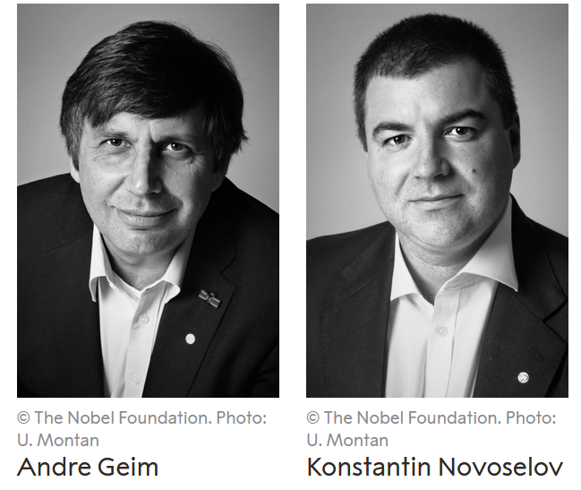
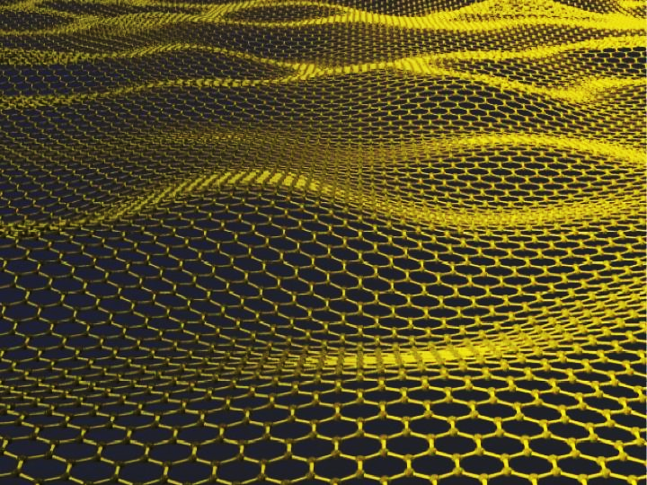
How small can crystal dimensions be ?
Nobel Prize in Physics 2010
Graphite
As thin as one atom !
Graphene
Weakly bound layers
"for groundbreaking experiments regarding the two-dimensional material graphene."

Slide 8
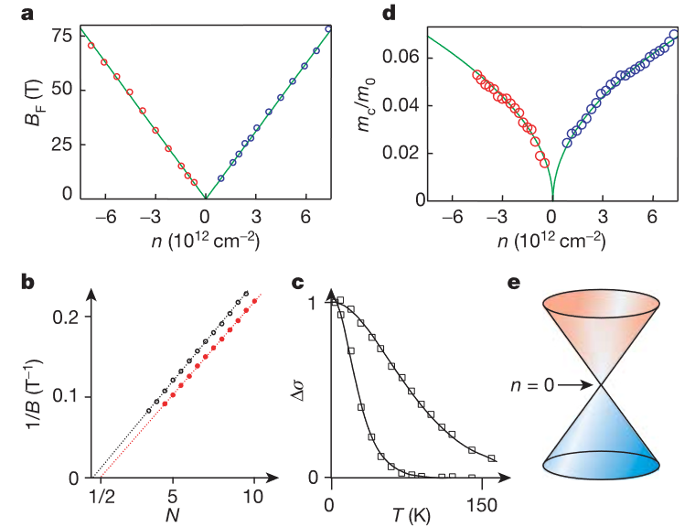
Demonstration of graphene & its properties
Graphene field-effect transistors
Massless electrons
Nobel Prize in Physics 2010
"for groundbreaking experiments regarding the two-dimensional material graphene."
K. Novoselov, Nature 438, 197 (2005)
K. Novoselov, Science 306, 666 (2004)

Slide 9
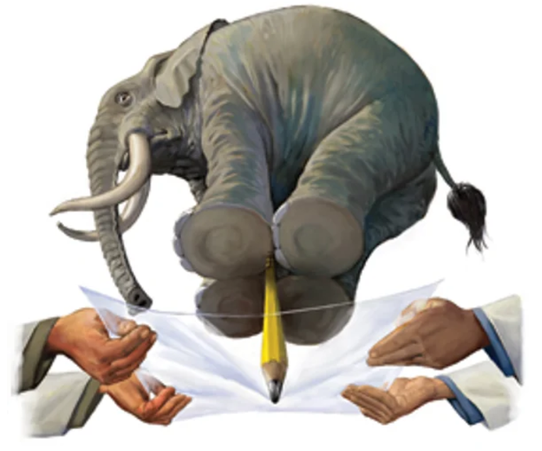
Mechanical strength of graphene
“Our research establishes graphene as the strongest material ever measured, some 200 times stronger than structural steel. It would take an elephant, balanced on a pencil, to break through a sheet of graphene the thickness of Saran Wrap.”
Jim Hone, Columbia U. (2008)
C. Lee, Science 321, 386 (2008)

Slide 10
Graphene “superlatives”
A. Geim / U. Manchester
https://slidetodoc.com/some-things-you-might-be-interested-in-knowing-2/
thinnest imaginable material
largest surface-to-weight ratio (~2, 700 m per gram)
strongest material ‘ever measured’
stiffest known material (stiffer than diamond)
most stretchable crystal (up to 20% elastically)
record thermal conductivity (outperforming diamond)
highest current density at room T (106 times of copper)
highest intrinsic mobility (100 times more than in Si)
conducts electricity in the limit of no electrons
lightest charge carriers (zero rest mass)
longest mean free path at room T (micron range)
completely impermeable (even He atoms cannot squeeze through)

Slide 11
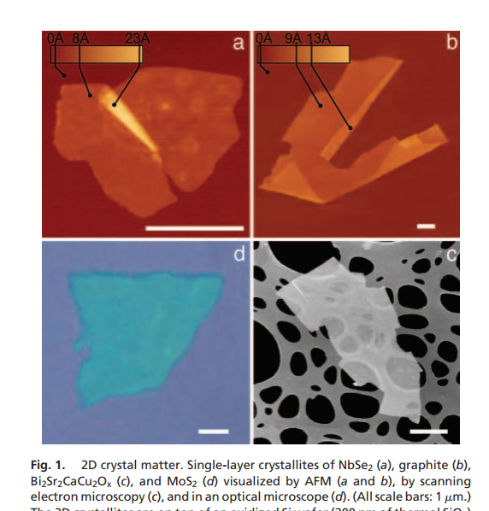
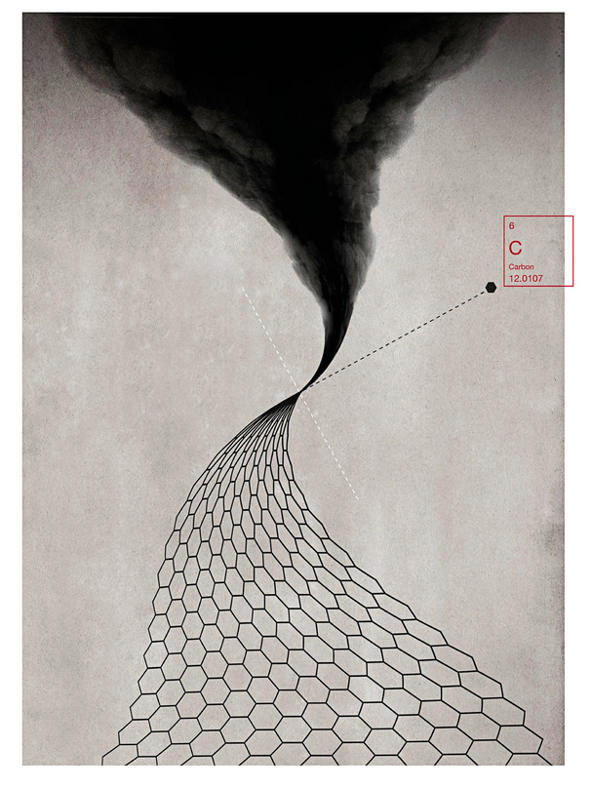
Beyond graphene
Single layers of different classes of electronic materials
Conductor
Superconductor
High-temperature superconductor
Semiconductor
C. Hagen, The New Yorker, Dec. 15 (2014)
K. Novoselov, PNAS 102, 10451 (2005)

Slide 12
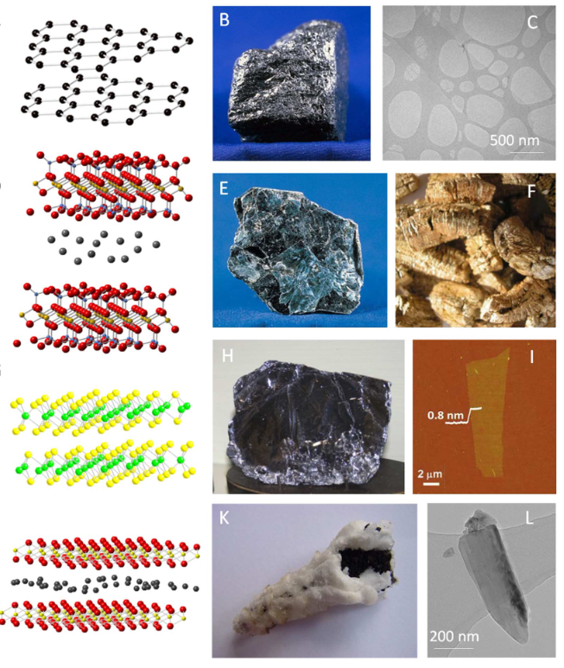
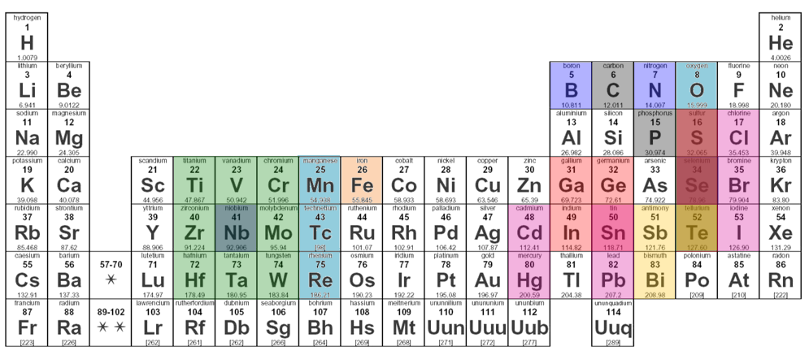
Hundreds of exfoliable van der Waals materials
Superconductors
Magnetic materials
Topological insulators
Hybrid perovskites
…and many more
V. Nikolosi, Science 340, 1226419 (2013)

Slide 13
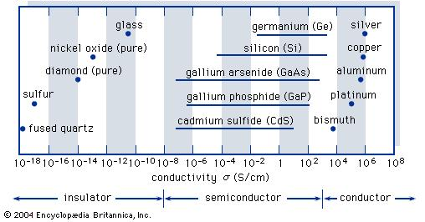
Conductivity of solids

Slide 14
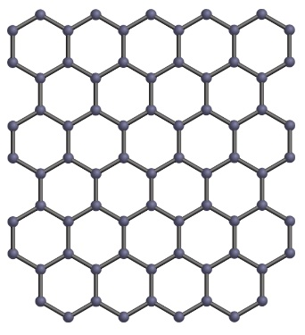
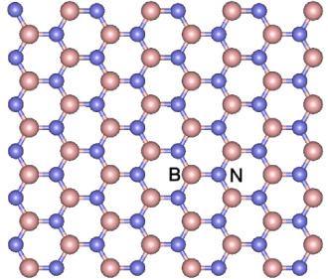
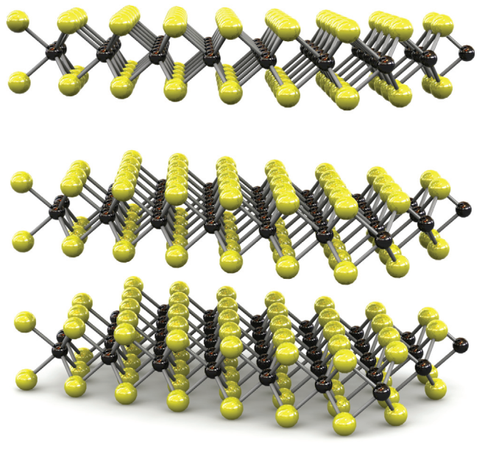
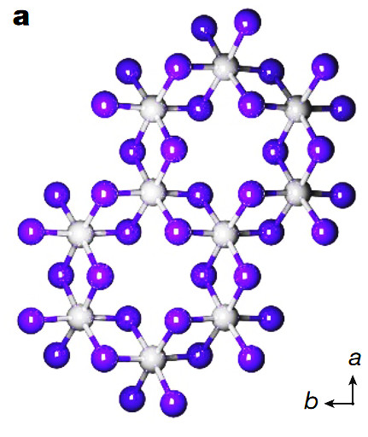
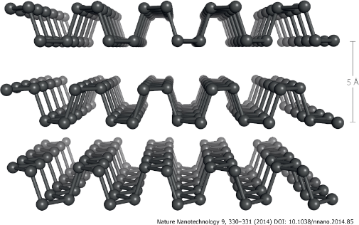
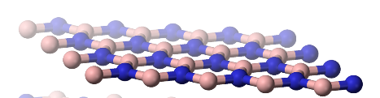

…a few examples
Transition-metal
dichalcogenides
semiconductors (VIS)
Graphene
semimetal
Boron nitride insulator
Black phosphorous semiconductor (NIR)
Chromium triiodide
ferromagnet
Metal-halide perovskite
hybrid semiconductor
A. Geim & K. Novoselov
Nature Mater. 6, 183 (2007)
S. Manzeli et al., Nature Rev. Mater. 2, 17033 (2017)
X. Jiang et al., Appl. Phys. Rev. 8, 031305 (2021)
J. D. Caldwell et al., Nature Rev. 4, 552 (2019)
Y. Xu et al., Nanoscale, 11, 14491 (2019)
L. Mao et al.,
J. Am. Chem. Soc. 141, 3 (2019)

