Slide 1
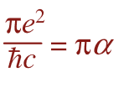
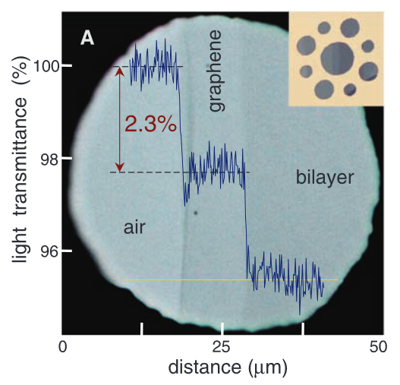
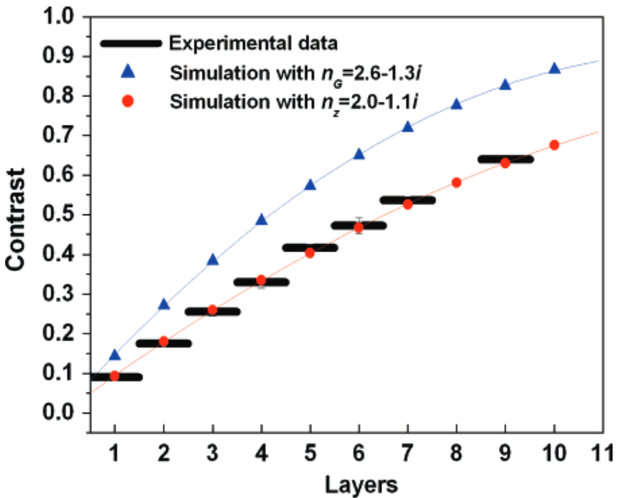
Detecting monolayers
“By eye” – optical contrast
Discrete steps with layer number
R. R. Nair et al. Science 320, 1308 (2008)
Z. H. Ni et al. Nano Lett. 7, 2758 (2007)

Slide 2
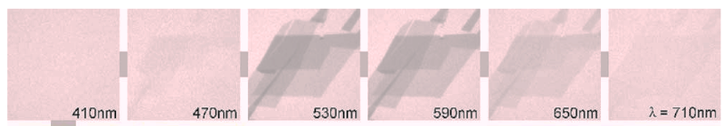
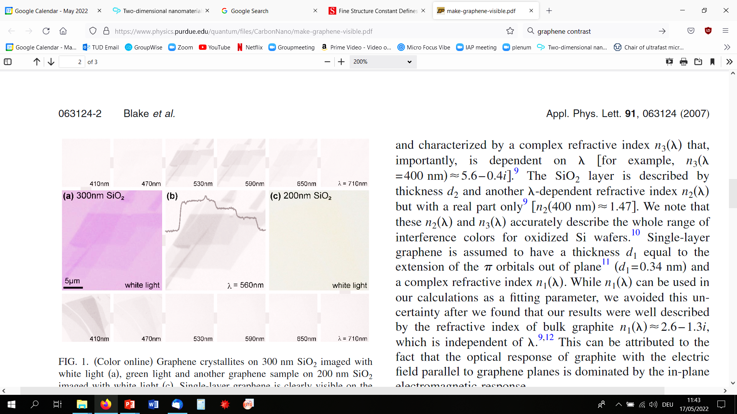
Taking advantage of interference
Wavelength of light matters
Reflected light:
result of multi-layer interference
r1
Graphene / thin layer graphite
t1
r2
SiO₂ thickness matters
r3
t2
SiO₂
300 nm
Si
P. Blake et al. Appl. Phys. Lett. 91, 063124 (2007)

Slide 3
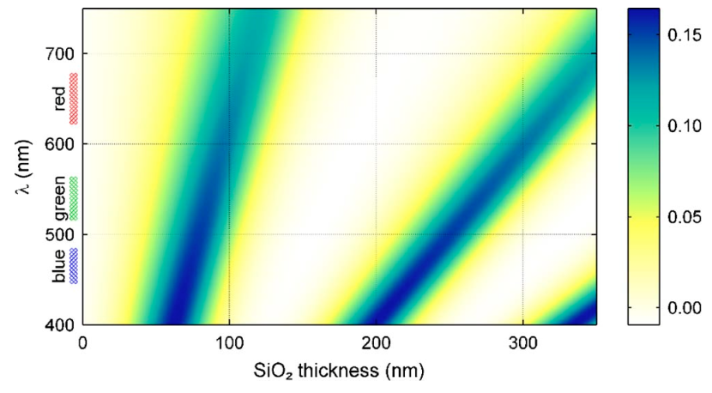
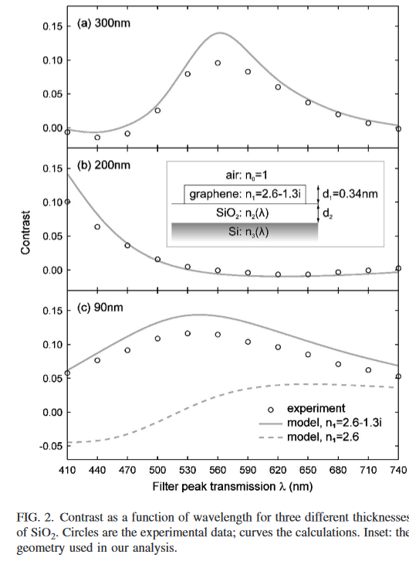
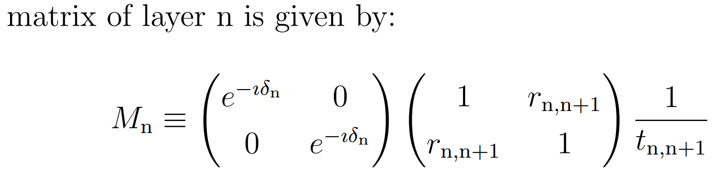
Solving multi-layer interference problem
Simple structure – Fresnel equations
More complex structures:
transfer matrix method
Steven J. Byrnes arXiv:1603.02720, https://pypi.org/project/tmm/
P. Blake et al. Appl. Phys. Lett. 91, 063124 (2007)

Slide 4
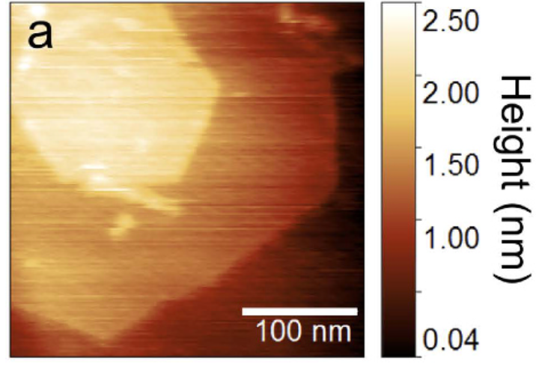
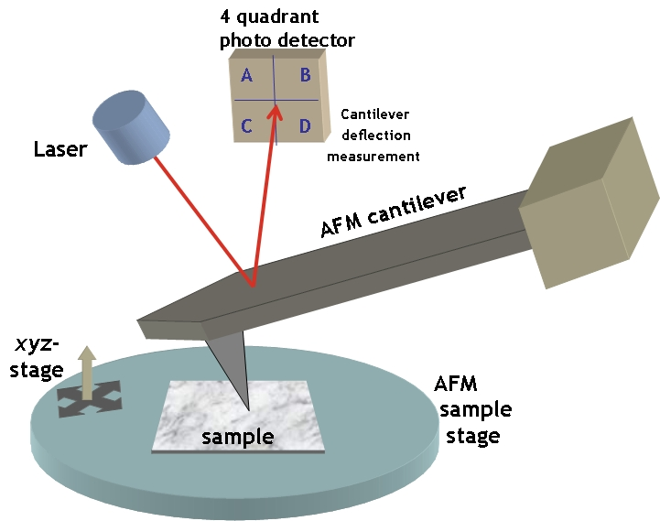
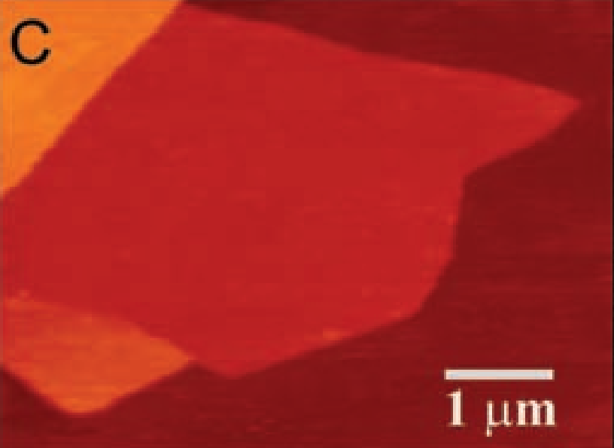
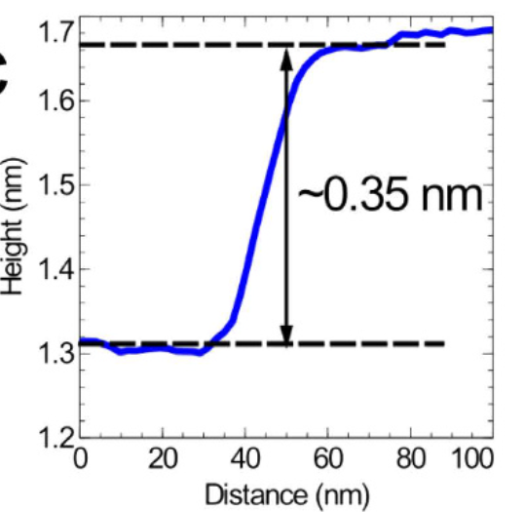
Atomic force microscopy (AFM)
“Making sure it is a monolayer….”
hBN
Graphene
(C) AFM image of single-layer graphene. Colors: dark brown, SiO2 surface; brown-red (central area), 0.8 nm height; yellow-brown (bottom left), 1.2 nm; orange (top left), 2.5 nm. Notice the folded part of the film near the bottom, which exhibits a differential height of 0.4 nm.
https://simple.wikipedia.org/wiki/Atomic_force_microscope#/media/File:AFMsetup.jpg
K. Novoselov, Science 306, 666 (2004)
Y.-J Cho et al., Sci. Rep. 6, 34474 (2016)

Slide 5
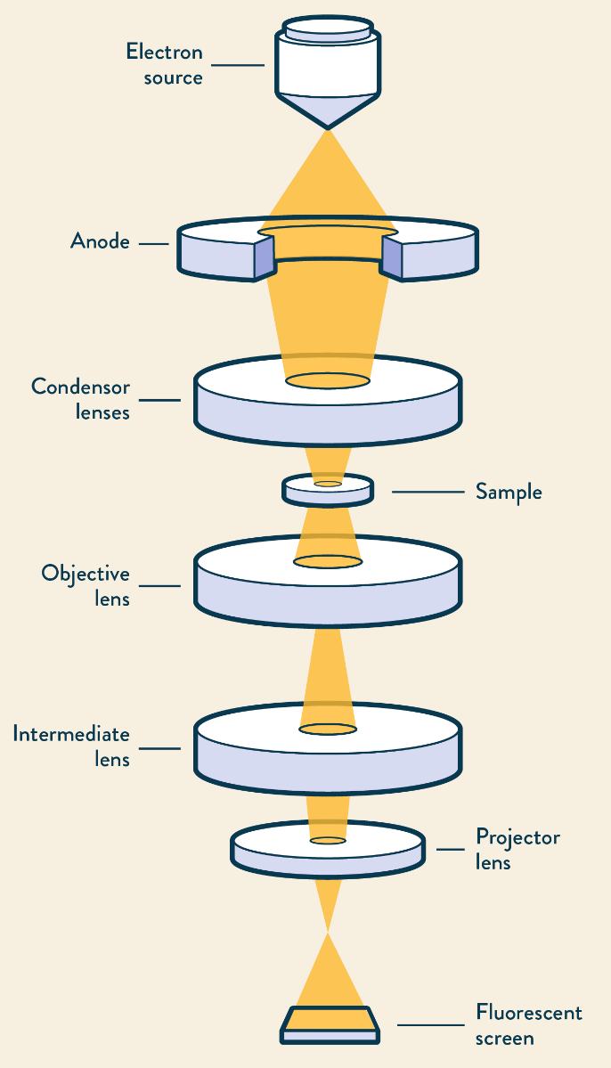
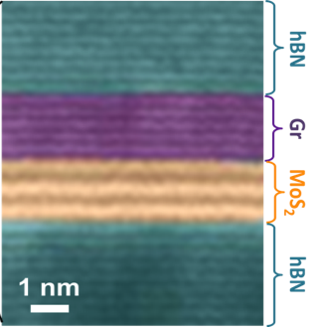
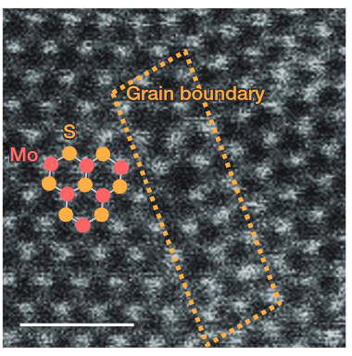
Transmission electron microscopy (TEM)
“Making sure it is a monolayer….”
Electron source
Anode
(acceleration)
hBN / graphene / MoS₂
MoS₂
Sample
Lenses
Fluorescent screen (detection)
X. Cui et al. Nature Nanotech. 10, 534 (2015)
K. Kang et al. Nature 520, 656 (2015)
https://www.technologynetworks.com/analysis/articles/sem-vs-tem-331262

Slide 6
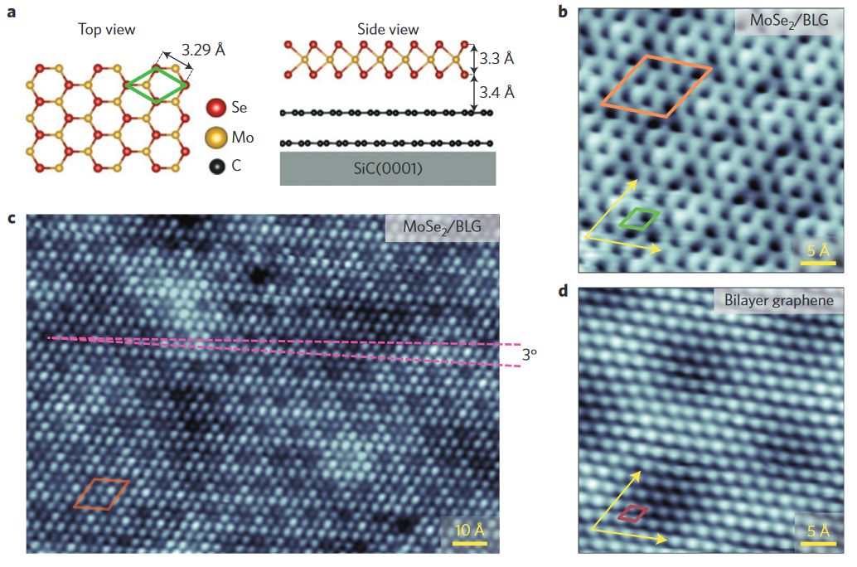
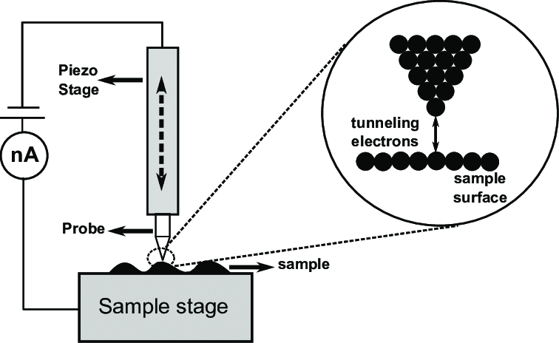
Scanning tunneling microscopy (STM)
“Making sure it is a monolayer….”
N. Marturi, «Vision and visual servoing for nanomanipulation and nanocharacterization in scanning electron microscope», thesis (2014)
M. Ugeda et al. Nature Mater. 13, 1092 (2014)

Slide 7
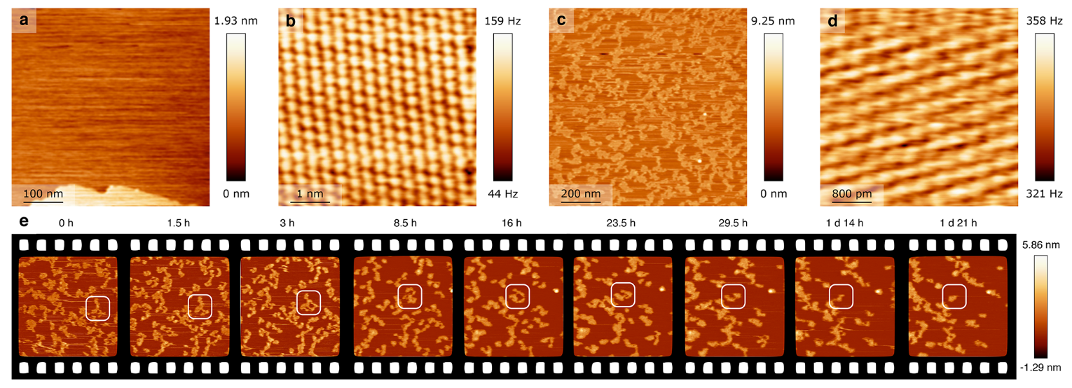
Atomic force microscopy
( Addendum: AFM can be operated under ambient conditions and have atomic resolution )
K. Pürkhauer et al. ACS Appl. Nano Mater. 2, 2593 (2019)

Slide 8
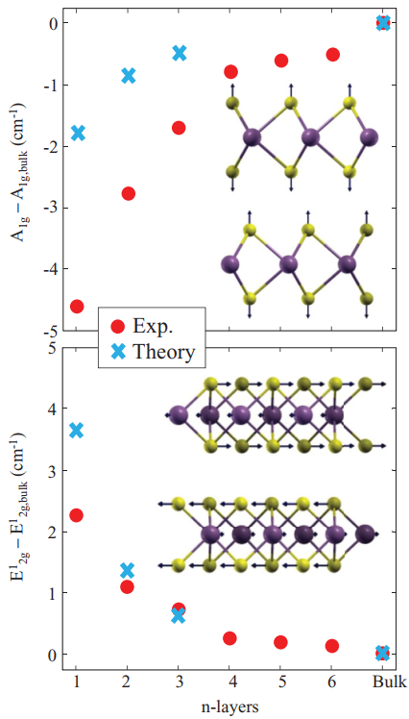
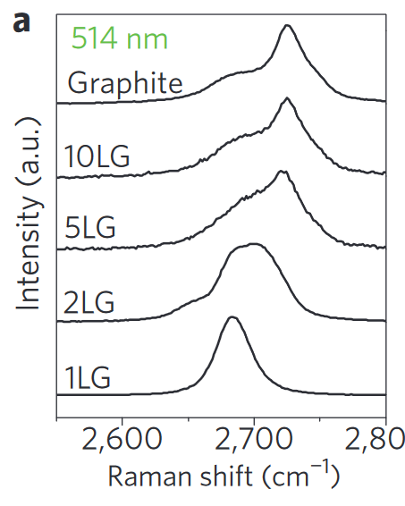
MoS₂
Raman spectroscopy
“Confirming monolayers fast”
Graphene
Light scattering
under phonon emission
E₀
E₀ - E_{phonon}
A. C. Ferrari et al. PRL 97, 187401 (2006)
A. Molina-Sánchez et al. PRB 84, 155413 (2011)

Slide 9
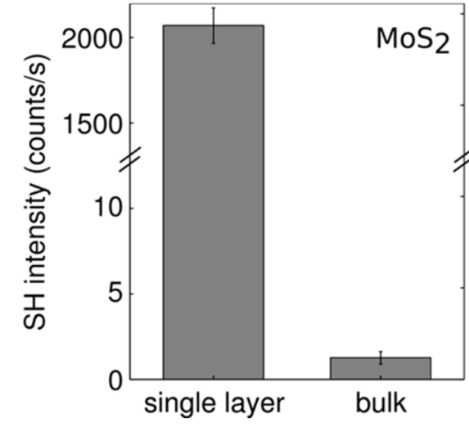
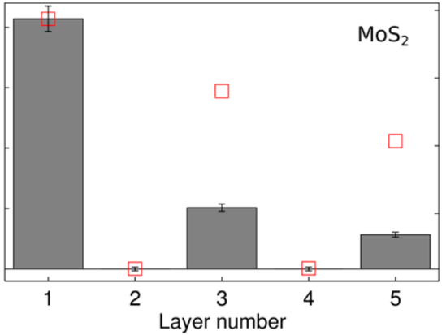
Second harmonic spectroscopy
Monolayer:
non-centrosymmetric
Bulk: centrosymmetric
2 x E₀
Y. Li et al. Nano Lett. 13, 3329 (2013)

