Slide 1
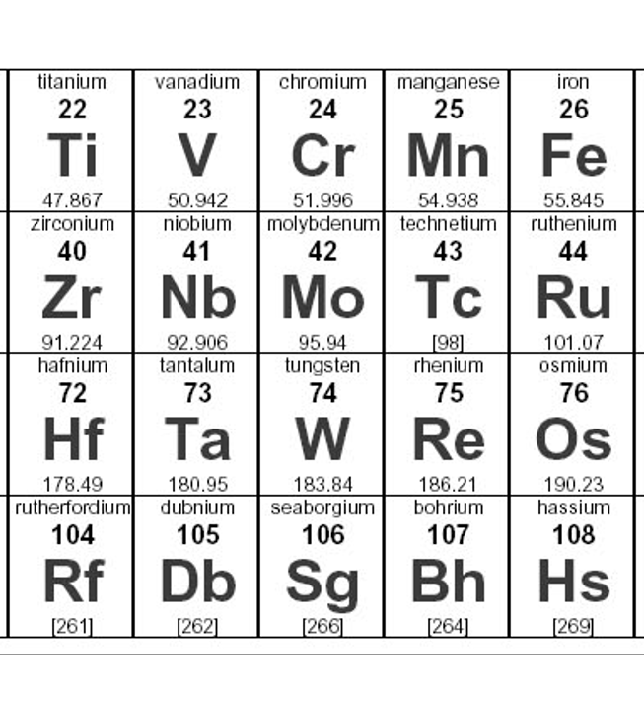
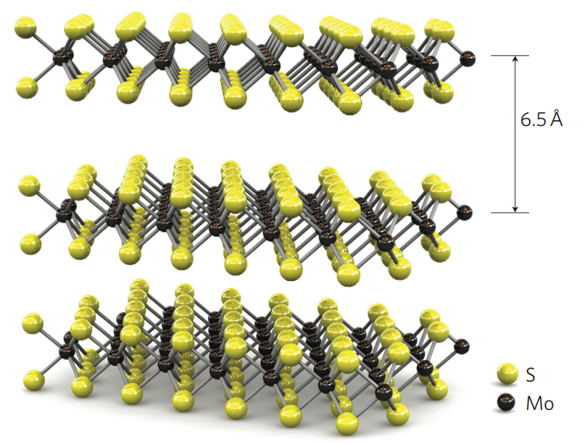
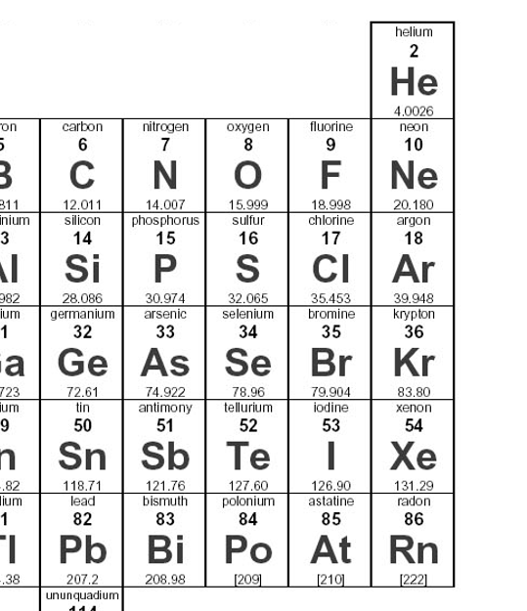
Atomically-thin semiconductors
Transistors
Light emitters
Lasers
Detectors
Modulators
Photonic devices
Single photon emitters
…
MoS₂
Radisavljevich et al., Nature Nanotech. 6, 149 (2011)
S. Manzeli et al., Nature Rev. Mater. 2, 17033 (2017)

Slide 2
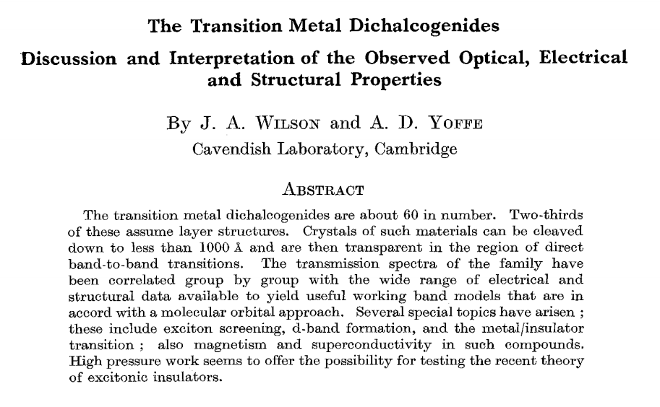
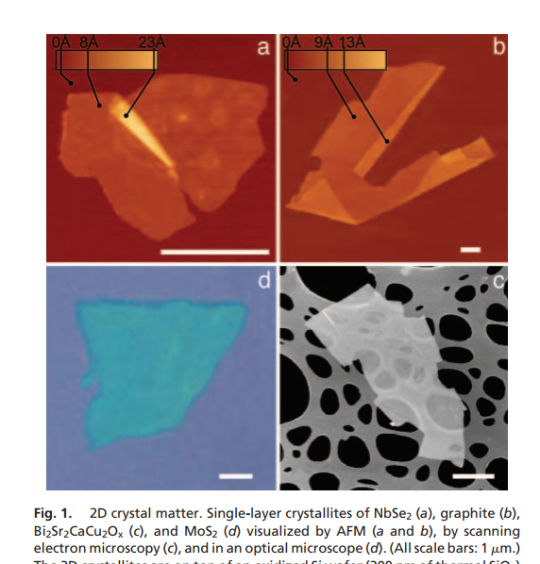
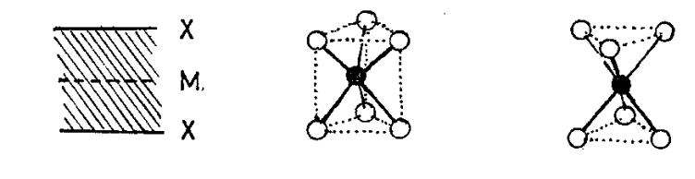
Transition-metal dichalcogenides (TMDCs)
Known for more than 50 years…
Realized & studied as monolayers in context of graphene
Frindt & Yoffe, Proc. Royal Soc. Lon. 273, 69 (1963)
Evans & Young, Proc. Phys. Soc. 91, 475 (1967)
Wilson & Yoffe, Adv. Phys. 18, 193 (1969)
Beal et al. J. Phys. C. 5, 3540 (1972)
K. Novoselov, PNAS 102, 10451 (2005)

Slide 3
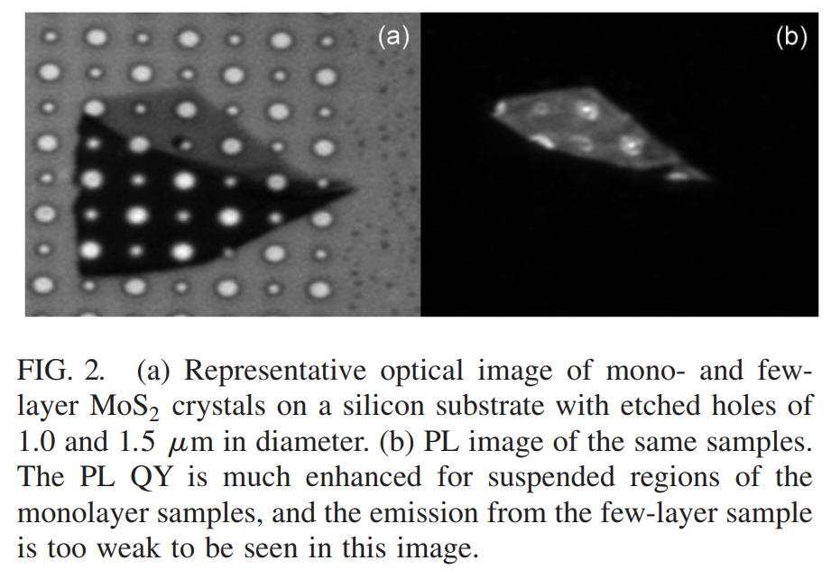
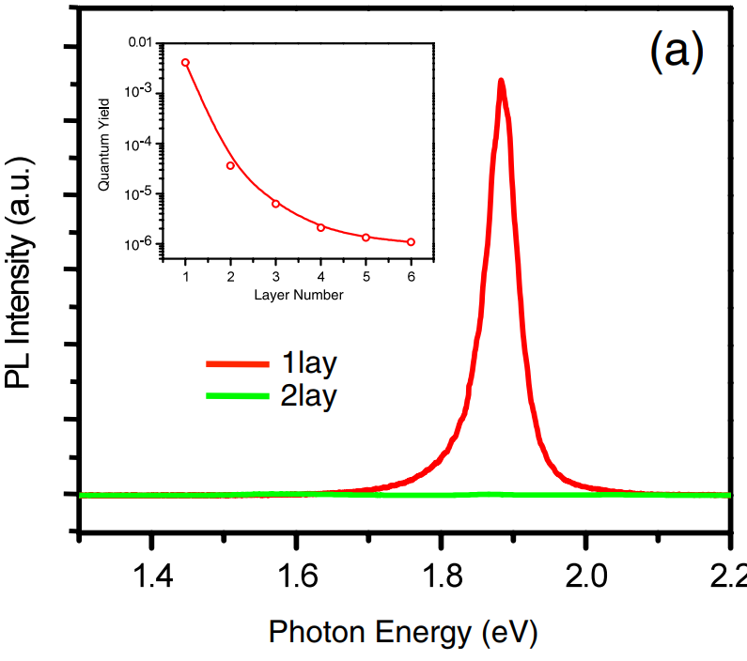
Light emission
Only monolayers emit light efficiently
Photoluminescence spectra
1L
K. F. Mak et al., PRL 105, 136805 (2010)

Slide 4
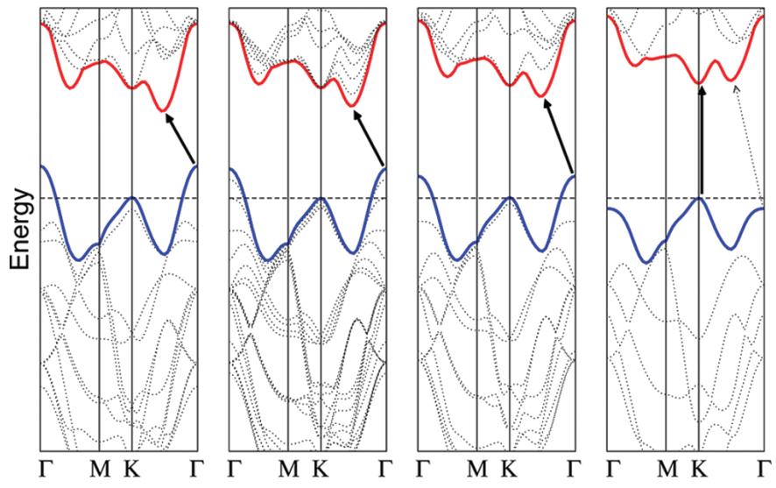
Indirect-to-direct bandgap transition
Bulk
4L
2L
1L
Indirect transition
Direct transition
Requires large momentum
Optically dark
Requires zero momentum
Optically bright
A. Splendiani et al., Nano Lett. 10, 1271 (2010)

Slide 5
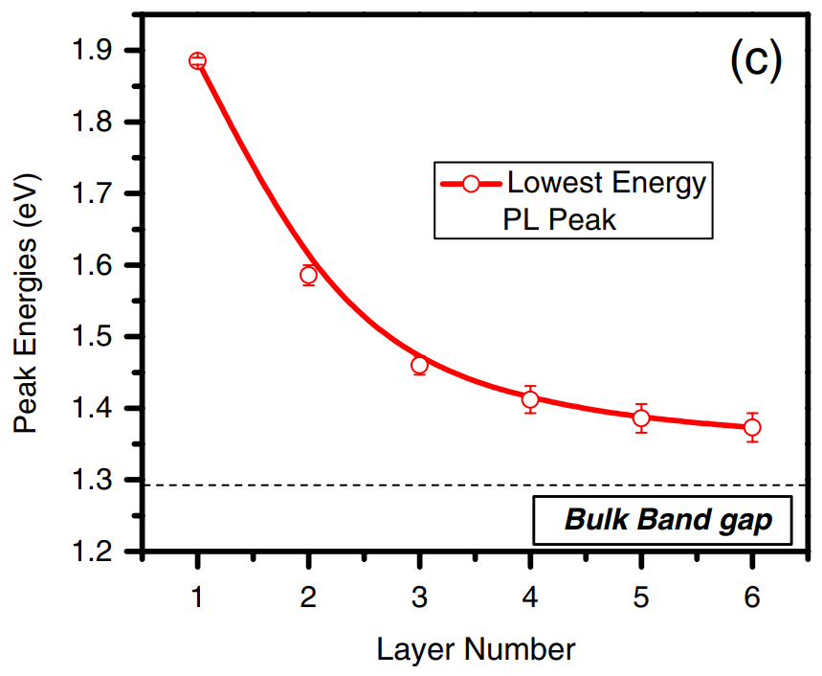
Indirect-to-direct bandgap transition
Lowest PL peak energy
Direct
Indirect
Bulk
K. F. Mak et al., PRL 105, 136805 (2010)

Slide 6
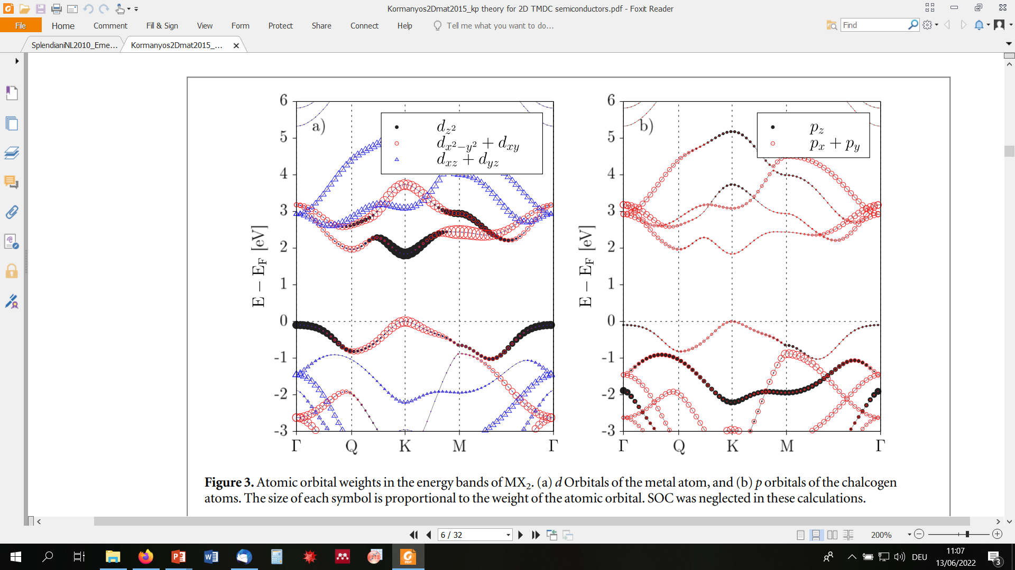
Electronic coupling
A. Kormanyos et al., 2D Mater. 2, 022001 (2015)

Slide 7
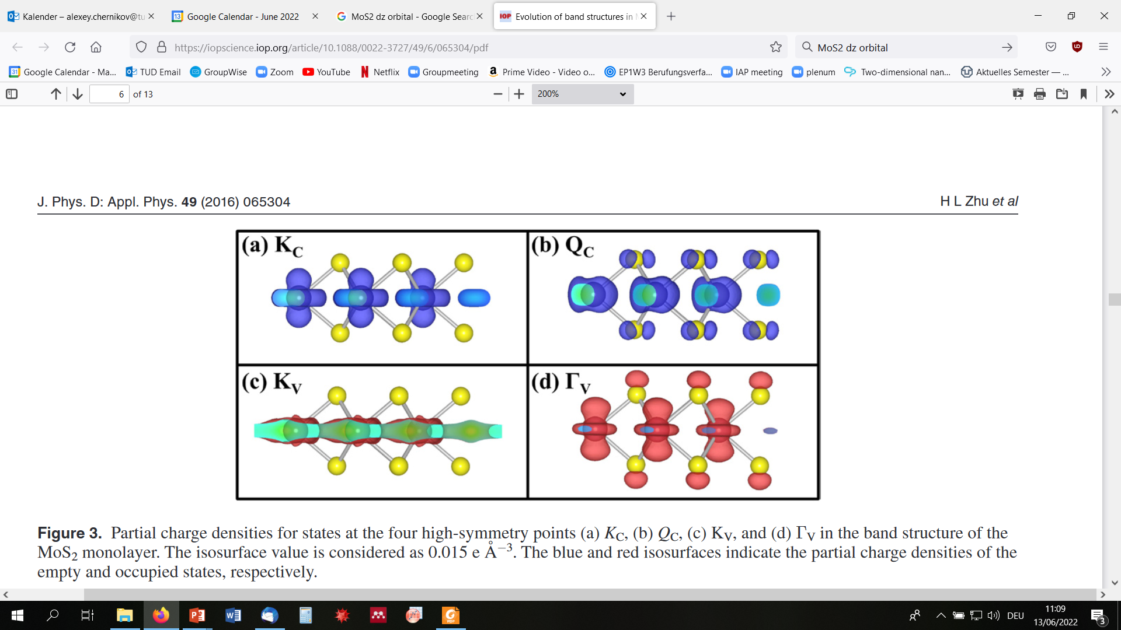
Electronic coupling
K-points (direct transition)
Q & Γ-points (indirect transition)
A. Kormanyos et al., 2D Mater. 2, 022001 (2015)

Slide 9
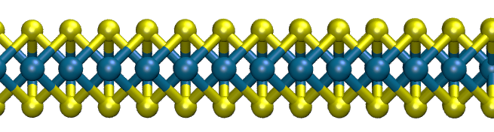
Optical absorption of TMDC monolayers
Monolayer WS₂, room temperature
20
Evidence of interactions
Non-interacting 2D electrons
15
Optical absorbance (%)
10
< 0.6 nm
5
0
1.5
2.0
2.5
3.0
Energy (eV)
Y. Li et al., Phys. Rev. B. 90, 205422 (2014)

Slide 10
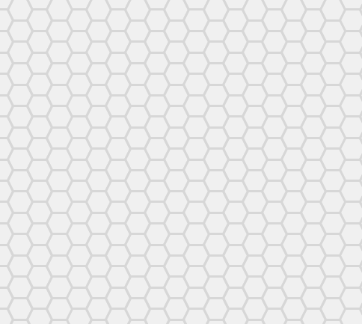
Exciton formation
Excitons =
hn
Bound electron-hole pairs
Dominate optical response
y
x
J. Frenkel, Physical Review 37, 17 (1931)
E. F. Gross and N. A. Karrjew, Dokl. Akad. Nauk SSSR 84, 471 (1952)

Slide 11
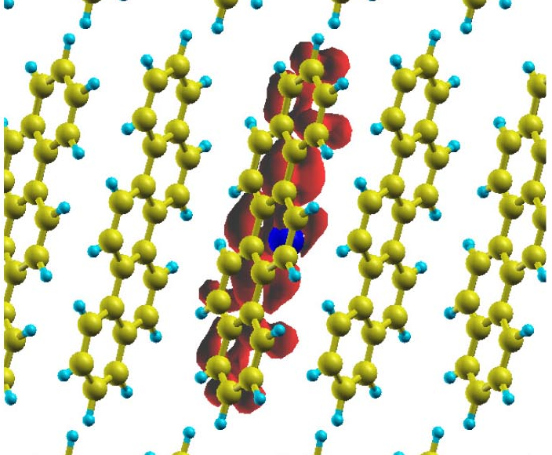
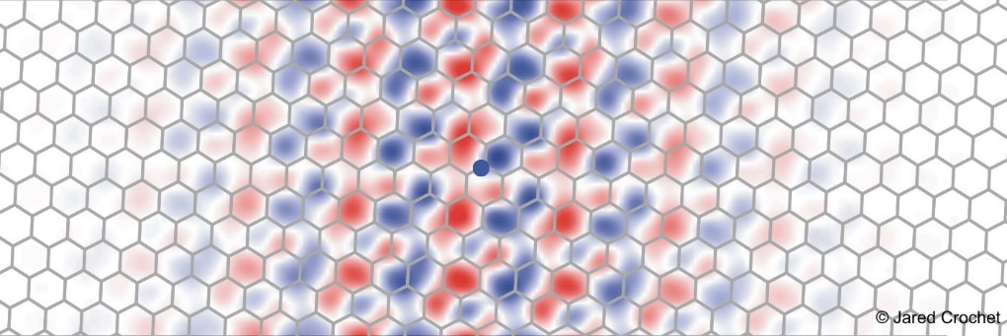
Types of excitons
Frenkel excitons
Wannier-Mott excitons
Localized on one molecule
Extend over many lattice sites
Molecules
Inorganic semiconductors
Molecular solids
Organic crystals
Quantum wells / wires
Tobias Hertel group, University Würzburg
P. Cudazzo et al., J. Phys. Cond. Mat 27, 113204 (2015)
(carbon nanotube)
(picene crystal)

Slide 12



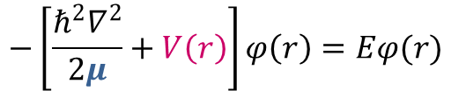
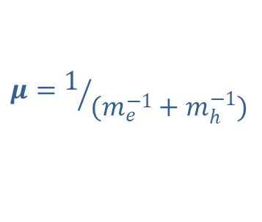



Hydrogen model for Wannier excitons
$$−\left[\frac{ℏ^{2}∇^{2}}{2μ}+V\left(r\right)\right]φ\left(r\right)=Eφ(r)$$
$$m_{e}$$
Coulomb interaction potential
$$ε$$
Reduced effective mass
$$\sim \frac{1}{εr}$$
$$m_{h}$$
$$μ=1/{(m_{e}^{−1}+m_{h}^{−1})}$$
Dielectric screening constant
Effective mass approximation
Homogenous dielectric medium
Exciton binding energy
(solution in 3D)
$$E_{b}=13.6 eV×\frac{μ}{ε^{2}}$$
Exciton radius
$$a_{X}=0.53 Å×\frac{ε}{μ}$$

Slide 13
Dielectric screening in matter
Ion core (+)
Effective field in the opposite direction
Electron cloud (-)
Electric field
only 1 – 10% compared to vacuum
Coulomb interaction is usually weak in (inorganic) matter
Exciton binding energies often ~ 10’s of meV

Slide 14
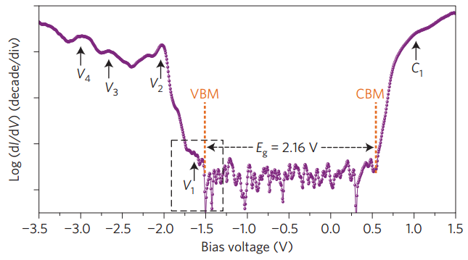
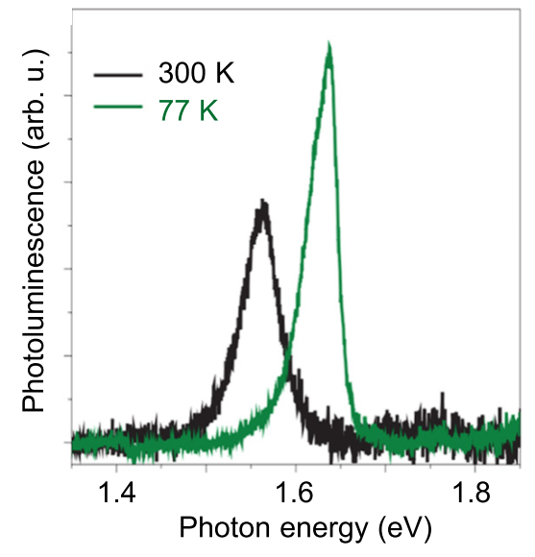
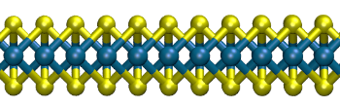
Measuring excitons & bandgap
Scanning tunneling spectroscopy
+ exciton absolute energy E_{X} from PL
Free-particle bandgap E_{gap}
V_{bias}
VB
CB
Graphite
1L MoSe₂
SiO₂
M. M. Ugeda et al., Nature Mater. 13, 1091 (2014)
C. Zhang et al., Nano Lett. 14, 2443 (2014)
E_{gap} – E_{X}
~ 500 ± 100 meV exciton binding energy

Slide 15
Measuring excitons & bandgap
Exciton spectroscopy
Ground state n = 1
1st excited n = 2
2nd excited n = 3
Ionization continuum n = ∞
= Bandgap
n = 1
Binding energy
Optical absorption
Ionization continuum
n = 2
n = 3
= Bandgap
…
1s
2s
3s
Photon energy

Slide 16
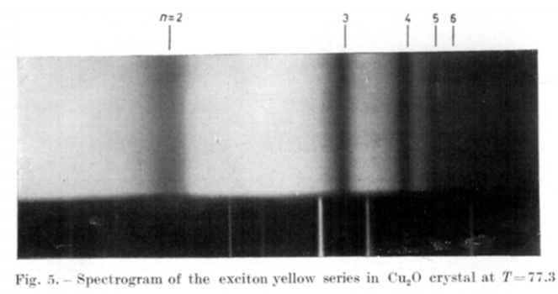
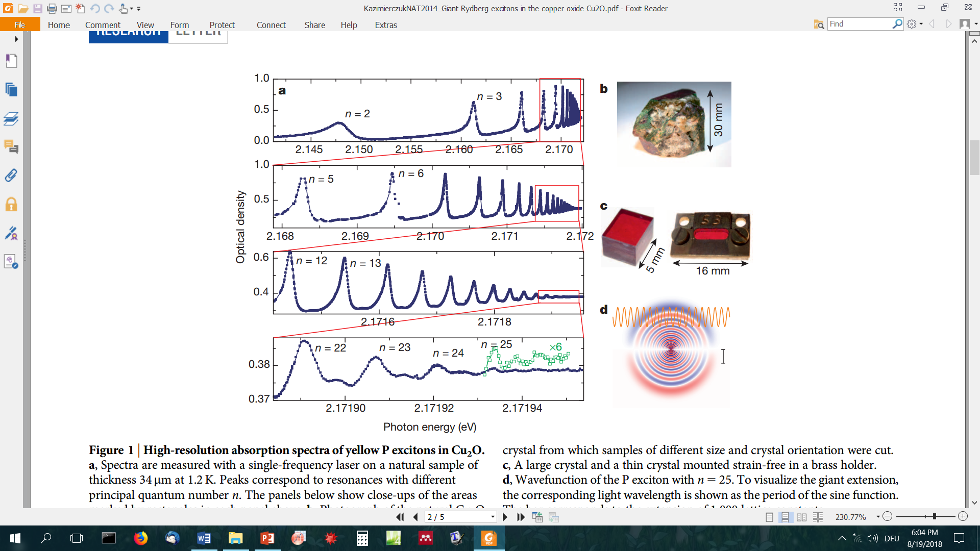
Measuring excitons & bandgap
Exciton spectroscopy
E. F. Gross and N. A. Karrjew, Dokl. Akad. Nauk SSSR 84, 471 (1952)
Historical evidence of excitons
T. Kazimierczuk et al., Nature 514, 343 (2014)

Slide 17


monolayer WS₂
Measuring excitons & bandgap
Exciton spectroscopy
2D hydrogen model
$$∝{(n−1/2)}^{−2}$$
n = 1
2
3
4
5
$$∂R/∂E$$
Bandgap
Exciton binding energy: 320 meV
Reflectance derivative,
x30
Exciton ground state
Ground state exciton
~ free carrier bandgap
Phys. Rev. Lett. 113, 076802 (2014)
Phys. Rev. Lett. 113, 026803 (2014)

Slide 18
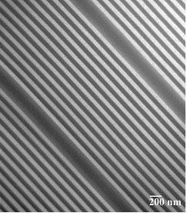
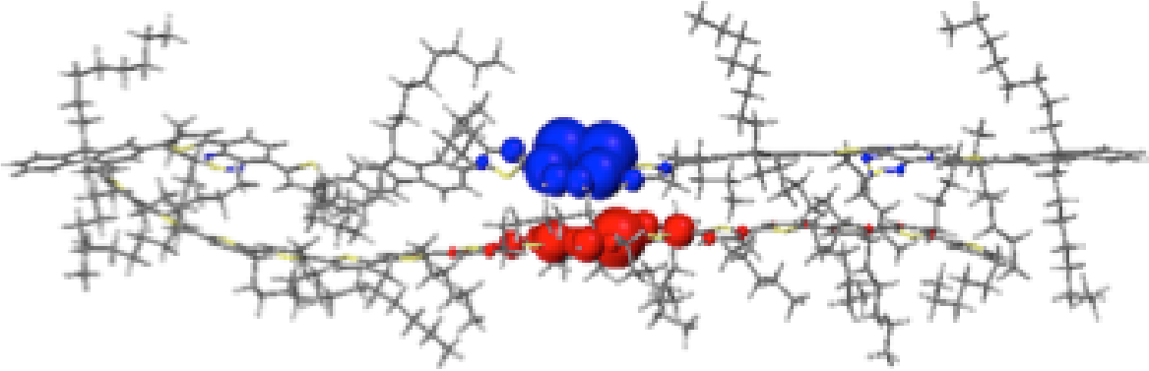
Heterostructures
Quantum wells
Organic blends
A. A. Bakulin et al., Science 335, 1340 (2012)
D. Mathes and R. Hull http://vcsel.mntl.illinois.edu/projects/crvcl/

Slide 19
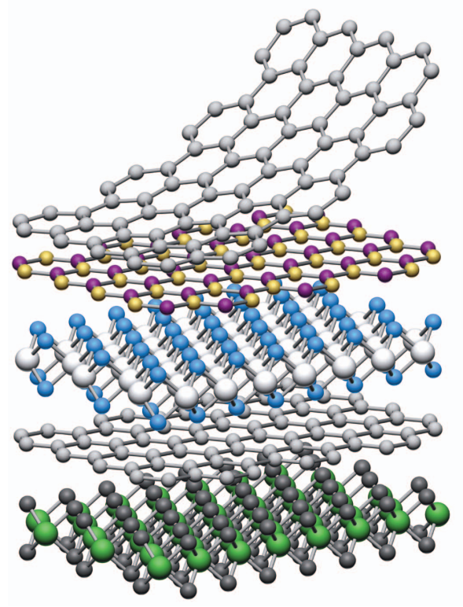
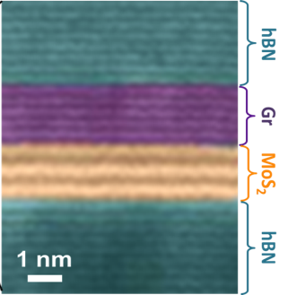
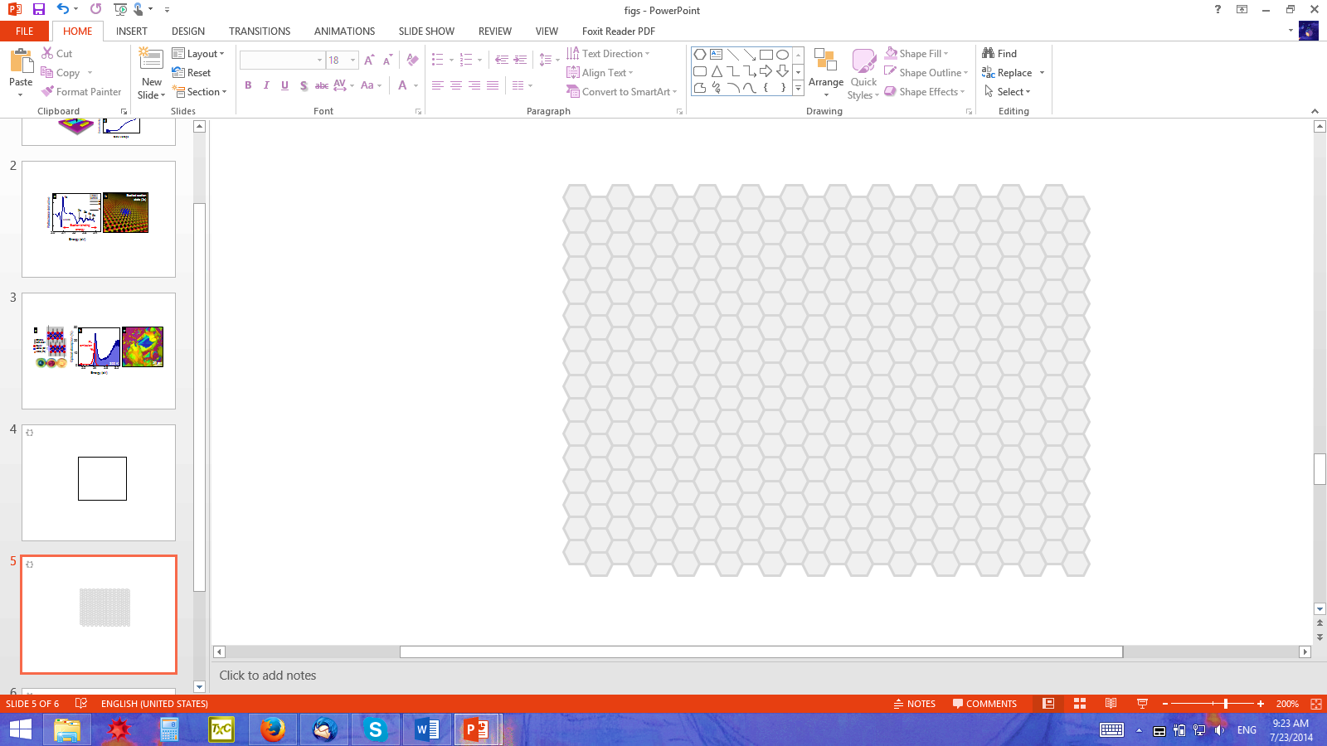
Van der Waals heterostructures
Atomically defined interfaces
Twist degree of freedom
Van der Waals assembly
Geim & Grigorieva, Nature 499, 419 (2013)
Cui et al., Nature Nano. 10, 534 (2015)
Rivera et al., Nature Nano. 13, 1004 (2018)

Slide 20
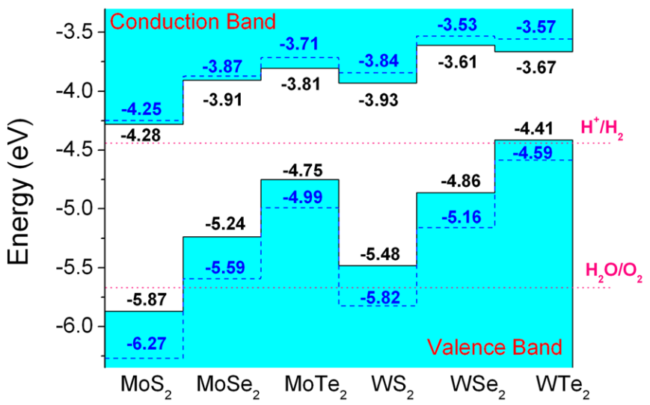
Interlayer transitions
Interlayer transition
(also labeled)
Type II junction
Charge-transfer state
J. Kang et al., Appl. Phys. Lett. 102, 012111 (2013)

Slide 21
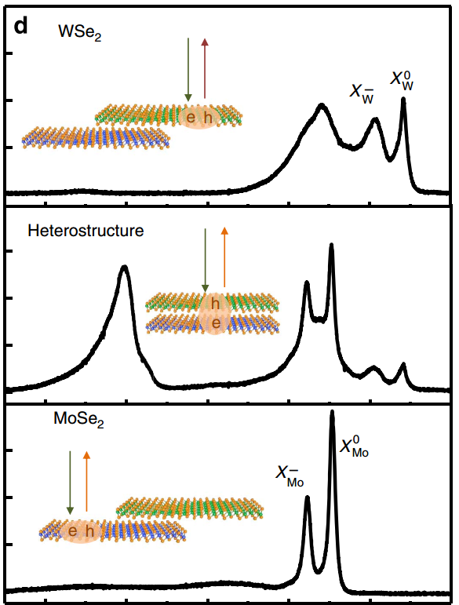
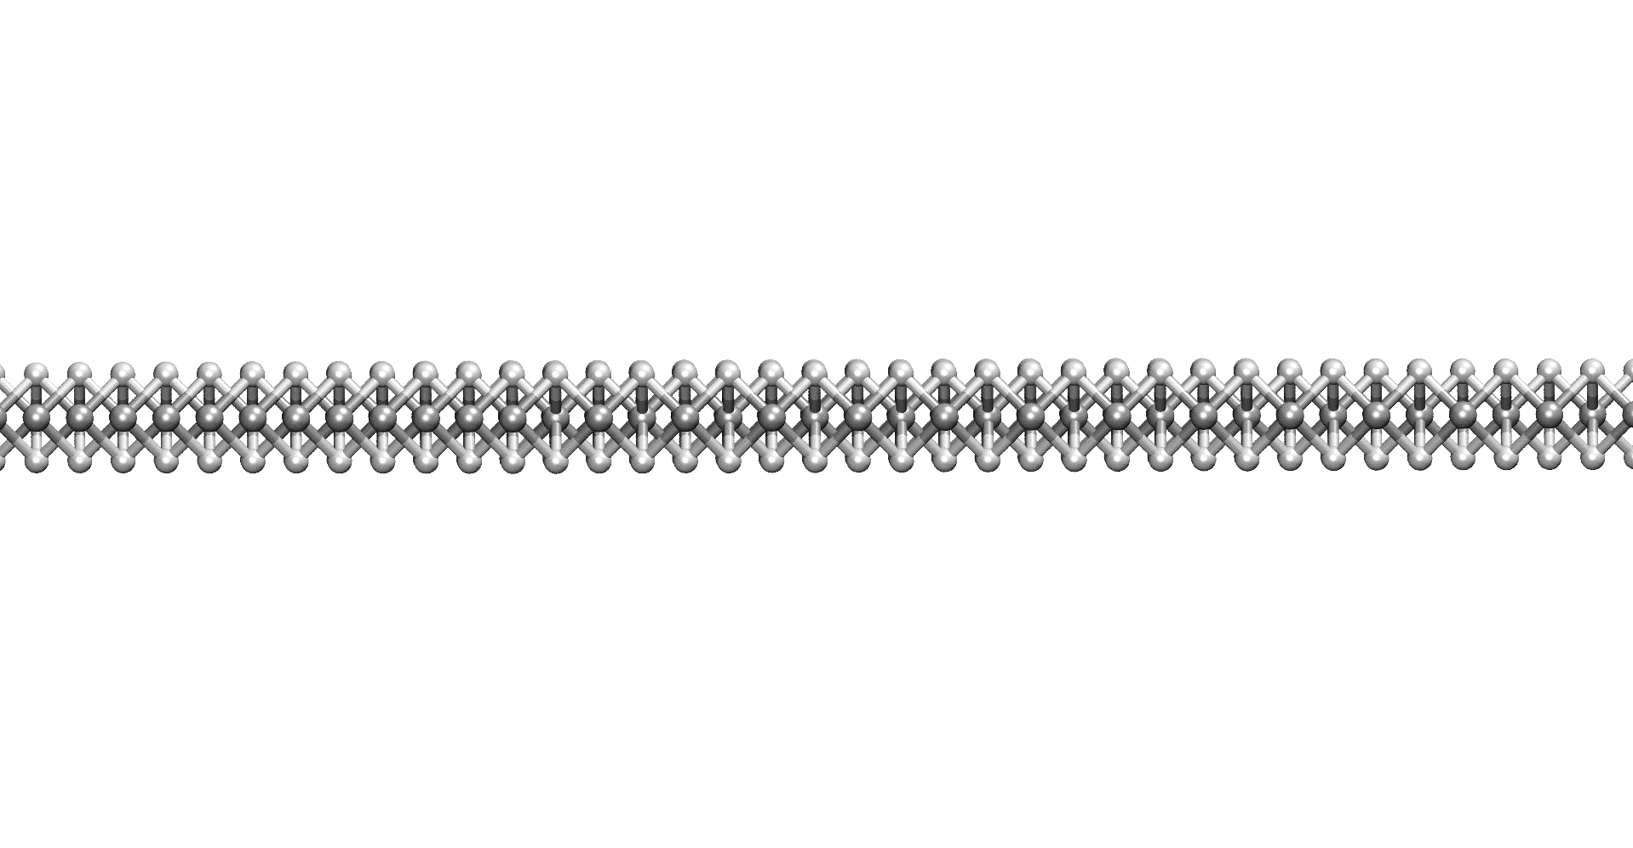
Interlayer excitons
WSe₂
Intralayer exciton
Top layer
Interlayer exciton
WSe₂/ MoSe₂
WSe₂
Photoluminescence intensity
Heterostructure
MoSe₂
MoSe₂
Bottom layer
P. Rivera et al., Nature Commun. 6, 6242 (2015)
1.3
1.4
1.5
1.6
1.7
Energy (eV)

Slide 22
Moiré lattices

Slide 23
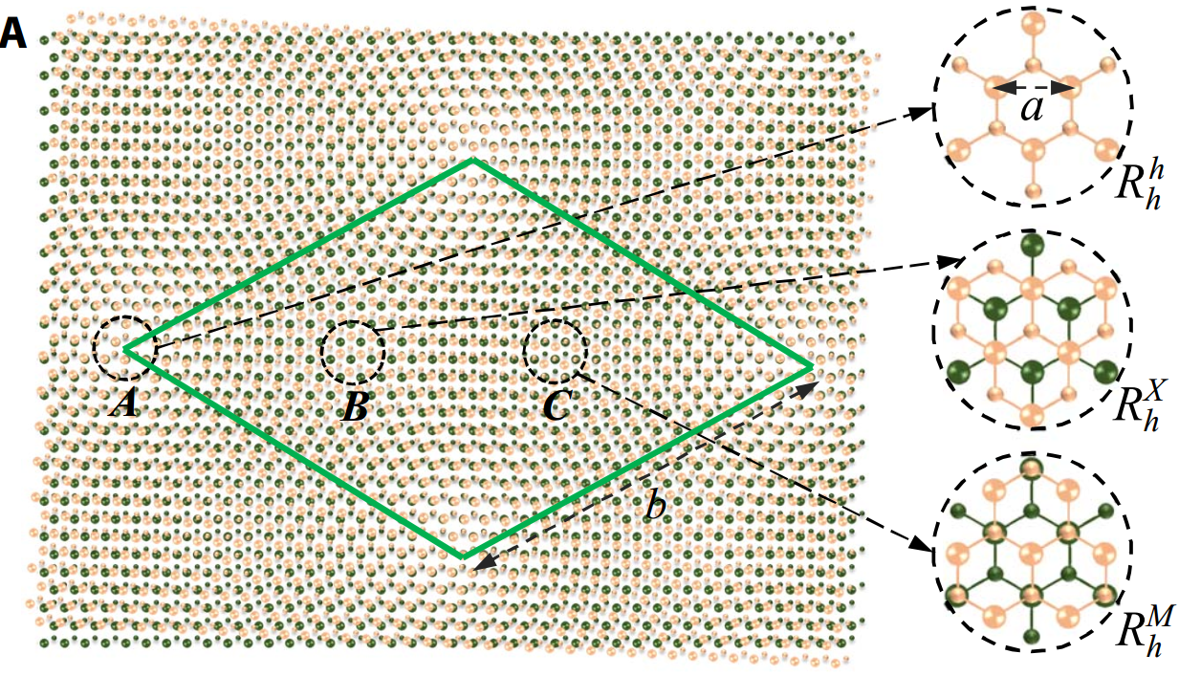
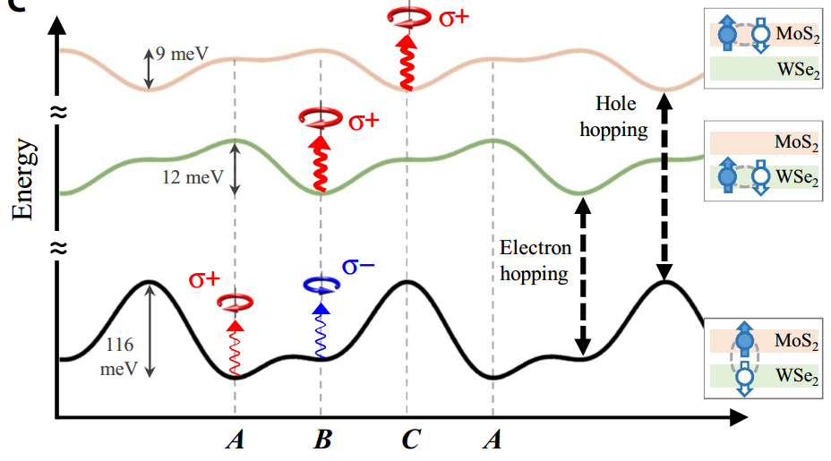
Moiré lattices
Moiré patterns
Spatially-varying energies & selection rules
H. Yu et al., Sci. Adv. 3, e1701696 (2017)

Slide 24
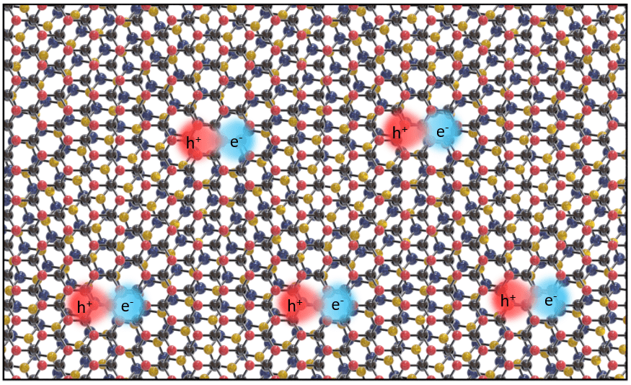
Electronic & optical excitations in moiré lattices
Xiadong Xu, https://physicsworld.com/a/twistronics-lights-up-with-moire-exciton-experiments/
+ rich physics of correlated electronic states in artificial superlattices

