Slide 1




Ecotransit
Packaging
A Sustainable Innovation for logistics solutions
Leveraging Rice Straw for Eco-Friendly Packaging

Slide 2



The Team
Nolan
Min
Maggy
CFO
CEO
Chief Engineer
Tran Huu Nhan
Nguyen Xuan Minh
Magdaleena Nakambale

Slide 3


Overview
Introduction
Our solution
Our offer
Presenter: Tran Huu Nhan

Slide 4


ABOUT US
Chief Executive Officer - Min

Slide 5


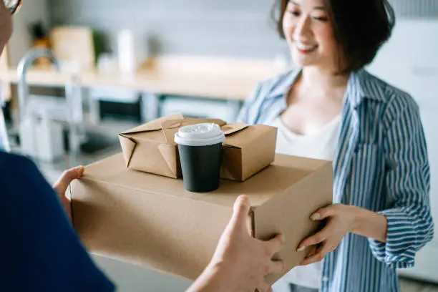
Who are we?
Packaging Solution
Mission
Value
We deliver and provide customers with specific products in the most sustainable way
Be sustainable and creative
Customizing to fit customers' demand
Presenter: Min - CEO

Slide 6
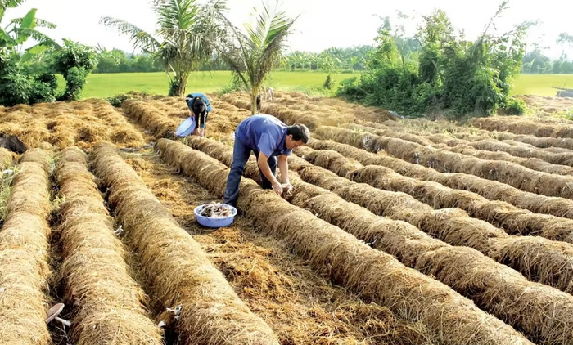
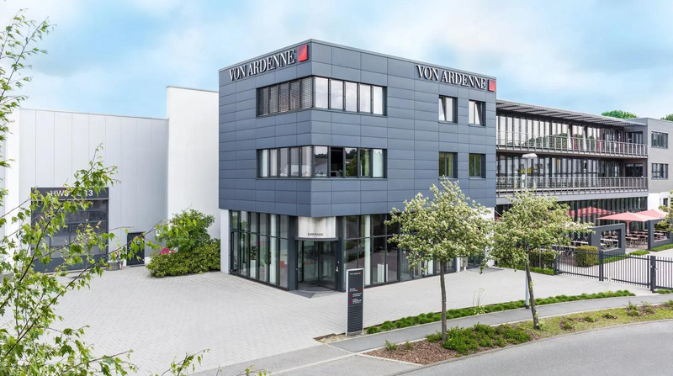

How Can We Deliver?
Rich Sources of Fibre
Von Ardenne Vietnam
Competitive Price
We have many suppliers across Vietnam with large amout of natural fibres every year
We can collaborate easily with Von Ardenne Vietnam
to minimize the logistic costs
We offer afforable price for our solutions
Presenter: Min - CEO

Slide 7

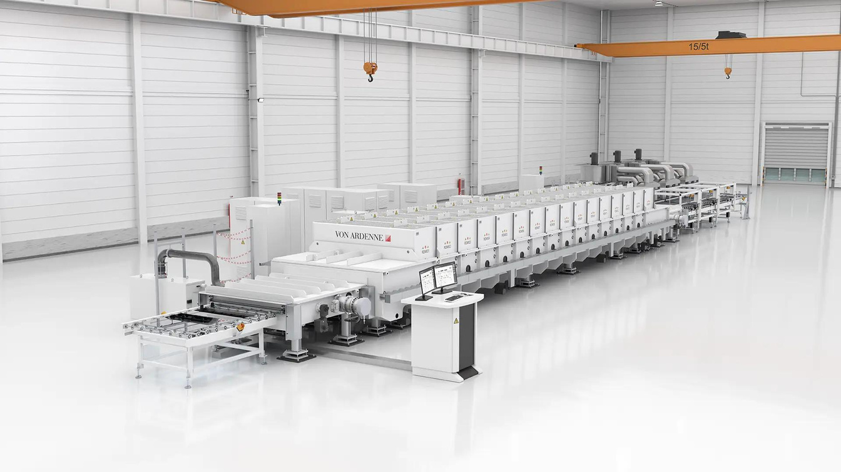
MAGNET BAR
Glass Coating Machine
Source: Von Ardene
Presenter: Min - CEO

Slide 8
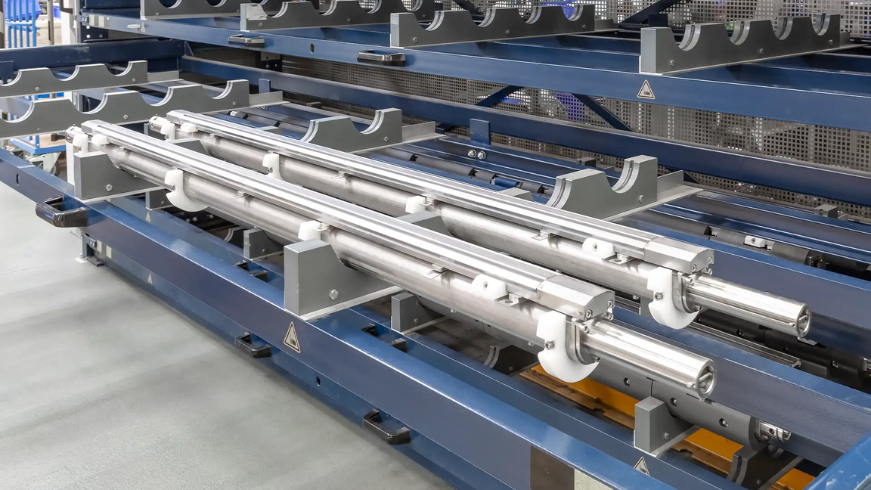

MAGNET BAR
Guidance
Source: Von Ardene
Presenter: Min - CEO

Slide 9
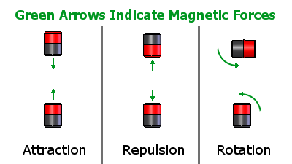
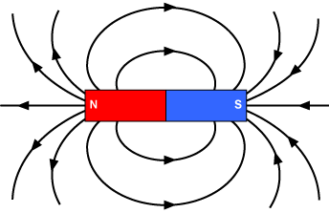
MAGNET BAR
Logistic Challenges
Source: K&J Magnetic
Magnetic Field Interference
Source: Northeastern University
Presenter: Min - CEO

Slide 10

01
Thermal isolation
02
Ensure the stability
Criteria
03
Sustainable material
04
Low cost
Presenter: Min - CEO

Slide 11
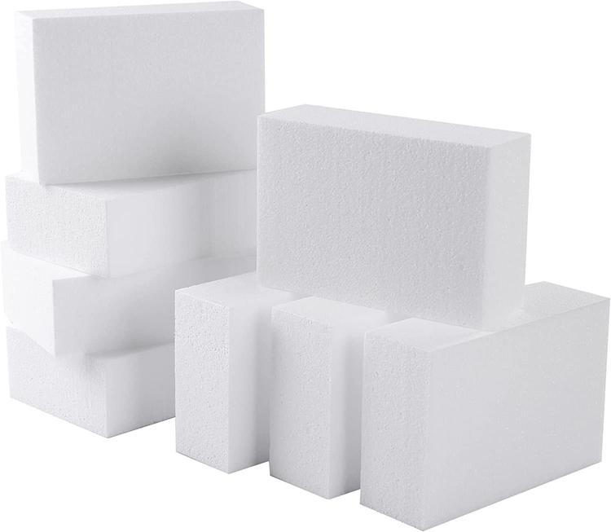
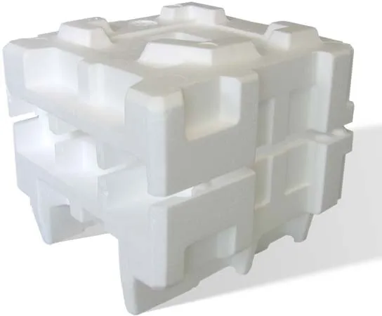
The Challenge
Presenter: Min - Ceo

Slide 12
TECHNOLOGY
Chief Engineer - Maggy
Presenter: Maggy

Slide 13
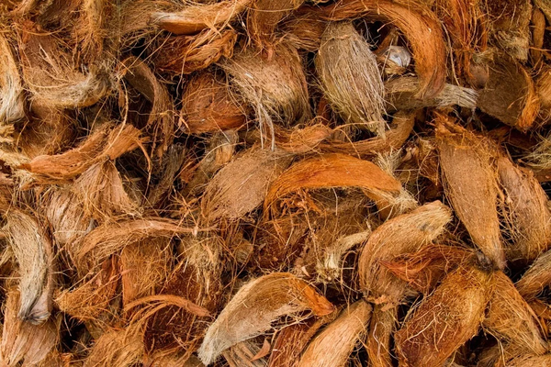
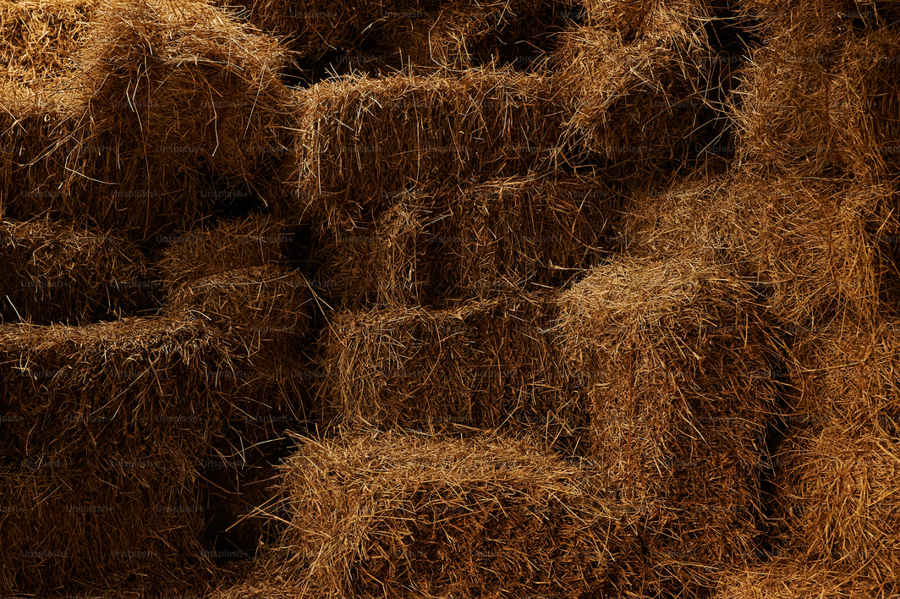
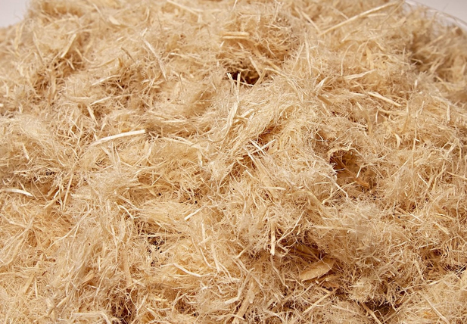
NATURAL FIBRE
Coconut Fibre
Straw Fibre
Wood Fibre
Presenter: Maggy

Slide 14
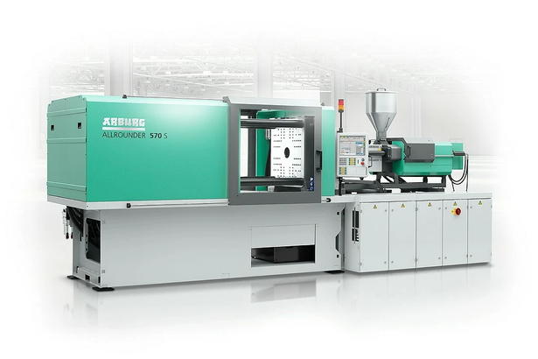
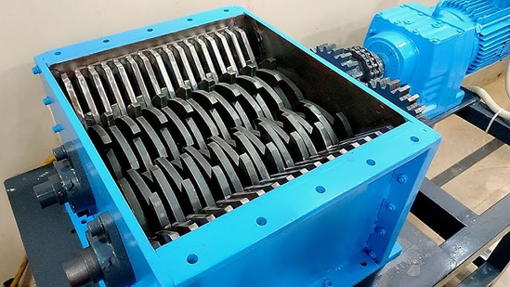
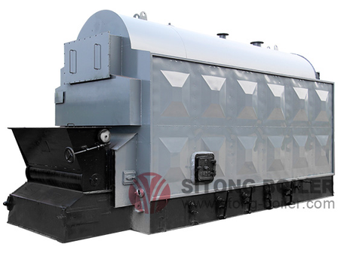
MACHINE
Moulding Machine
Schreeding Machine
Drying Machine
Presenter: Maggy

Slide 15
RAW MATERIAL
TREATMENT PROCESS
A Dual-Output System
Biogas Collection
Biogas Collection
Raw materials Collection
Dry Molding (Compression)
Alkali Soaking & Pretreatment
Anaerobic Digestion
Final Packaging
+ Shredding
Dried Fiber
Natural fiber to Biogas and Sustainable packaging process
Presenter: Maggy

Slide 16
OUR OFFER
Chief Financial Officer - Nolan
Presenter: Nolan - CFO

Slide 17
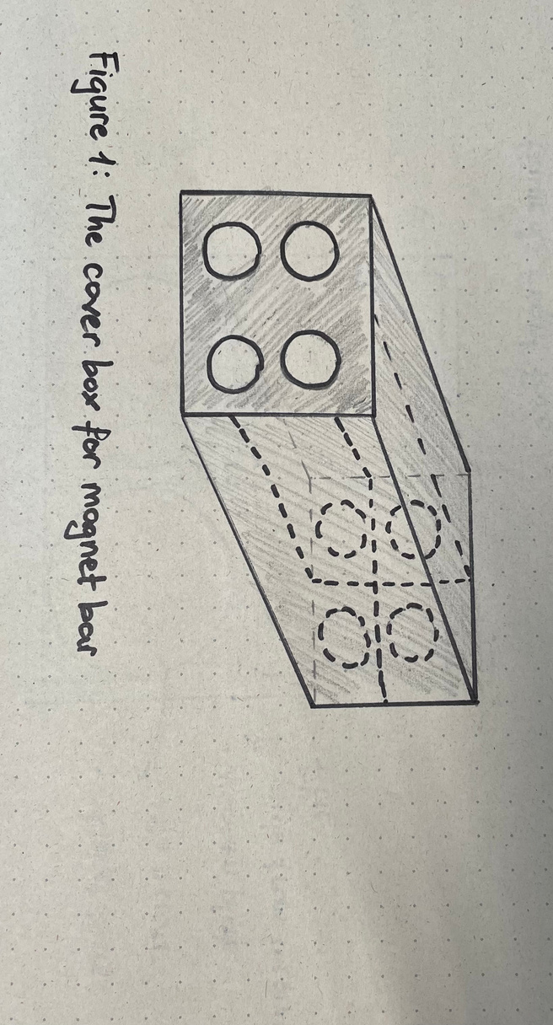
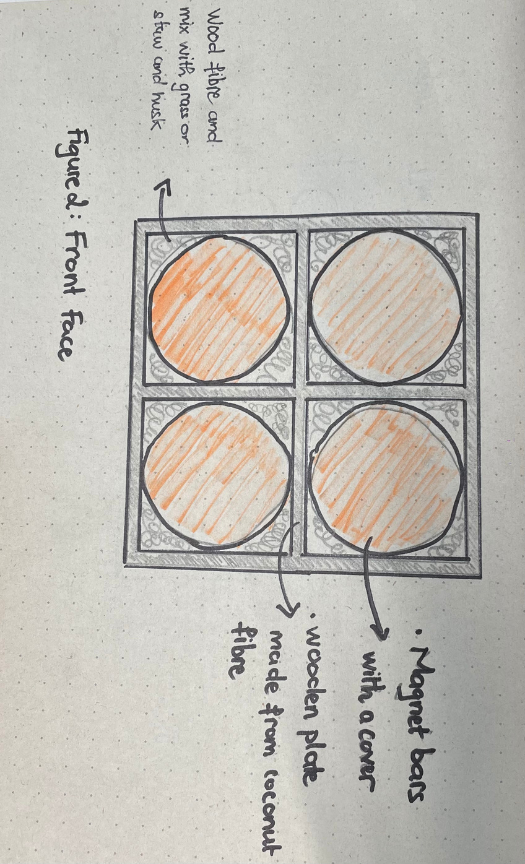
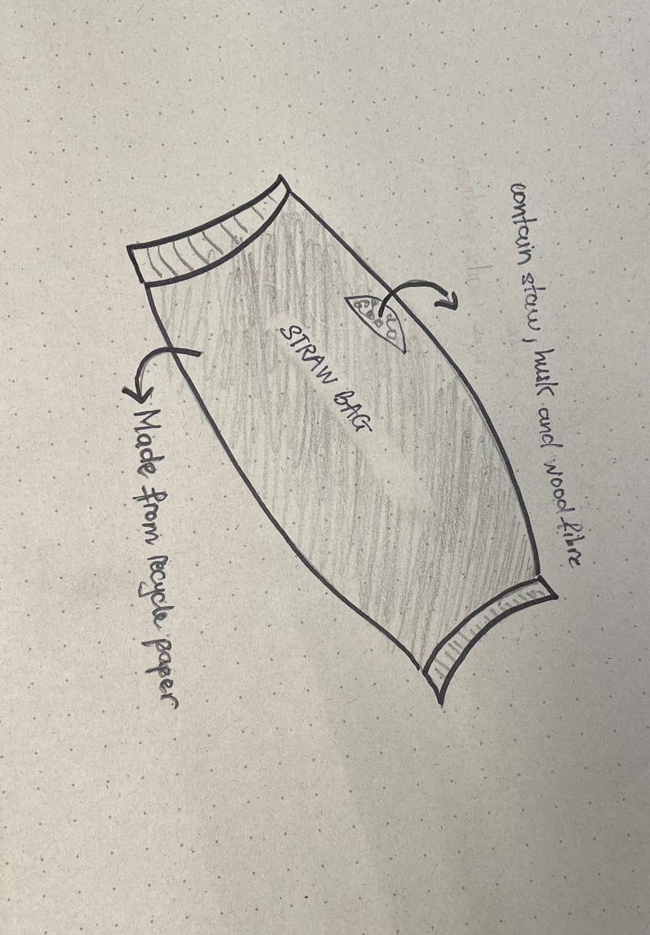
OUR DESIGN
& HOW IT WORKS
Presenter: Nolan - CFO

Slide 18



Our Price Offer
Designing
Packaging Supply
Packaging Supply
1000
per machine
1000
for magnet bar
8000
for the whole machine
$
$
$
Presenter: Nolan - CFO

Slide 19


THANK YOU!

