Slide 1


Behind the Secrets of Large Language Models
Lecture 4
Word embeddings & Tokenization
Simon Razniewski

Slide 2

Acknowledgment/License
Shared under CC BY 4.0 with permission by
  First part based on “Speech and Language Processing” (3rd ed. draft)
  Dan Jurafsky and James H. Martin, Lec. 6, https://web.stanford.edu/~jurafsky/slp3/
  Second part based on „Advanced NLP“, Mohit Iyyer https://people.cs.umass.edu/~miyyer/cs685/

Slide 3
Annoucements
No lecture and lab next week
In the future, labs will also topically shift by a week, based on feedback
  Day N: Lecture N Lab N-1
  Day N+1: Lecture N+1 Lab N
  …

Slide 4
Outline
0. Projects
Word embeddings (60 min)
  Vector semantics
  Words and vectors
  Cosine for computing word similarity
  TF-IDF
  Word2vec
  Word2vec: Learning the embeddings
  Properties of the embeddings
Tokenization (25 min)
  Group work (5 min)

Slide 5
Project timeline
Project period: 16.12.-10.2.
Reports due 10.2.
Peer grading: 17.-23.2.
Presentations: 26.+28.2. all day

Slide 6
Project options
DataComp document selection
SemEval emotion detection
Long list elicitation
Saxon LLM construction

Slide 7
1. DataComp document selection
https://www.datacomp.ai/dclm
LLM architecture and training process is fixed, goal is to identify the best training dataset, from a larger noisy text dataset
(to be covered in detail in lecture 5)
Suggestion: The selection, in turn, could use LLMs
Evaluation: Online leaderboard

Slide 8
2. SemEval Emotion detection
https://github.com/emotion-analysis-project/SemEval2025-Task11
Subtask 11a
Text classification with 5 emotion labels
Train an LLM for the task
Suggestion: Consider auxiliary tasks, synthetic training data generation, or similar enhancements
Evaluation: Online leaderboard

Slide 9
3. Long list elicitation from LLMs
LLMs are trained to give terse answers
Can you make them return all 6,400 species of mammal? All 16k inhabitated islands worldwide? All millions of people born in London? …
Suggestion: Perform systematic prompt tuning, design iterative or recursive prompting schemes, use agent or self-criticism frameworks
Open models or GPT-4o ($100)
Evaluation: Precision and recall w.r.t. Wikidata

Slide 10
4. SäxyLLM: Build an LLM that speaks Saxon²
Sächsisch is sexy, but current open models don’t speak it
Build an LLM that speaks Saxonian by default
Suggestion: Collect training data from web or try synthesizing it with commercial models, consider training objectives and evaluation
Evaluation: TBD (Manual labelling or automated embedding similarity on test tasks)
² Note: „Saxon“ here refers to the German dialect spoken in today‘s state of Saxony https://en.wikipedia.org/wiki/Upper_Saxon_German

Slide 11
Grading
33% performance
33% report
33% presentation
Criteria for report and presentation (all 5 equal weight):
  Discussion of and positioning w.r.t. state of the art
  Novelty of approach
  Technical depth
  Clarity and presentation
  Analysis/discussion
Report template will be provided
(max 8 pages double column ACL style)

Slide 12
Projects
Survey on course webpage
  Non-binding
Kick-off meetings will follow
Questions?

Slide 13
Outline
Word embeddings (60 min)
  Vector semantics
  Words and vectors
  Cosine for computing word similarity
  TF-IDF
  Word2vec
  Word2vec: Learning the embeddings
  Properties of the embeddings
Tokenization (25 min)
  Group work (5 min)

Slide 14
Desiderata for word meaning representation
Concepts or word senses
  Have a complex many-to-many association with words (homonymy, multiple senses)
Have relations with each other
  Synonymy
  Antonymy
  Hyponymy
  Similarity
  Relatedness
  Connotation

Slide 15
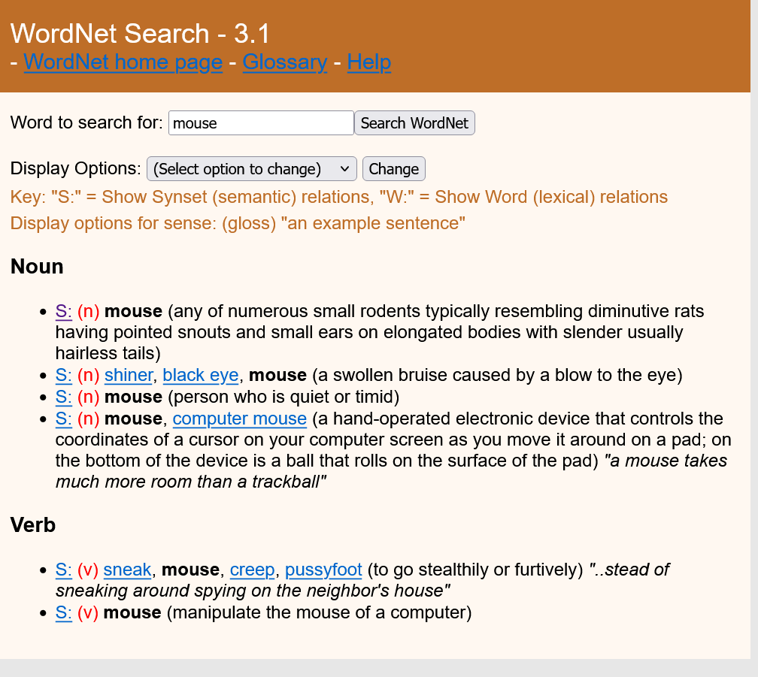
Classic top-down approach:
Word meaning Database
http://wordnetweb.princeton.edu/perl/webwn
  Synonymy
  Antonymy
  Hyponymy
  Similarity
  Relatedness
  Connotation

Slide 16
Computational models of word meaning
Can we build a theory of how to represent word meaning, that accounts for most of the desiderata?
We'll introduce vector semantics
  The standard model in modern language processing!
  Handles many of our goals!

Slide 17
Ludwig Wittgenstein
Wittgenstein:
  "The meaning of a word is its use in the language“
One way to define "usage": words are defined by their environments (the words around them)
Zellig Harris (1954):
  If A and B have almost identical environments we say that they are synonyms.

Slide 18
What does recent English borrowing ongchoi mean?
Suppose you see these sentences:
  Ong choi is delicious sautéed with garlic.
  Ong choi is superb over rice
  Ong choi leaves with salty sauces
And you've also seen these:
  …spinach sautéed with garlic over rice
  Chard stems and leaves are delicious
  Collard greens and other salty leafy greens
Conclusion:
  Ongchoi is a leafy green like spinach, chard, or collard greens
    We could conclude this based on words like "leaves" and "delicious" and "sauteed"

Slide 19
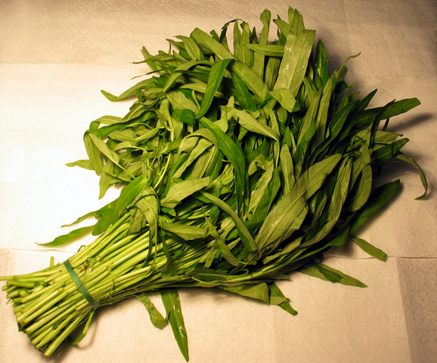
Ongchoi: Ipomoea aquatica "Water Spinach"
空心菜
kangkong
rau muống
Wasserspinat
…

Slide 20
Idea 1:
Defining meaning by linguistic distribution
Let's define the meaning of a word by its distribution in language use, meaning its neighboring words or grammatical environments.

Slide 21
Idea 2:
Meaning as a point in space (Osgood et al. 1957)
3 affective dimensions for a word
  valence: pleasantness
  arousal: intensity of emotion
  dominance: the degree of control exerted
Hence the connotation of a word is a vector in 3-space
 | Word | Score |  | Word | Score
Valence | love | 1.000 |  | toxic | 0.008
 | happy | 1.000 |  | nightmare | 0.005
Arousal | elated | 0.960 |  | mellow | 0.069
 | frenzy | 0.965 |  | napping | 0.046
Dominance | powerful | 0.991 |  | weak | 0.045
 | leadership | 0.983 |  | empty | 0.081
NRC VAD Lexicon
(Mohammad 2018)

Slide 22
Idea 1: Defining meaning by linguistic distribution
Idea 2: Meaning as a point in multidimensional space

Slide 23
Defining meaning as a point in space based on distribution
Each word = a vector (not just "good" or "w₄₅")
Similar words are "nearby in semantic space"
We build this space automatically by seeing which words are nearby in text

Slide 24
We define meaning of a word as a vector
Called an "embedding" for historic reasons
The standard way to represent meaning in NLP
Every modern NLP algorithm uses embeddings as the representation of word meaning
Fine-grained model of meaning for similarity

Slide 25
Intuition: why vectors?
Consider sentiment analysis:
  With words, a feature is a word identity
    Feature 5: 'The previous word was "terrible"'
    requires exact same word to be in training and test
  With embeddings:
    Feature is a word vector
    'The previous word was vector [35,22,17…]
    Now in the test set we might see a similar vector [34,21,14]
    We can generalize to similar but unseen words!!!

Slide 26
We'll discuss 2 kinds of embeddings
tf-idf
  Information Retrieval workhorse!
  A common baseline model
  Sparse vectors
  Words are represented by (a simple function of) the counts of nearby words
Word2vec
  Dense vectors
  Representation is created by training a classifier to predict whether a word is likely to appear nearby
  Later we'll discuss extensions called contextual embeddings

Slide 27
Outline
Word embeddings (60 min)
  Word meaning
  Vector semantics
  Words and vectors
  Cosine for computing word similarity
  TF-IDF
  Word2vec
  Word2vec: Learning the embeddings
  Properties of the embeddings
Tokenization (30 min)

Slide 28
Term-document matrix
Each document is represented by a vector of words
(Shakespeare drama’s)

Slide 29
Visualizing document vectors

Slide 30
Vectors are the basis of information retrieval
Vectors are similar for the two comedies
But comedies are different than the other two
Comedies have more fools and wit and fewer battles.

Slide 31
Idea for word meaning: Words can be vectors too!!!
battle is "the kind of word that occurs in Julius Caesar and Henry V"
fool is "the kind of word that occurs in comedies, especially Twelfth Night"

Slide 32
More common: word-word matrix
(or "term-context matrix")
Two words are similar in meaning if their context vectors are similar

Slide 34
Outline
Word embeddings (60 min)
  Word meaning
  Vector semantics
  Words and vectors
  Cosine for computing word similarity
  TF-IDF
  Word2vec
  Word2vec: Learning the embeddings
  Properties of the embeddings
Tokenization (30 min)

Slide 35
Computing word similarity:
Dot product and cosine
The dot product between two vectors is a scalar:
The dot product tends to be high when the two vectors have large values in the same dimensions
Dot product can thus be a useful similarity metric between vectors

Slide 36
Problem with raw dot-product
Dot product favors long vectors
Dot product is higher if a vector is longer
(has higher values in many dimension)
Vector length:
Frequent words (of, the, you) have long vectors (since they occur many times with other words).
So dot product overly favors frequent words

Slide 37
Alternative: cosine for computing word similarity
Based on the definition of the dot product between two vectors a and b

Slide 38
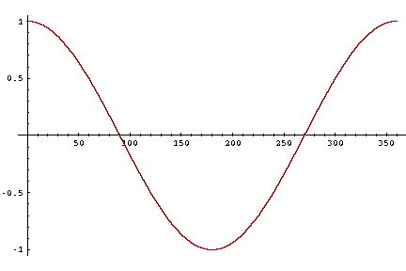
Cosine as a similarity metric
-1: vectors point in opposite directions
+1: vectors point in same directions
0: vectors are orthogonal
But since raw frequency values are non-negative, the cosine for term-term matrix vectors ranges from 0–1

Slide 39
Exercise time
Compute the similarity of V1 to the other vectors:
V1 = (1, 1, 1, 1, 0, 0, 0, 0)
V2 = (1, 1, 1, 1, 0, 0, 0, 0)
V3 = (1, 1, 0, 0, 0, 0, 1, 1)
V4 = (1, 0, 0, 0, 0, 1, 1, 1)
V5 = (0, 0, 0, 0, 1, 1, 1, 1)
V1 = (3, 4)
V2 = (3, 4)
V3 = (4, 3)
V4 = (0, 4)
V5 = (0, 3)

Slide 40
Cosine examples
 | pie | data | computer
cherry | 442 | 8 | 2
digital | 5 | 1683 | 1670
information | 5 | 3982 | 3325
40

Slide 41
Visualizing cosines
(well, angles)

Slide 42
Outline
Word embeddings (60 min)
  Word meaning
  Vector semantics
  Words and vectors
  Cosine for computing word similarity
  TF-IDF
  Word2vec
  Word2vec: Learning the embeddings
  Properties of the embeddings
Tokenization (30 min)

Slide 43
Frequency problem II
Cosine fights one frequency problem: Some words that we want to represent are much more common than others
  Therefore co-occur with other words more often
  Computing raw dot product with such words tends to be large
But there’s another problem with frequencies
  Some words very frequently appear in the context of almost every word
  E.g., the, it, or, they, …
  Correspondingly, embedding vectors of all words would look similar in the largest dimensions

Slide 44

Two common solutions for word weighting
tf-idf: tf-idf value for word t in document d:
PMI: (Pointwise mutual information)
  $\text{PMI}\left(w_{1},w_{2}\right)=log\frac{p(w_{1},w_{2})}{p\left(w_{1}\right)p(w_{2})}$
Words like "the" or "it" have very low idf
See if words like "good" appear more often with "great" than we would expect by chance

Slide 45
Term frequency (tf) in the tf-idf algorithm
We could imagine using raw count:
tf_{t,d} = count(t,d)
But instead of using raw count, we usually squash a bit:

Slide 46
Document frequency (df)
df_{t} is the number of documents t occurs in.
(note this is not collection frequency: total count across all documents)
"Romeo" is very distinctive for one Shakespeare play:

Slide 47
Inverse document frequency (idf)
N is the total number of documents
in the collection

Slide 48
What is a document?
Could be a play or a Wikipedia article
But for the purposes of tf-idf, documents can be anything; we often call each paragraph a document!

Slide 49
Final tf-idf weighted value for a word
Raw counts:
tf-idf:

Slide 50
Outline
Word embeddings (60 min)
  Word meaning
  Vector semantics
  Words and vectors
  Cosine for computing word similarity
  TF-IDF
  Word2vec
  Word2vec: Learning the embeddings
  Properties of the embeddings
Tokenization (30 min)

Slide 51
Sparse versus dense vectors
tf-idf (or PMI) vectors are
  long (length |V|= 20,000 to 50,000)
  sparse (most elements are zero)
Alternative: learn vectors which are
  short (length 50-1000)
  dense (most elements are non-zero)

Slide 52
Sparse versus dense vectors
Why dense vectors?
  Short vectors may be easier to use as features in machine learning (fewer weights to tune)
  Dense vectors may generalize better than explicit counts
  Dense vectors may do better at capturing synonymy:
    car and automobile are synonyms; but sparse dimensions usually fail to capture this
  In practice, they work better

Slide 53
Common methods for getting short dense vectors
“Neural Language Model”-inspired models
  Word2vec (skipgram, CBOW), GloVe
Singular Value Decomposition (SVD)
  A special case of this is called LSA – Latent Semantic Analysis
Alternative to these "static embeddings": Contextual Embeddings (ELMo, BERT)
  Compute distinct embeddings for a word in its context
  Separate embeddings for each token of a word
  Future lectures…

Slide 54
Simple static embeddings you can download!
Word2vec (Mikolov et al)
https://code.google.com/archive/p/word2vec/
GloVe (Pennington, Socher, Manning)
http://nlp.stanford.edu/projects/glove/

Slide 55
Word2vec
Popular embedding method
Very fast to train
Code available on the web
Idea: predict rather than count
Word2vec provides various options. We'll do:
skip-gram with negative sampling (SGNS)

Slide 56
Word2vec
Instead of counting how often each word w occurs near "apricot"
  Train a classifier on a binary prediction task:
    Is w likely to show up near "apricot"?
We don’t actually care about this task
    But we'll take the learned classifier weights as the word embeddings
Big idea: self-supervision:
    A word c that occurs near apricot in the corpus counts as the gold "correct answer" for supervised learning
    No need for human labels
    Bengio et al. (2003); Collobert et al. (2011)

Slide 57
Approach: predict if candidate word c is a "neighbor"
Treat the target word t and a neighboring context word c as positive examples.
Randomly sample other words in the lexicon to get negative examples
Use logistic regression to train a classifier to distinguish those two cases
Use the learned weights as the embeddings

Slide 58
Skip-Gram Training Data
Assume a +/- 2 word window, given training sentence:
  …lemon, a [tablespoon of apricot jam, a] pinch…
c1 c2 c3 c4
[target]

Slide 59
Skip-Gram Classifier
(assuming a +/- 2 word window)
  …lemon, a [tablespoon of apricot jam, a] pinch…
c1 c2 [target] c3 c4
Goal: train a classifier that is given a candidate (word, context) pair
(apricot, jam)
(apricot, aardvark)
…
And assigns each pair a probability:
P(+|w, c)
P(−|w, c) = 1 − P(+|w, c)

Slide 60
Similarity is computed from dot product
Remember: two vectors are similar if they have a high dot product
  Cosine is just a normalized dot product
So:
  Similarity(w,c) ∝ w ∙ c
We’ll need to normalize to get a probability
  (cosine isn't a probability either)

Slide 61
Turning dot products into probabilities
Sim(w,c) ≈ w ∙ c
To turn this into a probability
We'll use the sigmoid from logistic regression:

Slide 62
How Skip-Gram Classifier computes P(+|w, c)
This is for one context word, but we can have lots of context words.
We'll assume independence and just multiply them:

Slide 63
Skip-gram classifier: summary
A probabilistic classifier, given
  a test target word w
  its context window of L words c_{1:L}
Estimates probability that w occurs in this window based on similarity of w (embeddings) to c_{1:L} (embeddings).
To compute this, we just need embeddings for all the words.

Slide 64
These embeddings we'll need: a set for w, a set for c

Slide 65
Outline
Word embeddings (60 min)
  Word meaning
  Vector semantics
  Words and vectors
  Cosine for computing word similarity
  TF-IDF
  Word2vec
  Word2vec: Learning the embeddings
  Properties of the embeddings
Tokenization (30 min)

Slide 66
Skip-Gram Training data
  …lemon, a [tablespoon of apricot jam, a] pinch…
c1 c2 [target] c3 c4
For each positive example we'll grab k negative examples, sampling by frequency

Slide 67
Skip-Gram Training data
  …lemon, a [tablespoon of apricot jam, a] pinch…
c1 c2 [target] c3 c4

Slide 68
Word2vec: how to learn vectors
Given the set of positive and negative training instances, and an initial set of embedding vectors
The goal of learning is to adjust those word vectors such that we:
  Maximize the similarity of the target word, context word pairs (w , c_{pos}) drawn from the positive data
  Minimize the similarity of the (w , c_{neg}) pairs drawn from the negative data.

Slide 69
Loss function for one w with c_{pos} , c_{neg1} ...c_{negk}
Maximize the similarity of the target with the actual context words, and minimize the similarity of the target with the k negative sampled non-neighbor words.

Slide 70
Learning the classifier
How to learn?
  Stochastic gradient descent!
We’ll adjust the word weights to
  make the positive pairs more likely
  and the negative pairs less likely,
  over the entire training set.

Slide 71
Intuition of one step of gradient descent

Slide 72
Two sets of embeddings
SGNS learns two sets of embeddings
Target embeddings matrix W
Context embedding matrix C
It's common to just add them together, representing word i as the vector w_{i} + c_{i}

Slide 73
Summary: How to learn word2vec (skip-gram) embeddings
Start with V random d-dimensional vectors as initial embeddings
Train a classifier based on embedding similarity
  Take a corpus and take pairs of words that co-occur as positive examples
  Take pairs of words that don't co-occur as negative examples
  Train the classifier to distinguish these by slowly adjusting all the embeddings to improve the classifier performance
  Throw away the classifier code and keep the embeddings.

Slide 74
Outline
Word embeddings (60 min)
  Word meaning
  Vector semantics
  Words and vectors
  Cosine for computing word similarity
  TF-IDF
  Word2vec
  Word2vec: Learning the embeddings
  Properties of the embeddings
Tokenization (30 min)

Slide 75
The kinds of neighbors depend on window size
Small windows (C= +/- 2): nearest words are syntactically similar words in same taxonomy
  Hogwarts nearest neighbors are other fictional schools
    Sunnydale, Evernight, Blandings
Large windows (C= +/- 5): nearest words are related words in same semantic field
  Hogwarts nearest neighbors are Harry Potter world:
    Dumbledore, half-blood, Malfoy

Slide 76
Analogical relations
The classic parallelogram model of analogical reasoning (Rumelhart and Abrahamson 1973)
To solve: "apple is to tree as grape is to _____"
Add tree – apple to grape to get vine

Slide 77
Analogical relations via parallelogram
The parallelogram method can solve analogies with both sparse and dense embeddings (Turney and Littman 2005, Mikolov et al. 2013b)
king – man + woman is close to queen
Paris – France + Italy is close to Rome
For a problem a:a*::b:b*, the parallelogram method is:
argmin

Slide 78
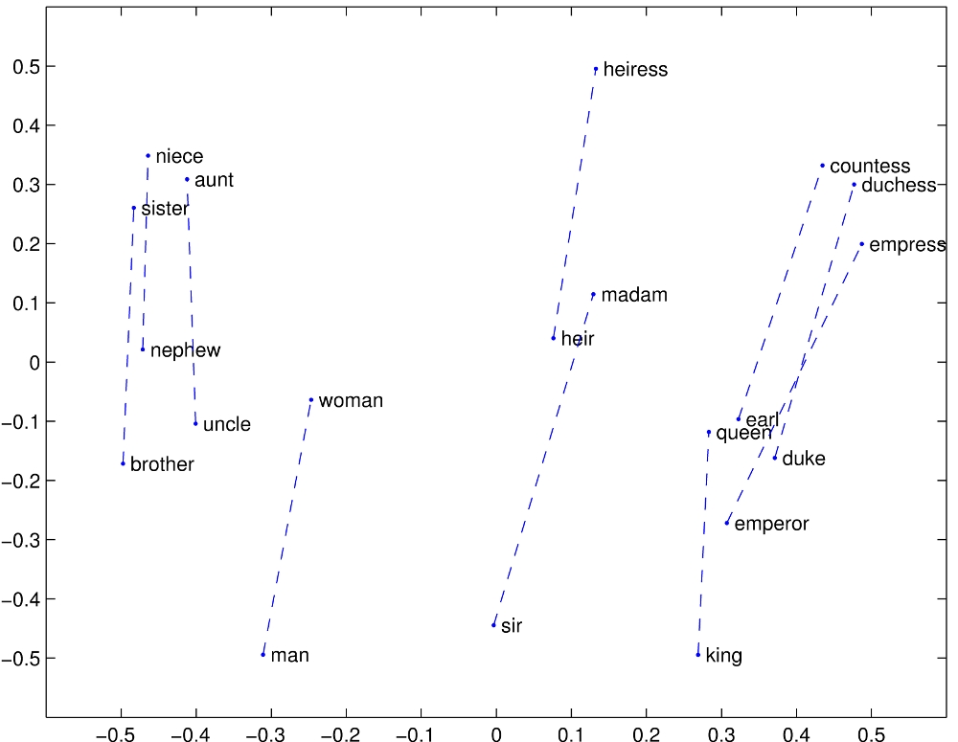
Structure in GloVE Embedding space

Slide 79
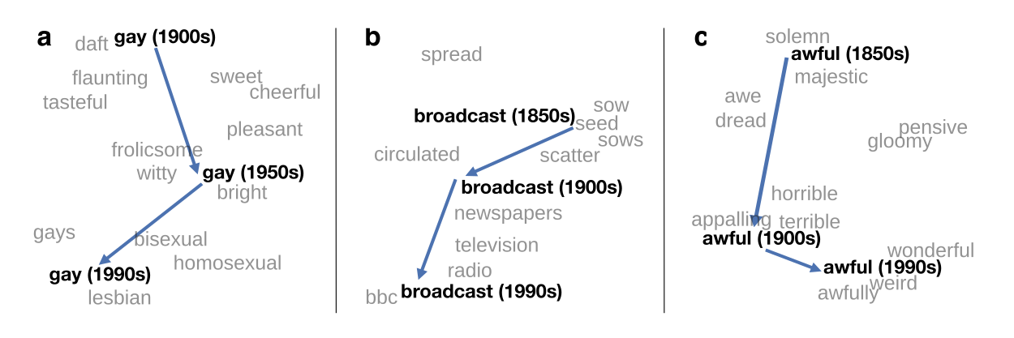
Embeddings as a window onto historical semantics
Train embeddings on different decades of historical text to see meanings shift
~30 million books, 1850-1990, Google Books data
William L. Hamilton, Jure Leskovec, and Dan Jurafsky. 2016. Diachronic Word Embeddings Reveal Statistical Laws of Semantic Change. Proceedings of ACL.

Slide 80
Embeddings reflect cultural bias!
Bolukbasi, Tolga, Kai-Wei Chang, James Y. Zou, Venkatesh Saligrama, and Adam T. Kalai. "Man is to computer programmer as woman is to homemaker? debiasing word embeddings." In NeurIPS, pp. 4349-4357. 2016.
Ask “Paris : France :: Tokyo : x”
  x = Japan
Ask “father : doctor :: mother : x”
  x = nurse
Ask “man : computer programmer :: woman : x”
  x = homemaker
Algorithms that use embeddings as part of e.g., hiring searches for programmers, might lead to bias in hiring

Slide 81
Word2Vec demo
http://epsilon-it.utu.fi/wv_demo/

Slide 82
Outline
Word embeddings (60 min)
  Word meaning
  Vector semantics
  Words and vectors
  Cosine for computing word similarity
  TF-IDF
  Word2vec
  Word2vec: Learning the embeddings
  Properties of the embeddings
Tokenization (25 min)
  Group work (5 min)

Slide 83
Tokenization
We’ve seen idea of embeddings, but what actually do we embed?
Every word?
Input text: students opened their books Input token IDs: 11 298 34 567
This tokenization step requires an external
tokenizer to detect word boundaries!

Slide 84
Problem 1: Tokenization is not simple
Not just a split on whitespace and punctuation…
Mr. O'Neill thinks that the boys' stories about San Francisco aren't amusing.
Word tokenizers require lots of specialized rules about how to handle specific inputs
  Check out spaCy’s tokenizers! (https://spacy.io/)

Slide 85
Problem 2: Unknown words
What happens when we encounter a word at test time that we’ve never seen in our training data?
  With word level tokenization, we have no way of assigning an index to an unseen word!
  This means we don’t have a word embedding for that word and thus cannot process the input sequence
Workaround: replace low-frequency words in training data with a special <UNK> token, use this token to handle unseen words at test time too
  Why use <UNK> tokens during training?

Slide 86
Limitations of <UNK>
We lose lots of information about texts with a lot of rare words / entities
The chapel is sometimes referred to as "Hen Gapel Lligwy" ("hen" being the Welsh word for "old" and "capel" meaning "chapel").
The chapel is sometimes referred to as " Hen <unk> <unk> " (" hen " being the Welsh word for "old " and "<unk> " meaning " chapel ").

Slide 87
Problem 3: Sparsity
Word-level tokenization treats different forms of the same word (e.g., “open”, “opened”, “opens”, “opening”, etc) as separate types —> separate embeddings for each
This can be problematic especially when training over smaller datasets, why?

Slide 88
An alternative: character tokenization
Small vocabulary, just the number of unique characters in the training data!
However, you pay for this with longer input sequences.
Look forward: Why would this be a problem for LLMs?

Slide 89
2016: subword tokenization
Developed for machine translation by Sennrich et al.,
ACL 2016
“The main motivation behind this paper is that the translation of some words is transparent in that they are translatable by a competent translator even if they are novel to him or her, based on a translation of known subword units such as morphemes or phonemes.”
Later used in BERT, T5, RoBERTa, GPT, etc.
Relies on a simple algorithm called byte pair encoding (Gage, 1994)

Slide 90
Byte pair encoding
Form base vocabulary
(all characters that occur in the training data)
word | frequency
hug | 10
pug | 5
pun | 12
bun | 4
hugs | 5
Base vocab: b, g, h, n, p, s, u
Example from https://huggingface.co/transformers/tokenizer_summary.html

Slide 91
Byte pair encoding
Now, count up the frequency of each character pair in the data, and choose the one that occurs most frequently
word | frequency |  | character pair | frequency
h+u+g | 10 |  | u+g | 20
p+u+g | 5 |  | p+u | 17
p+u+n | 12 |  | u+n | 16
b+u+n | 4 |  | h+u | 15
h+u+g+s | 5 |  | g+s | 5
 |  |  | …
Example from https://huggingface.co/transformers/tokenizer_summary.html

Slide 92
Byte pair encoding
Now, choose the most common pair (ug) and then merge the characters together into one symbol. Add this new symbol to the vocabulary.
New vocab: b, g, h, n, p, s, u, ug
Then, retokenize the data
word | frequency |  | character pair | frequency
h+ug | 10 |  | u+n | 16
p+ug | 5 |  | h+ug | 15
p+u+n | 12 |  | p+u | 12
b+u+n | 4 |  | p+ug | 5
h+ug+s | 5 |  | ug+s | 5
Example from https://huggingface.co/transformers/tokenizer_summary.html

Slide 93
Byte pair encoding
Keep repeating this process! This time we choose un to merge
New vocab: b, g, h, n, p, s, u, ug, un
Next time we choose h+ug, etc.
word | frequency |  | character pair | frequency
h+ug | 10 |  | h+ug | 15
p+ug | 5 |  | p+u | 12
p+un | 12 |  | p+ug | 5
b+un | 4 |  | ug+s | 5
h+ug+s | 5 |  | …
Example from https://huggingface.co/transformers/tokenizer_summary.html

Slide 94
Byte pair encoding
Eventually, after a fixed number of merge steps, we stop
Final vocab: b, g, h, n, p, s, u, ug, un, hug
Example from https://huggingface.co/transformers/tokenizer_summary.html

Slide 95
Byte pair encoding
Space is commonly just treated like any other character
To avoid <UNK>, all possible characters / symbols need to be included in the base vocab. This can be a lot if including all unicode characters (there are ~138K unicode symbols)!
GPT-2 uses bytes as the base vocabulary (size 256) and then applies BPE on top of this sequence (with some rules to prevent certain types of merges).
Commonly have vocabulary sizes of 32K to 64K

Slide 96
Other subword encoding schemes
WordPiece (Schuster et al., ICASSP 2012): merge by likelihood as measured by language model, not by frequency
SentencePiece (Kudo et al., 2018): can do subword tokenization without pretokenization (good for languages that don’t always separate words w/ spaces), although pretokenization usually improves performance
Tokenizer matters, especially for multilingual models
[Tokenizer Choice For LLM Training: Negligible or Crucial? Ali et al., 2024]

Slide 97
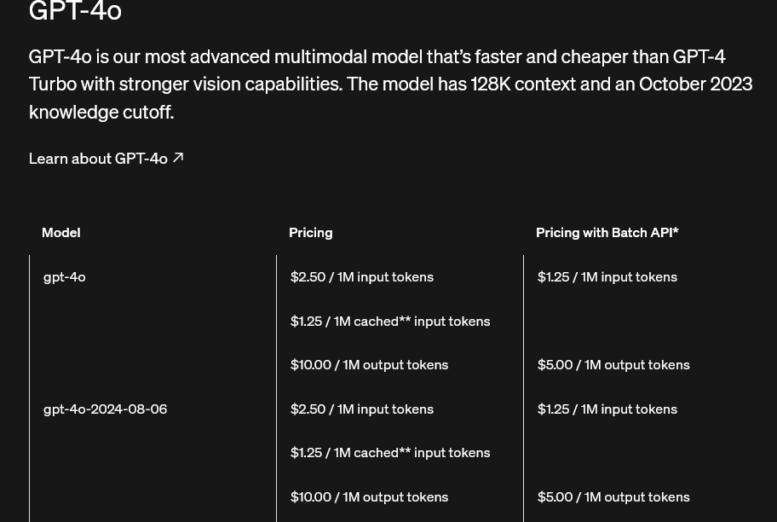
Tokens and LLMs
Tokens are the staple of LLMs, input and charging unit
OpenAI Rule of thumb: one token = ca. 4 characters of text for English text. This translates to roughly ¾ of a word (so 100 tokens ~= 75 words).

Slide 98
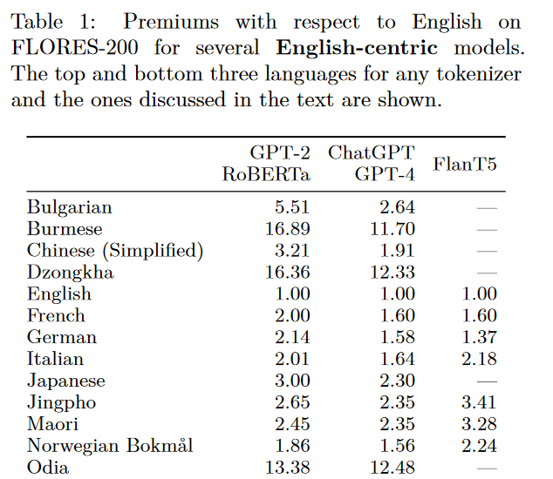
[Language Model Tokenizers Introduce Unfairness Between Languages]

Slide 99
Demo: OpenAI Tokenizer
https://platform.openai.com/tokenizer

Slide 100
Outline
Word embeddings (60 min)
  Word meaning
  Vector semantics
  Words and vectors
  Cosine for computing word similarity
  TF-IDF
  Word2vec
  Word2vec: Learning the embeddings
  Properties of the embeddings
Tokenization (25 min)
  Group work (5 min)

Slide 101
Group work
Discuss the following questions with your neighbor:
  What is meant by sparse vs. dense embeddings?
  What are advantages of either?
  What is normalization by vector length, versus by IDF? Why do both matter?
  Why do we need dedicated tokenizers?
  Why not just split at word borders?

Slide 102
Take home – Lecture 4
Vector space model as foundation of meaning representation
Popular static embedding model: Word2Vec
  We will later learn about contextual embedding models like BERT
Tokenization of text using byte-pair-encoding algorithm
Lab today:
  Select your own corpus
  Build a tokenizer
  Build word embeddings
  Discover analogies

