Slide 1


Behind the Secrets of Large Language Models
Lecture 5
Collecting LLM training data
Simon Razniewski

Slide 2

Acknowledgment/License
Shared under CC BY 4.0 with permission and based on slides by Malte Ostendorff, IDESSAI 2024 summer school

Slide 3
Matrix channel for lecture
https://matrix.to/#/#secretllm:tu-dresden.de

Slide 4

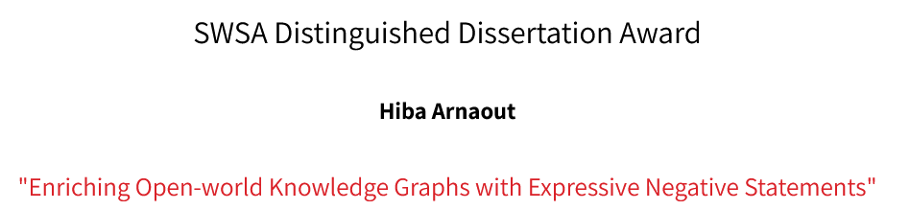


Tales from the road
https://iswc2024.semanticweb.org/
https://lm-kbc.github.io/workshop2024/

Slide 5
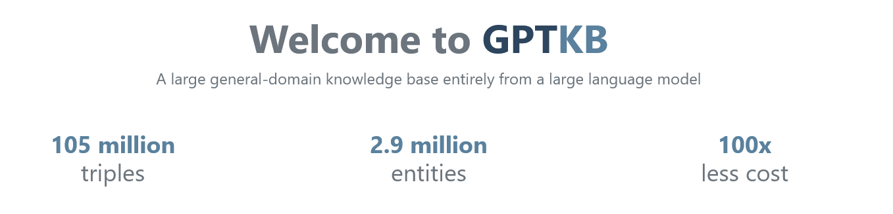
Research advertisement
https://arxiv.org/abs/2411.04920
https://gptkb.org
Related: Project 3

Slide 6
Outline
Importance of data
Unsupervised pre-training (50 min)
Crawling
Scraping and Cleaning
Datasets
Supervised Instruction and answer fine-tuning (30 min)
Crowdsourcing
Synthetic data & data augmentation
Discussion (10 min)
Group work

Slide 7
Recap: Lecture so far
L2: Neural networks
L3: Deep learning
L4: Word representation
Language models are statistical models that learn a probability distribution over a sequence of words from their training data and that predict the next token with the highest probability for a given input text.
What do we learn from?
→ Data!
5

Slide 8
LLMs and data?

Slide 9
Data matters!
"We find that data quality is critical to a highly-performing model”
(Google Gemini technical report, 2023)
“Data curation was the most important work for building Grok”
(Elon Musk at the Lex Friedman Podcast, 2023)

Slide 10













Training data
Stage 1: Unsupervised Pretraining
Large amounts of plain text (Llama3: 15 trillion tokens)
Diverse sources and topics (scientific literature, news, forums)
Most prominent source: Web crawled text (CommonCrawl)
Stage 2: Supervised Instruction Fine-tuning
Supervised text pairs (input-output, question-answer, text-summary)
Task-oriented data (diverse tasks are needed to generalize to unseen tasks)
Stage 3: Alignment C preference-tuning
Human (or AI) feedback data on preferred output (style and format)
Pairwise feedback (good vs bad)
Listwise feedback (ranking)
Less public sources
8

Slide 11
Outline
Importance of data
Unsupervised pre-training
Crawling
Scraping and Cleaning
Datasets
Supervised Instruction and answer fine-tuning
Crowdsourcing
Synthetic data & data augmentation
Conclusion
Group work

Slide 12
A language model is a probability distribution over sequences of words.
Next word Given words
P ( X_{t+1} = x_{t+1} | x₁ , …, x_{t} )

Slide 13
Learning from text
Context
Next prediction
Alice.txt downloaded from web
Alice | painted | her | car | on | Saturday | .
painted | her | car | on | Saturday | . | She
her | car | on | Saturday | . | She | has
car | on | Saturday | . | She | has | a
on | Saturday | . | She | has | a | VW
Saturday | . | She | has | a | VW | Beetle
LLM’s internal processing window
Alice painted her car on Saturday. She has a VW Beetle, which she decided to coat in a vibrant, sunny yellow. It now stands out beautifully as she drives through town, turning heads and drawing smiles everywhere she goes.
Steps
The context shifts by one token to the right
The earliest token in the context is deleted
A new token is predicted.
In the next step, output of the last step becomes the latest entry in the context window
This data comes from the web. Thus we don’t need to label it explicitly.
Hence self-supervised

Slide 14
What data for unsupervised pretraining?
Major LLMs:
GPT2 (2019): 40 GB of Web text (from outbound Reddit links)
BERT (2019): BooksCorpus (800M words) and Wikipedia (2,500M words)
GPT3 (2020): 570GB of Web text after filtering, roughly equivalent to 400
billion byte-pair-encoded tokens, Books1, Books2, Wikipedia
GPT-Neox / The Pile (2020): 800GB text from Web, academic text, news,
Wikipedia, subtitles, books, laws, programming code.
Bloom / Roots (2022): 1.6TB of text from various sources (mostly Web text)
→ Underlying skills: crawling, scraping, filtering!

Slide 15
Outline
Importance of data
Unsupervised pre-training
Crawling
Scraping and cleaning
Datasets
Supervised instruction fine-tuning
Crowdsourcing
Synthetic data & data augmentation
Conclusion
Group work

Slide 16
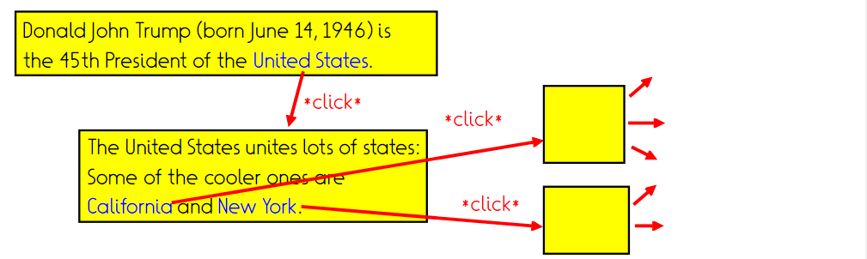
Crawling: Task
Given: One or several source URLs
Return: Document corpus obtained by transitive hyperlink closure (bounded)

Slide 17
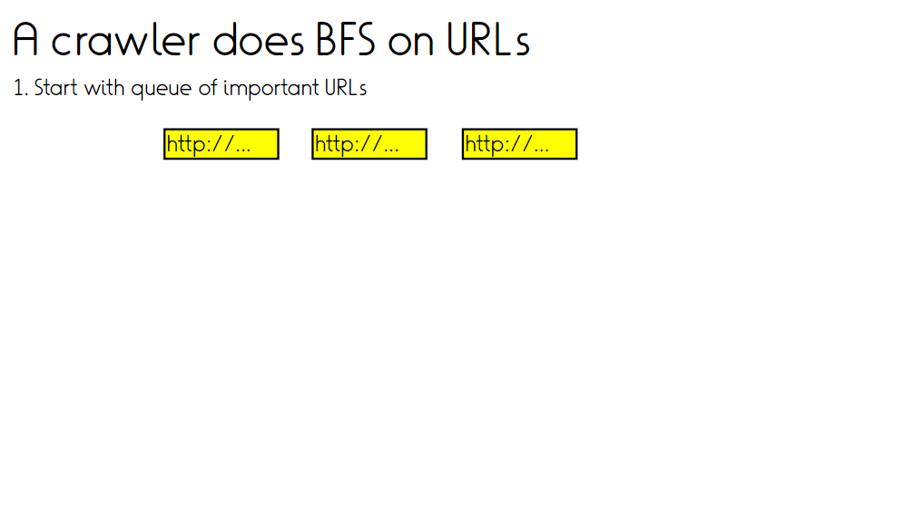

Slide 18
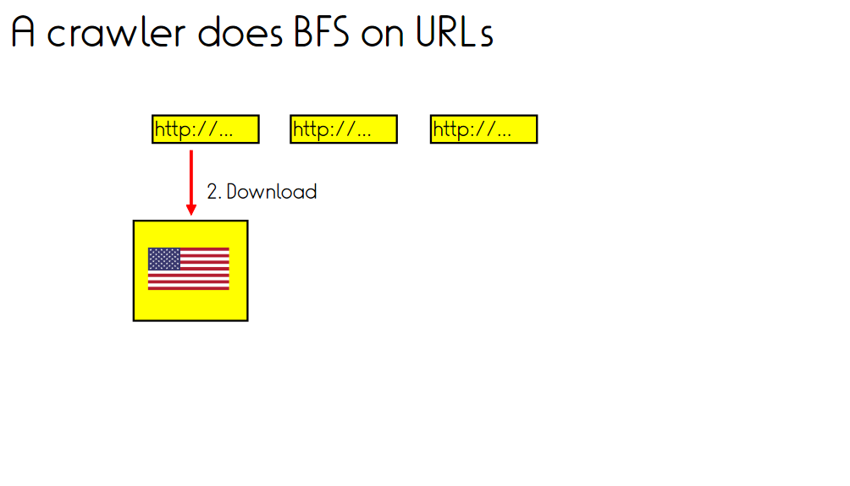

Slide 19
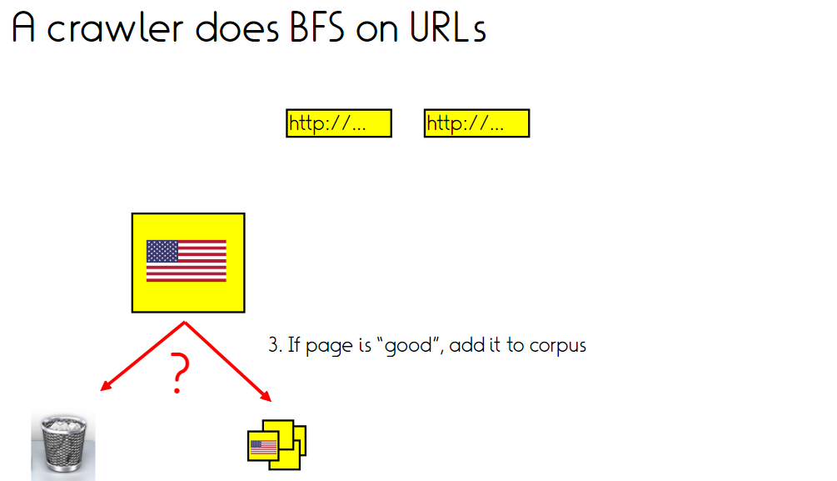

Slide 20
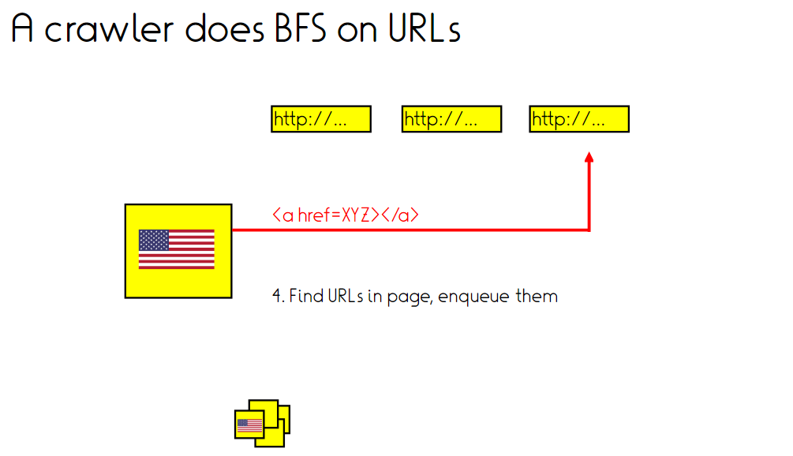

Slide 21
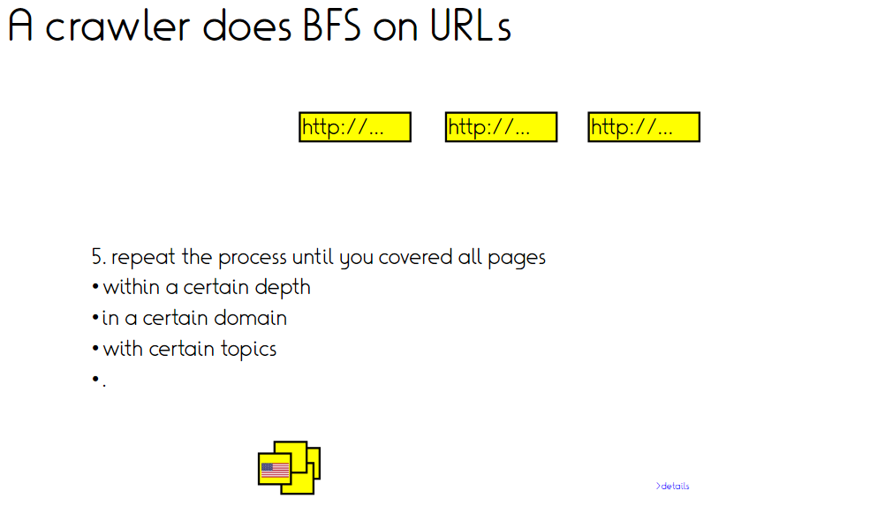

Slide 22
Crawling: The fine print
How to find hyperlinks?
How to decide when to revisit/how often to revisit?
Denial of service
Captchas
Deep web
Existing crawl corpora

Slide 23
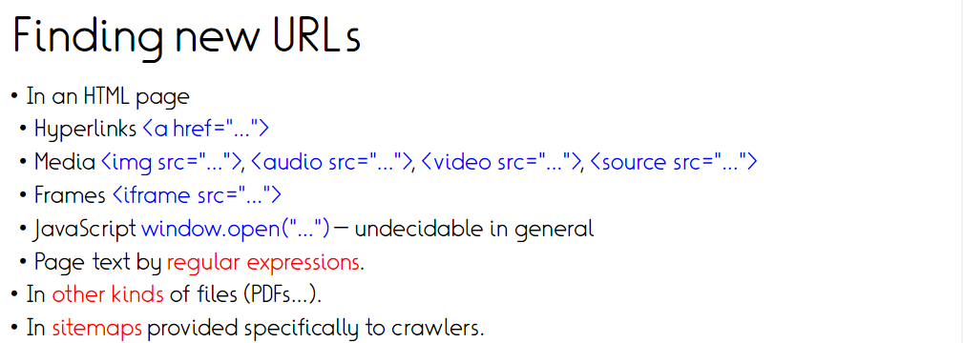

Slide 24
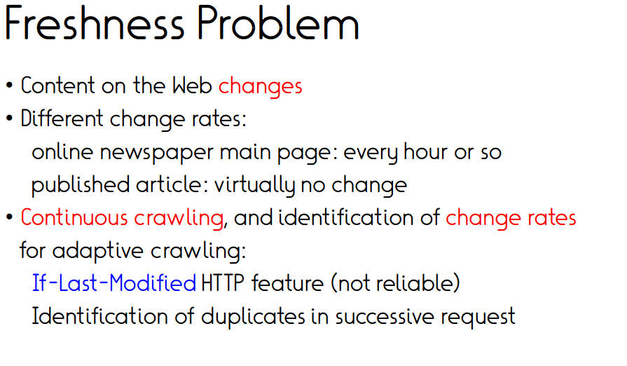

Firefox: Developer tools/Network/Response header
https://scads.ai/
Let’s try!

Slide 25
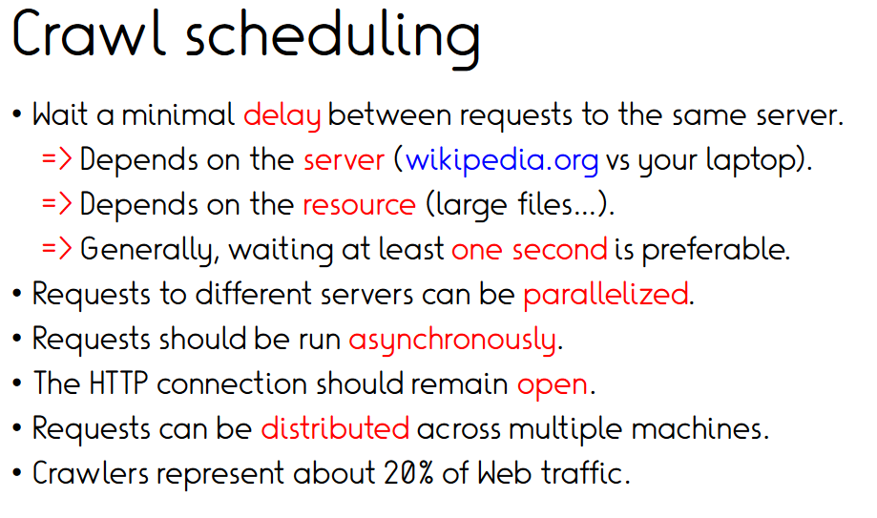

Slide 26
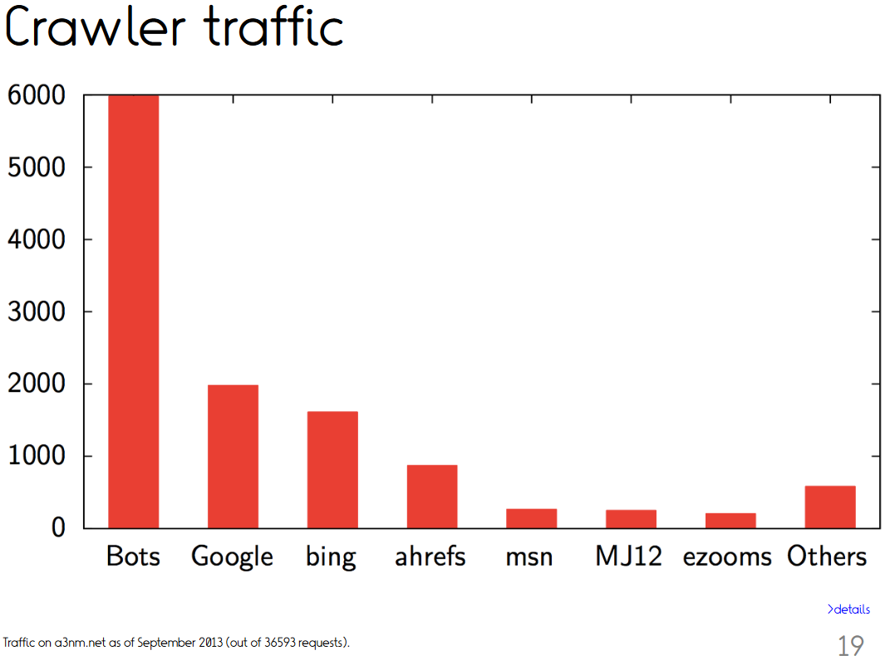
Crawler traffic
[Yuan et al., CCN 2002]
“We estimate that approximately 40% of Internet traffic is due to Web crawlers”
Almost half of all internet traffic comes from bots. For the fifth consecutive year in a row this figure has been on the rise. [2024 Imperva Bad Bot Report]

Slide 27
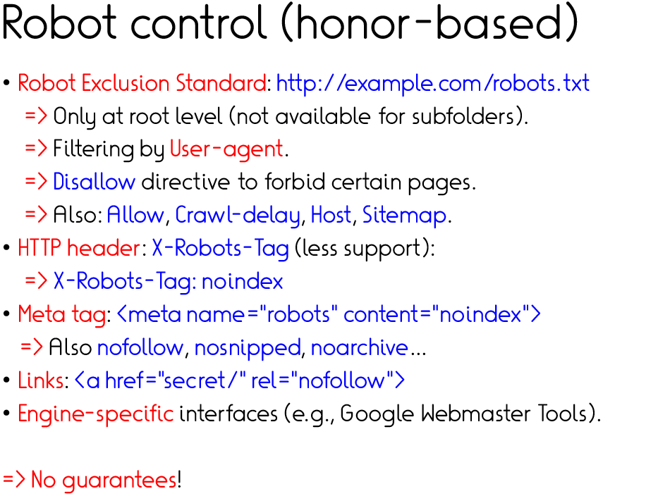
https://tu-dresden.de/robots.txt
https://www.google.de/robots.txt

Slide 28
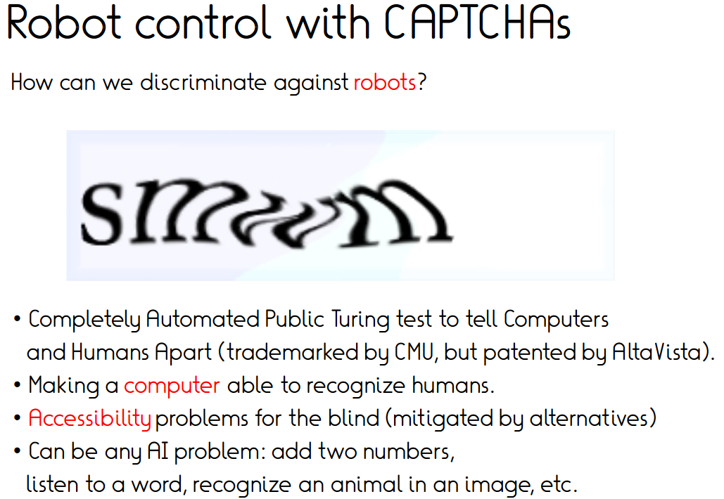

Slide 29
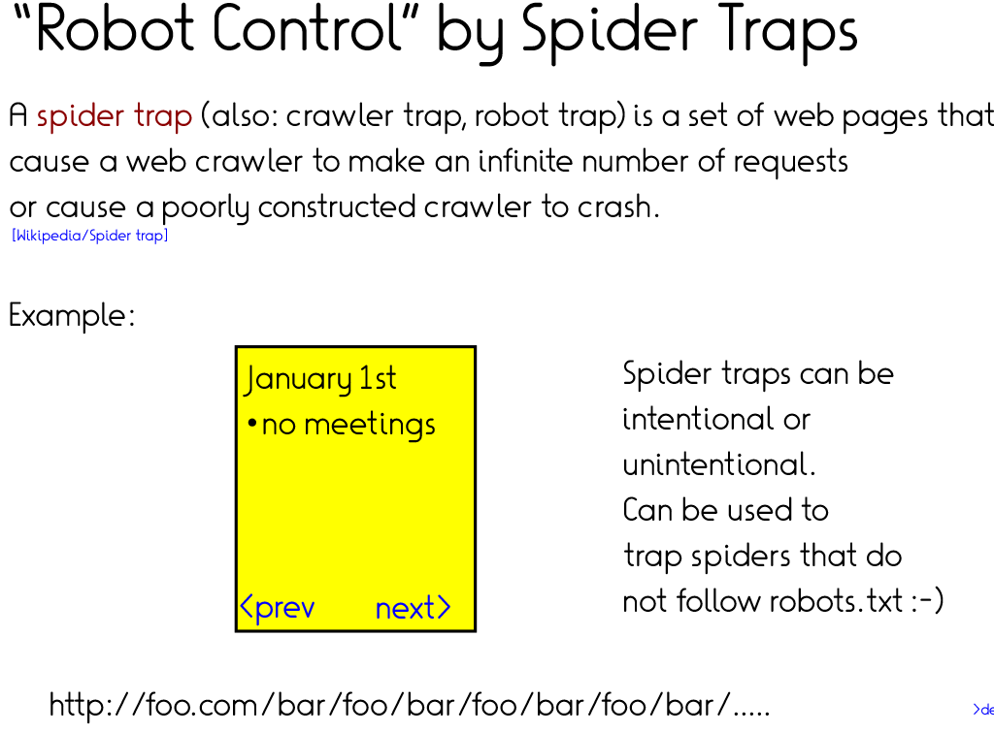

Slide 30
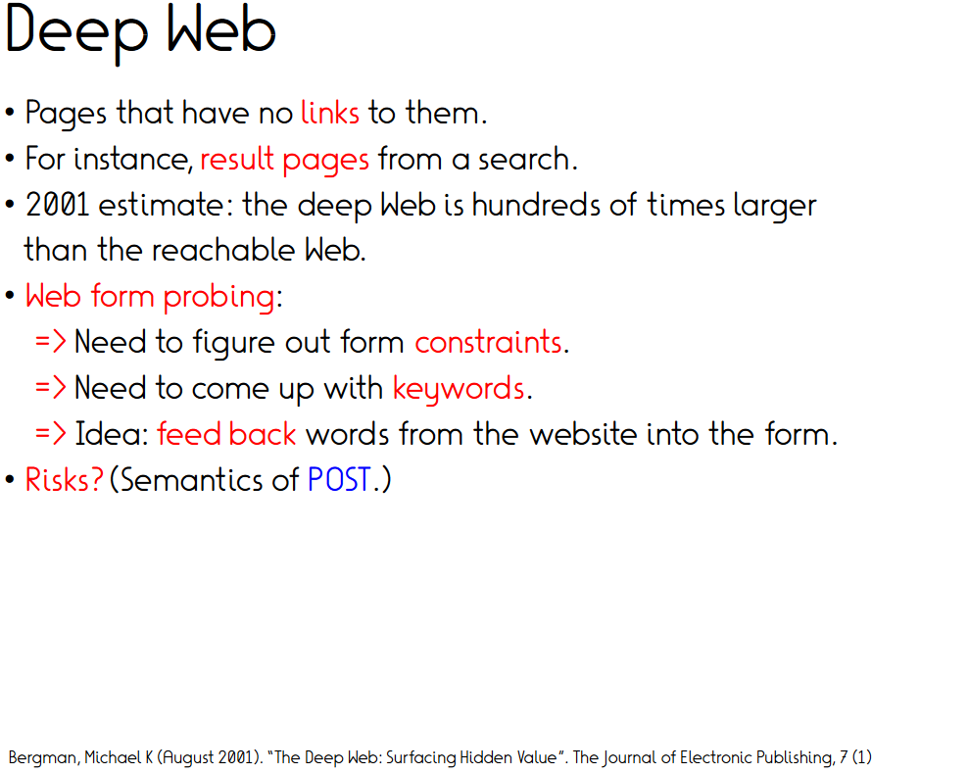
Deep web / dark web

Slide 31
Insights from crawling mpi-inf.mpg.de
URL ending inclusion/exclusion criteria need thought
Long (machine-generated URLs) need exclusion
Beyond that no issues
35 lines in Python
Sequential runtime for 2000 pages: ~10 minutes
Completeness?

Slide 32
Outline
Importance of data
Unsupervised pre-training
Crawling
Scraping and cleaning
Datasets
Supervised instruction fine-tuning
Crowdsourcing
Synthetic data & data augmentation
Conclusion
Group work

Slide 33
Regex
Web data is ugly
Extensive cleaning needed
Remove code, retain content (+structure?)
<div class="wp-block-columns container pt-8 is-layout-flex wp-container-core-columns-is-layout-1 wp-block-columns-is-layout-flex">
<div class="wp-block-column is-layout-flow wp-block-column-is-layout-flow">
<h2 class="wp-block-heading">ScaDS.AI Dresden/Leipzig</h2>
<p class="pr-8">ScaDS.AI (Center for Scalable Data Analytics and Artificial Intelligence) and Big Da
<div class="colored-link"><a href="https://scads.ai/about-us" class="default">Learn more</a></div><br></div>
<div class="wp-block-column is-layout-flow wp-block-column-is-layout-flow">
<figure class="wp-block-image"><img loading="lazy" decoding="async" width="1440" ds/GA_Leipzig_2023. 2
</div>
</div>

Slide 34
Regex to the rescue
Regular expression (regex) are sequences of characters that specifies a match pattern in text.
Usually used by string-searching algorithms for "find" or "find and replace" operations on strings
Stem from theoretical computer science and formal language theory.

Slide 35
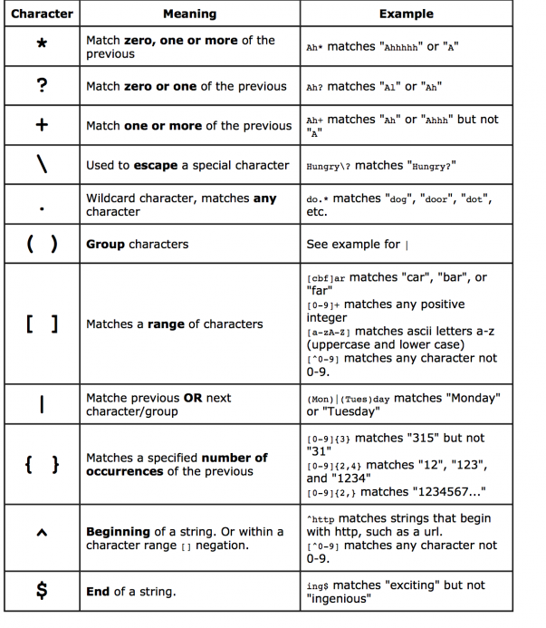
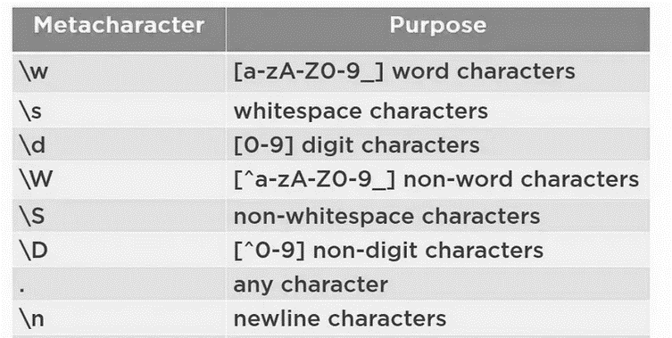
Regex cheatsheet

Slide 36
Regex tasks
Write a regex to find all HTML tags (<….>)
<[^>]*>
Write a regex to find all hyperlink texts (content between <a href …> XYZ </a>
<a\s+href="[^"]*">(.*?)<\/a>
Write a regex to match all URLs
https?://(?:www\.)?[a-zA-Z0-9-]+\.[a-zA-Z]{2,}(?:/[^\s]*)?
https://regex101.com/

Slide 37
BeautifulSoup + Selenium
BeautifulSoup
Python HTML/XML Parsing Library: Great for static pages; works with requests.
Lightweight & Fast: Quickly extracts tags, attributes, and text.
Selenium
Browser Automation: Controls real browsers to interact with dynamic pages.
Handles JavaScript: Ideal for sites with interactive elements.
Slower but Versatile: Suitable for complex websites, supports running without rendering (headless mode).

Slide 38
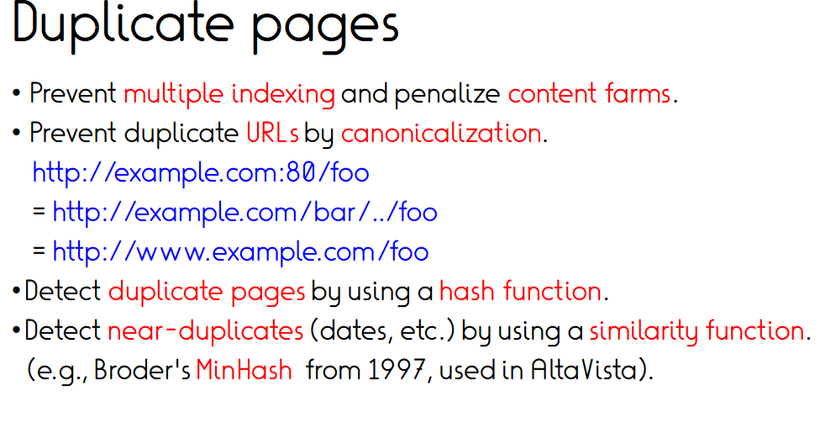

Slide 39
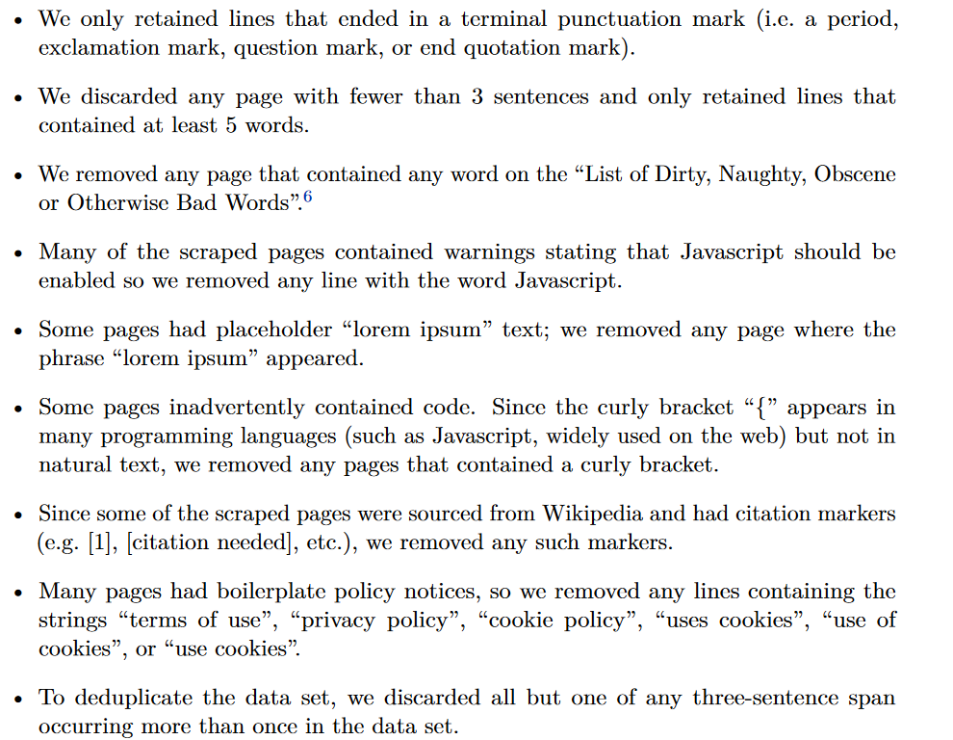
Data cleaning in C4
[Exploring the Limits of Transfer Learning with a Unified Text-to-Text Transformer, 2020]

Slide 40
Badword filter
https://github.com/LDNOOBW/List-of-Dirty-Naughty-Obscene-and-Otherwise-Bad-Words
[Dodge, Jesse et al. “Documenting Large Webtext Corpora: A Case Study on the Colossal Clean Crawled Corpus.” EMNLP’21]
“We provide some of the first documentation for the C4 corpus. We begin by investigating where the data came from, and find a significant amount of text from unexpected sources like patents and US military websites.
To understand the impact of the filters applied to create this dataset, we evaluate the text that was removed, and show that blocklist filtering disproportionately removes text from and about minority individuals.”

Slide 41



OSCAR: Multilingual Web Data
The OSCAR project is an Open Source project aiming to provide web-based
multilingual resources and datasets. Funded by Inria and DFKI (Ortiz et al., 2019)
Web data filtering is challenging!
Large scale of Web data (+100 TBs and more)
All filtering methods need to be highly-efficient and scalable.
Simple heuristics (OSCAR documentation):
tiny: The document has a low (<5) number of lines.
short_sentences: The document has a high number (>50%) of short lines (<400 bytes)
noisy: The document has a high percentage of punctuation (>50%)
and other filters …
Filter Web content based on URL using block lists (Blacklist UT1)
Adult Content Filtering: Perplexity from a KenLM model trained on known adult content.
Deduplication: Remove duplicated content with Locality Sensitive Hashing.

Slide 42
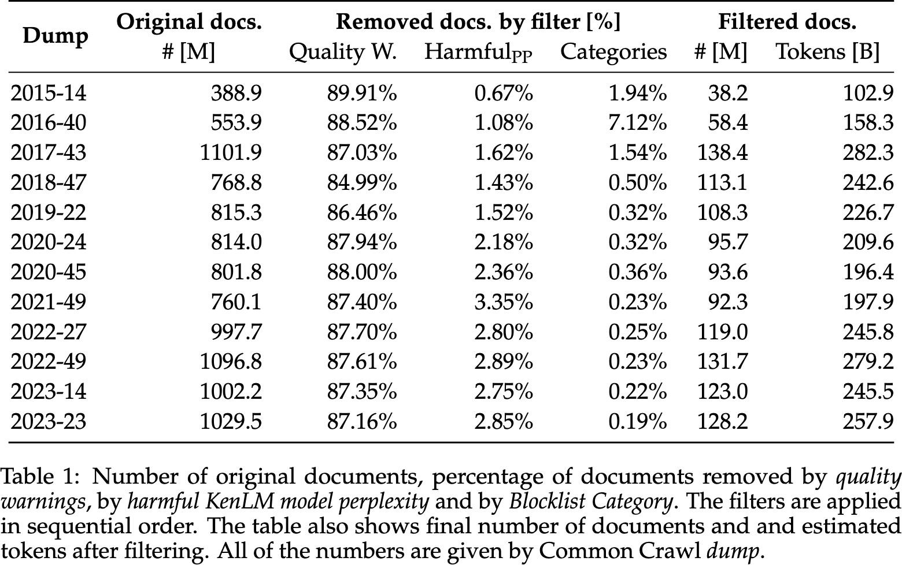
How much data is removed?
Filters remove
~90% of the data
Deduplication removes
another ~50%
Source: Ostendorff et. al. (2024). ”LLM-Datasets: An Open Framework for Pretraining Datasets of Large Language Models”. In COLM 2024
https://ostendorff.org/assets/pdf/ostendorff2024-preprint.pdf

Slide 43
What is high quality data?

Slide 44
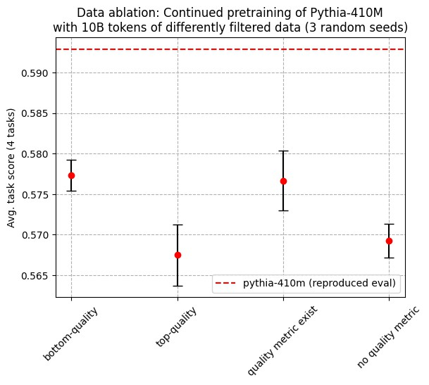
What is high quality data?
The term “high quality” is not well-defined!
Statistical models such as LLMs are defined by their training data.
High quality data = high quality model.
The only solution: Run experiments!

Slide 45
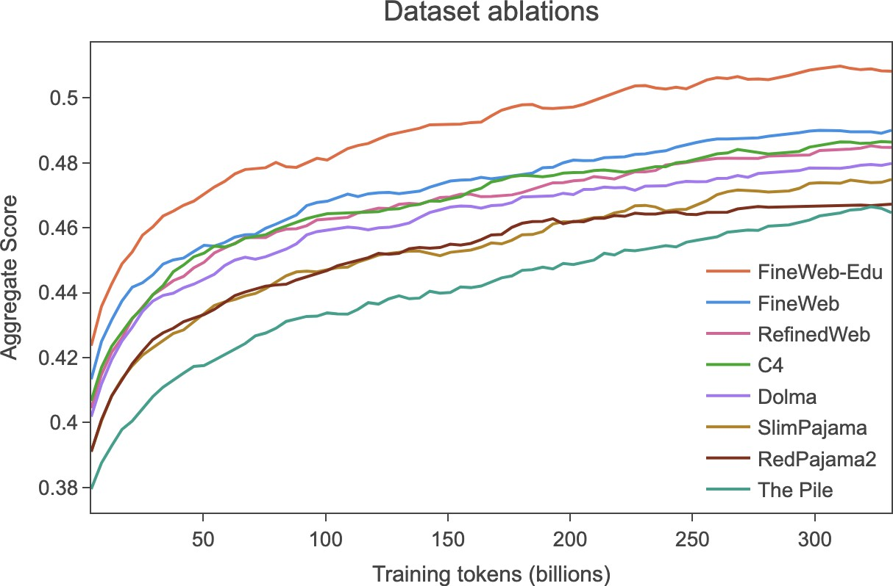
FineWeb: Data Quality Ablations at Scale
Penedo et al. (2024) conducted data quality studies
for language model pretraining.
More than 60,000 H100 GPU hours* for training ablation models of 1.8B parameters for ~ 28B tokens (and up to 350B tokens).
The final FineWeb pipeline consists of a various heuristics, URL-based filters and deduplication.
FineWeb-Edu: Most performance gains are achieved by using a Transformer-based model to filter for educational content.
BERT-based filtering of the 15T token dataset alone required 6,000 H100 GPU hours!
* $4.9 per H100-GPU hour on AWS ($ 300,000 in total)

Slide 46
Data-centric research is gaining more traction!
Razeghi et al. (2023): “Backtracking Mathematical Reasoning of LMs to the Pretraining Data”
Math-only data only improves simple arithmetic benchmarks.
Code data improves chain-of-thought reasoning, but not simple arithmetic reasoning.
Aryabumi et al. (2024): “To Code, or Not To Code? Exploring Impact of Code in Pre-training”
Code is a critical building block for generalization far beyond coding tasks and improvements to code quality have an outsized impact across all tasks.
Compared to text-only pre-training, the addition of code results in up to relative increase of 8.2% in natural language reasoning.
Muennighoff et al. (2023): “Scaling Data-Constrained Language Models”
Training with up to 4 epochs of repeated data yields negligible changes to loss compared to having unique data.

Slide 47
Outline
Importance of data
Unsupervised pre-training
Crawling
Scraping and cleaning
Datasets
Supervised instruction fine-tuning
Crowdsourcing
Synthetic data & data augmentation
Conclusion
Group work

Slide 48
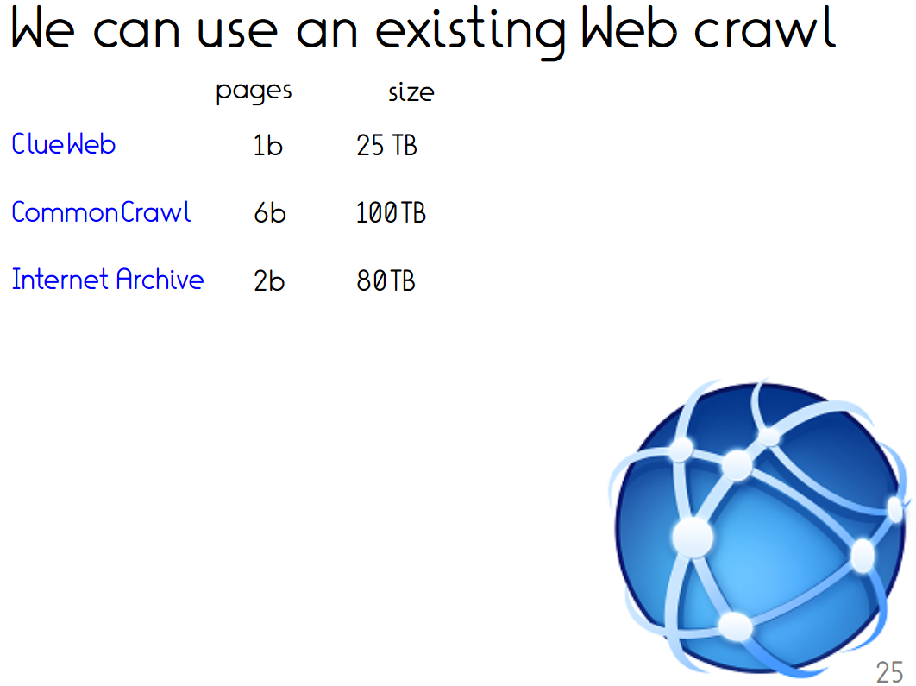
Existing open datasets
C4 corpus 750 GB
The Pile 825 GB
enWikipedia 5m 30 GB
Dresden web 125m table corpus
Twitter dumps 2016 US election 280m
Reddit dumps …
Wikia dumps …
…

Slide 49
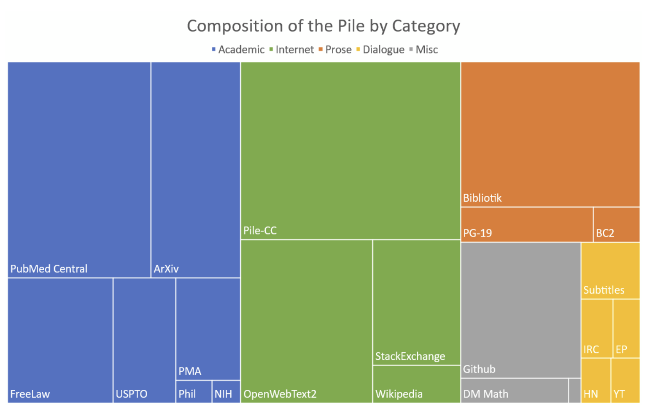
GPT-NeoX / The Pile (2020)
Oversampling – WP 3x, Gutenberg 2.5x, Arxiv 2x

Slide 50
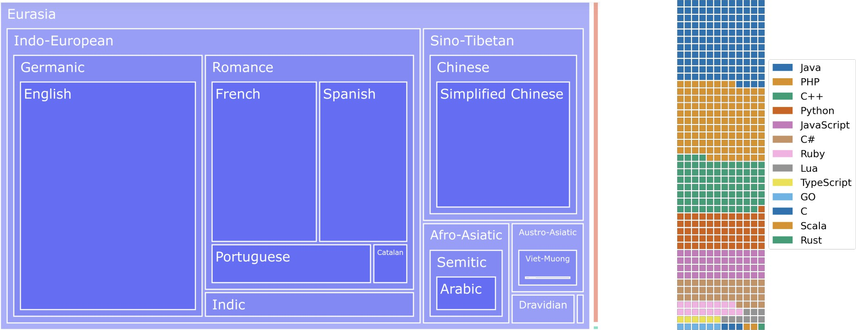
ROOTS: Data for Training of Bloom (2022)

Slide 51
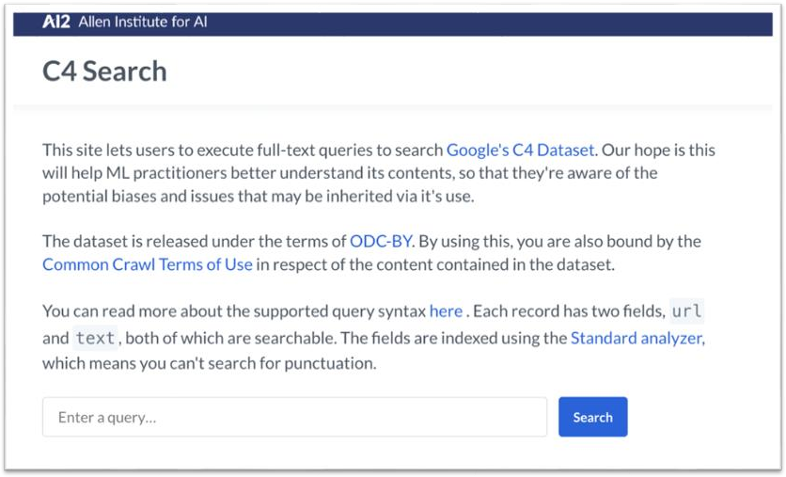
https://c4-search.apps.allenai.org/

Slide 52
What about today’s LLMs?

Slide 53
Where is the data coming from?
Today’s commercial LLM providers say very little about their training data.
Meta: “Llama 3 was pretrained on 15T tokens ... from publicly available sources”
Training data is the main differentiator between models. Crucial assets!
Legal issues such as copyright (see ongoing lawsuit: OpenAI vs New York Times)
The only source that provides enough data at low costs is the Web.
CommonCrawl: US-based non-profit that crawls the Web since 2008
250 billion Web pages spanning 17 years (petabytes of data from ~100 monthly crawls)
CC-Crawler operates with an US-IP address and an English user agent.
OpenWebSearch: Initiative for building a European Web search infrastructure.

Slide 54
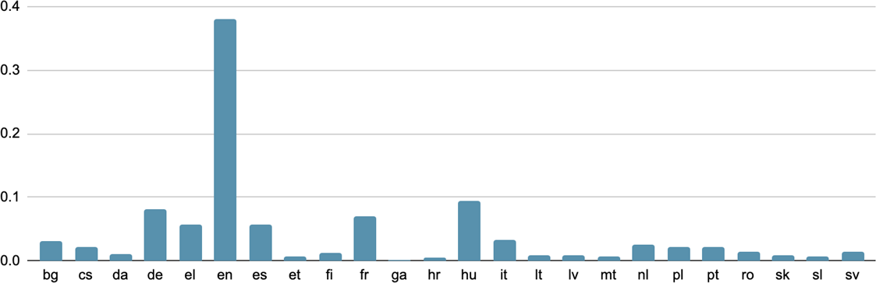

European languages in Web data
Available data by language based on OSCAR v23.01

Slide 55
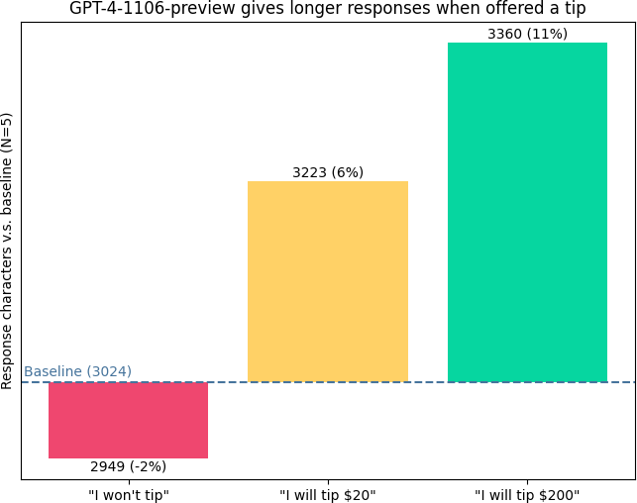
ChatGPT is American.
Source: https://x.com/voooooogel/status/1730726744314069190 (@voooooogel on X)

Slide 56



LLM-Datasets
LLM-Datasets is a collection of datasets for language model pretraining
including scripts for downloading, pre-processsing, and sampling.
Datasets for +32 European languages available
Filtered text data: approx. 2 Trillion Tokens (comparable to LLama2)
Easy to extend with your own datasets without the need of making your
data publicly available.
github.com/malteos/llm-datasets
Apache 2.0 license
Source: Ostendorff et. al. (2024). ”LLM-Datasets: An Open Framework for Pretraining Datasets of Large Language Models”. In COLM 2024
https://ostendorff.org/assets/pdf/ostendorff2024-preprint.pdf
30

Slide 57
Outline
Importance of data
Unsupervised pre-training
Crawling
Scraping and cleaning
Datasets
Supervised instruction and answer fine-tuning
Crowdsourcing
Synthetic data & data augmentation
Conclusion
Group work

Slide 58
Supervised Instruction Fine-tuning
LLMs predict the next token with the highest probability according to their training data (mostly Web data).
A base language model is not a chatbot but a completion engine for Web content and other text seen during training.
Chatbots (language understanding, world knowledge, …) and other applications are built on top of LLMs.
LLMs can be optimized for specific tasks and applications (e.g., chatbots, instruction following, …) via fine-tuning (comparable to classical supervised learning).
Supervised fine-tuning requires structured/annotated datasets (input- output pairs for multiple tasks):
Questions and their answers
Texts with their summaries
Vanilla LLM (Base model)
Input | Where is the Eiffel Tower located?
Output | How tall is the Eiffel Tower?
QA-Fine-tuned LLM
Input | Where is the Eiffel Tower located?
Output | Paris

Slide 59
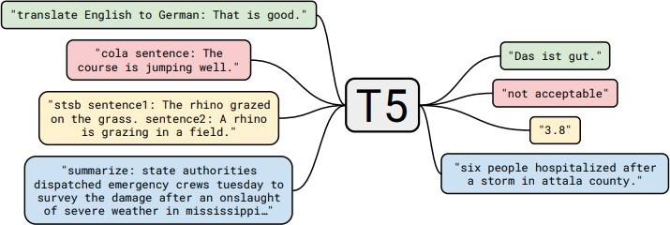
Multi-Task Learning
LLMs are meant to be general-purpose models: Many different tasks (unseen during training).
Multi-task learning is a common approach in various machine learning domains.
Raffel et al. (2019) popularized multi-task learning with their T5 language model.
cola = Corpus of Linguistic Acceptability = grammaticality
stsb = Semantic Textual Similarity Benchmark = semantic similarity
59

Slide 60
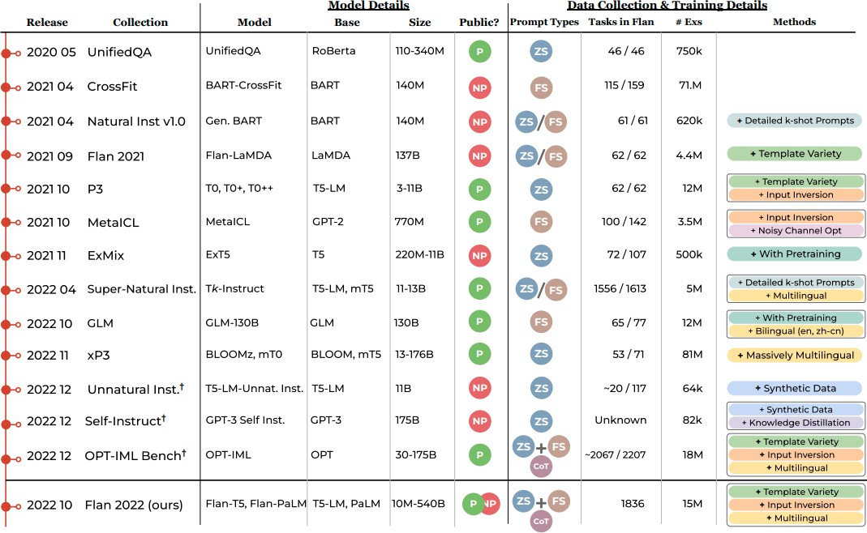
Scaling:
from 46 to
~2000 tasks
from 750k to 15M examples
Source: Longpre et al. (2023) “The Flan Collection: Designing Data and Methods for Effective Instruction Tuning”
60

Slide 61
LLMs should generalize to unseen tasks…
What is generalization when you train on more than 2,000 tasks?

Slide 62
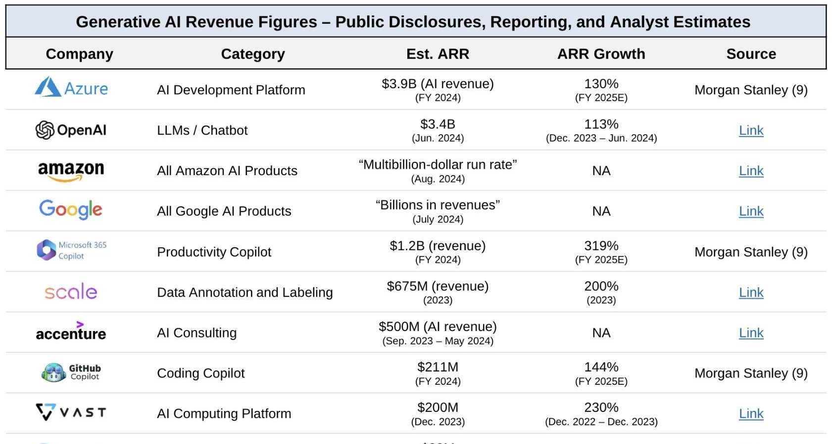
Source: Sapphire Ventures

Slide 63

Crowdsourcing
Data annotation a long challenge in NLP
Traditional expert annotations guidelines sometimes >100 pages
Crowdsourcing
Prominent platforms: Amazon Mechanical Turk, Prolific, …
Typical pay: Minimum wage
Complex or open-ended annotation tasks difficult
→ divide and conquer
Quality assurance:
Worker education/background
Worker reputation
Honeypot/test question-based filtering
Redundancy (majority opinion on task)
Task design is a science!
Crowdsourcing for instructions
Expenses likely in 100,000s of $ for commercial providers
Crowdsourcing for pairwise preference
Comparatively easy
See e.g., Chatbotarena

Slide 64

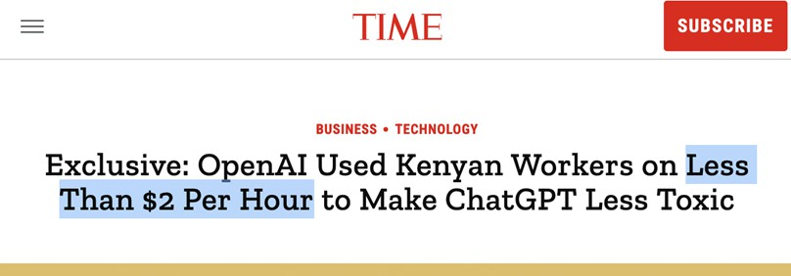
ChatGPT’s Crowdsourcing
Source: https://time.com/6247678/openai-chatgpt-kenya-workers/
39

Slide 65




https://data-workers.org/

Slide 66
Outline
Importance of data
Unsupervised pre-training
Crawling
Scraping and cleaning
Datasets
Supervised instruction fine-tuning
Crowdsourcing
Synthetic data & data augmentation
Conclusion
Group work

Slide 67

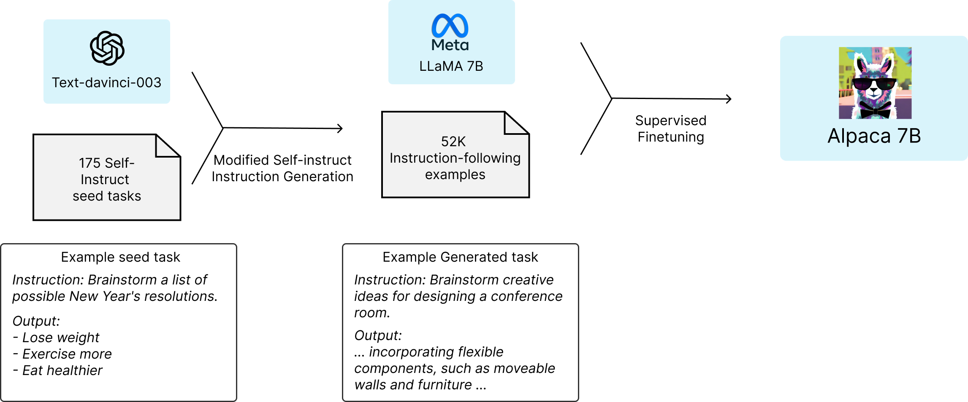
Alpaca: A Strong, Replicable Instruction-Following Model

Slide 68
You are asked to come up with a set of 20 diverse task instructions. These task instructions will be given to a GPT model and we will evaluate the GPT model for completing the instructions.
Here are the requirements:
1. Try not to repeat the verb for each instruction to maximize diversity.
2. The language used for the instruction also should be diverse. For example, you should combine questions with imperative instrucitons.
3. The type of instructions should be diverse. The list should include diverse types of tasks like open-ended generation, classification, editing, etc.
2. A GPT language model should be able to complete the instruction. For example, do not ask the assistant to create any visual or audio output. For another example, do not ask the assistant to wake you up at 5pm or set a reminder because it cannot perform any action.
3. The instructions should be in English.
4. The instructions should be 1 to 2 sentences long. Either an imperative sentence or a question is permitted.
5. You should generate an appropriate input to the instruction. The input field should contain a specific example provided for the instruction. It should involve realistic data and should not contain simple placeholders. The input should provide substantial content to make the instruction challenging but should ideally not exceed 100 words.
6. Not all instructions require input. For example, when a instruction asks about some general information, "what is the highest peak in the world", it is not necssary to provide a specific context. In this case, we simply put "<noinput>" in the input field.
7. The output should be an appropriate response to the instruction and the input. Make sure the output is less than 100 words.
List of 20 tasks:
https://github.com/tatsu-lab/stanford_alpaca/blob/main/prompt.txt

Slide 69
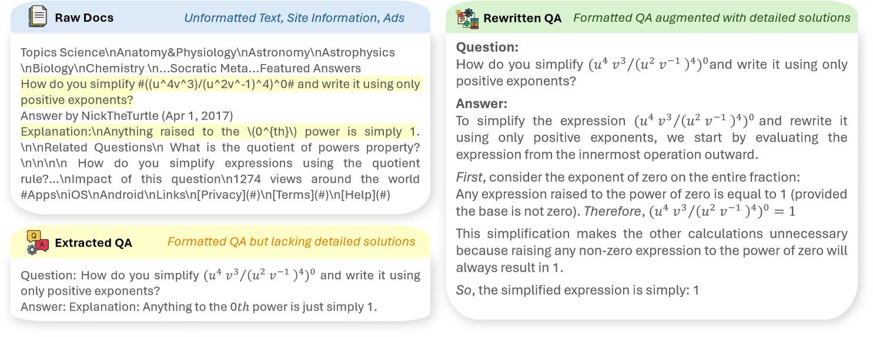
Synthetic Data Generation
Can obtain instructions from general web text
69
Taken from Yue et al. (2024) “MAmmoTH2: Scaling Instructions from the Web” https://tiger-ai-lab.github.io/MAmmoTH2/

Slide 70
Alignment & Preference Fine-Tuning
OpenAI popularized “reinforcement learning from human feedback” (RLHF) as a technique to
align language model outputs more with human preferences (Stiennon et al., 2020).
There are different ML algorithms for preference tuning (PPO, DPO, KTO, …).
Each of the methods expects training data in a different format.
Chosen | Reject
The Eiffel Tower is located in Paris, France. … | Paris
Response | Label
Paris | 0
The Eiffel Tower is located in Paris, France. … | 1

Slide 71
Base LLM
Input | Where is the Eiffel Tower located?
Output | How tall is the Eiffel Tower?
QA-Fine-tuned LLM
Input | Where is the Eiffel Tower located?
Output | Paris
Preference-fine-tuned LLM
Input | Where is the Eiffel Tower located?
Output | The Eiffel Tower is located in Paris, France. Specifically, it is situated on the Champ de Mars, a public park in the 7th arrondissement (district) of Paris, near the Seine River. The exact address is: 5 Avenue Anatole France, 75007 Paris, France. […]

Slide 72
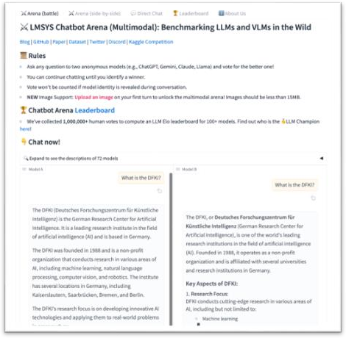
Chatbot Arena
Let’s try!
https://lmarena.ai/

Slide 73
LLM-as-a-judge
Like instruction data, also the collection of preference data with human labor
is costly (money and time).
Synthetic data generation using LLMs is an inexpensive alternative.
LLM acts as a judge to decide between “good” and “bad” responses.
LLMs can be iteratively used to generate, critique, and refine responses.
Why is this possible? Requires more syntactic than semantic understanding!
Chosen | Reject
<response of good LLM> | <response of bad LLM>

Slide 74
Outline
Importance of data
Unsupervised pre-training
Crawling
Scraping and cleaning
Datasets
Supervised Instruction and answer fine-tuning
Crowdsourcing
Synthetic data & data augmentation
Discussion
Group work

Slide 75
Open issues (forward pointer: ethics lecture)
Pretraining on large-scale Web data: Too big to inspect?
How to do science with LLMs if the training data is unknown?
Benchmark leakage
Are we running out of training data?
Copyright in the age of generative AI?
Will LLM-generated web content void the LLM training base?
…

Slide 76
Group work
Discuss the following questions with your neighbor:
What are the three kinds of training data LLMs need?
Where can we get each from? Which can be synthesized?
What are important filters on web data?

Slide 77
Take home – Lecture 5
Data is one of the main differentiators between language models,
Major commercial secret
LLM training broadly requires three types of data
Unupervised pre-training data, instruction fine-tuning data, answer format preference data
Most training data is web-crawled
Filtering crucial
Balance matters
Definition of “good” data is not clear
Instruction and answer format data often crowdsourced
Can in principle also be synthesized
Lab today:
Building a basic Transformer

Slide 78
MinHash notes

Slide 79
Freshness problem (2)
Prediction problem: Estimate page change frequency
From previous change behavior
Or from page content
Optimization problem: Decide crawl frequency
Fixed budget → How to distribute them
Flexible budget → Cost-benefit framework needed

Slide 80
Estimating change frequencies
Cho and Molina, TOIT 2003
Model changes as Poisson processes (i.e., memoryless/statistically independent)
Extrapolate change frequency from previous visits
Daily visit for 10 days, 6 changes detected
Change frequency: 0.6 changes/day?
Extrapolation underestimates change frequency due to multiple change possibility
Wijaya et al., EMNLP 2015
Wikipedia-specific
Learn state-change-indicating terms
E.g., nominated, elected

