Slide 1


Behind the Secrets of Large Language Models
Lecture 7
Training
Simon Razniewski

Slide 2
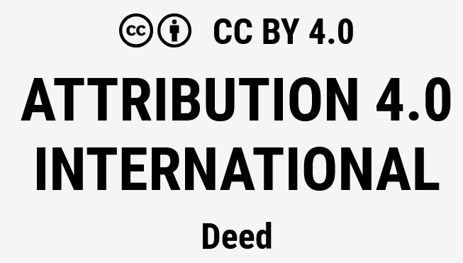
Acknowledgment/License
Shared under CC BY 4.0 with permission by https://slds-lmu.github.io/dl4nlp/team/

Slide 3
Project updates
Custom projects: Upload proposal asap to initiate approval process
New project option: ScholarlyLLM (Färber)
Avertisement: SaxonLLM (Razniewski)
Advertisement: Long lists (Razniewski)

Slide 4

Advertisement – Saxon LLM project
Now more guidelines and dataset pointers online
Humorous and serious at the same time
Exceptional outreach potential

Slide 5
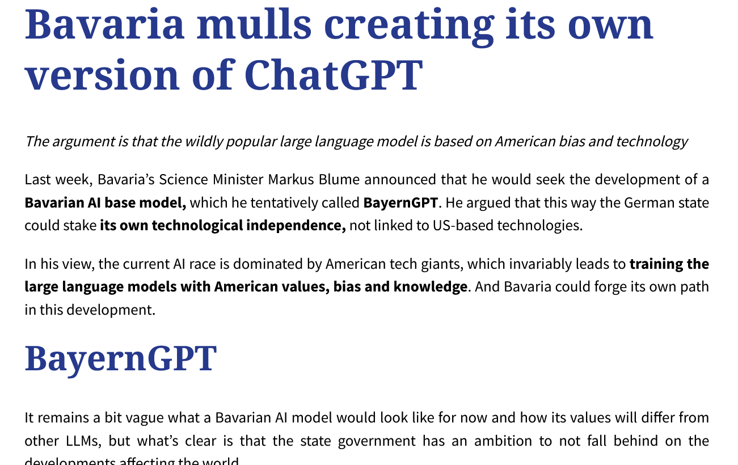

Slide 6
Saxon LLM - Resources
1. Text resources:
A large set of poems: https://www.sachsen-lese.de/streifzuege/mundartliches/
19 encyclopedic articles: https://incubator.wikimedia.org/wiki/Wp/sxu/Main_Page
9 poems: https://de.wikisource.org/wiki/Kategorie:Erzgebirgisch
Various short phrases: https://www.scribd.com/document/408398334/alltagsdeutsch-sachsisch
2. Rules (for rule-based synthesizing):
https://praxistipps.focus.de/saechsisch-lernen-diese-basics-sollten-sie-wissen_157089
3. Audio files (need transcription):
https://www.regionalsprache.de/Audio/Catalogue.aspx (search by location, e.g., "Dresden")
https://dsa.info/sachsen/
Long audio book for 1 €, perhaps this would be the biggest resource: https://www.amazon.de/Winnetou-auf-s%C3%A4chsisch-Karl-May/dp/3866045093
Other audio files: https://commons.wikimedia.org/wiki/Category:Obers%C3%A4chsisch?uselang=de
4. Synthetic training data: Prompt a strong commercial LLM?

Slide 7
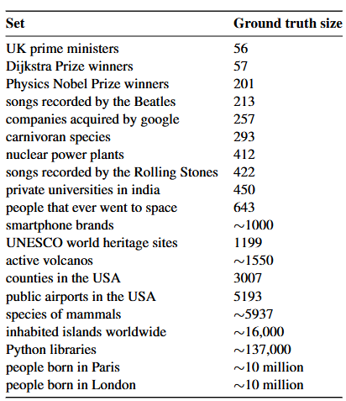
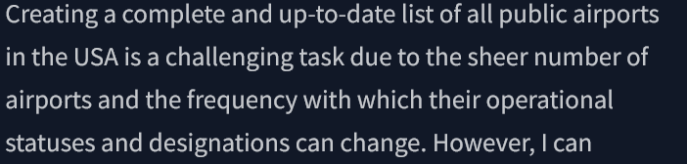
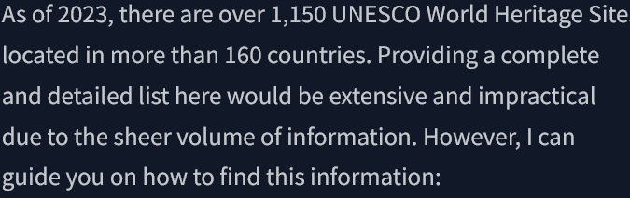
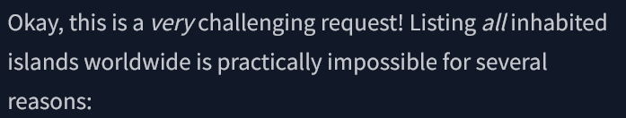
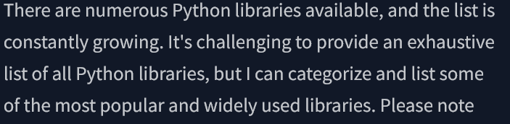
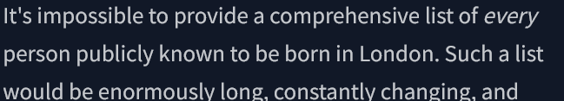
Advertisement – Long list creation
😊
🙂
😐
🙁
☹️

Slide 8
Advertisement – Long list creation
Possible questions to investigate
How much can prompt tuning achieve?
E.g., [GrIPS: Gradient-free, Edit-based Instruction Search for Prompting Large Language Models, 2023]
How much can iterative/recursive prompting achieve?
E.g., by year, region, starting letter, with randomness
Can LLMs themselves partition the task?
E.g., defining subcategories, or full agent frameworks
Can LLMs be fine-tuned for this task?
Strong links to KAAI research – GPTKB.org project

Slide 9
Backlog from last lecture

Slide 10

Llama 3+
“The Llama 3 Herd of Models” (AI@Meta, 2024)
“Open-source” alternative for GPT (but specific licensing)
Key differences compared to GPT-4
Model size:
Llama 3: 8B or 70B parameters
Llama 3.1: 8B or 70B or 405B parameters
Llama 3.2: 1B, 3B, 11B, 90B parameters
GPT-4: >1T parameters
Extended Context Window:
Llama 3: 8K tokens
Llama 3.1 & 3.2: 128K tokens
GPT-4: 32K tokens

Slide 11
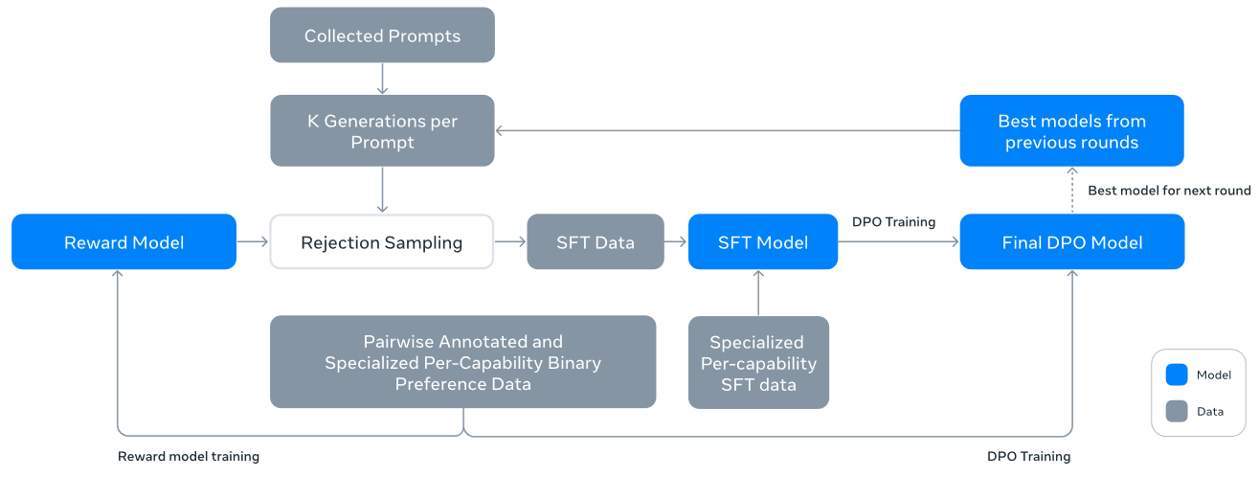
Llama 3+
See Sec. 3.4 in https://arxiv.org/abs/2407.21783
Pretraining:
Initial Pretraining: Gradually increasing batch size (4M → 16M tokens), adjusting data mix (non-English data, math, recent web data)
Long-Context Pretraining: Incrementally increase context length up to 128K tokens
Annealing: Reduce learning rate gradually to 0 with high-quality data upsampling
Fine-Tuning: Supervised Fine-Tuning (SFT) and RLHF
2. Fine-tune pre-trained checkpoints with supervised fine-tuning
1. Train a reward model using human-annotated preference data
3. Align checkpoints using Direct Preference Optimization (DPO)
Source: AI@Meta 2024: The Llama 3 Herd of Models

Slide 12
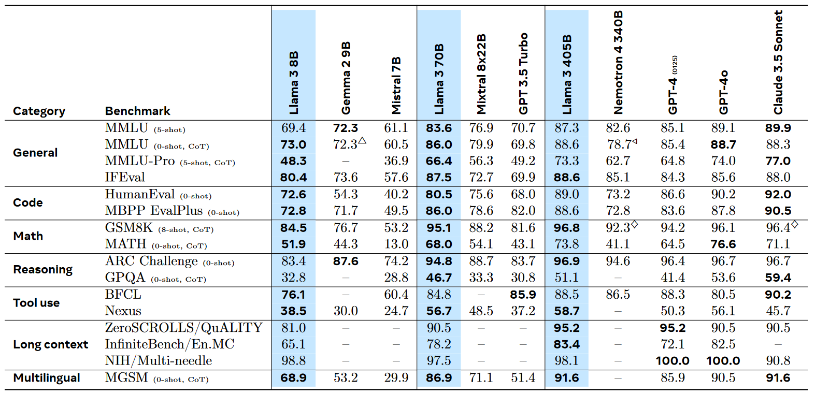
Llama 3+
Performance comparison on different benchmarks:
Source: AI@Meta 2024: The Llama 3 Herd of Models

Slide 13
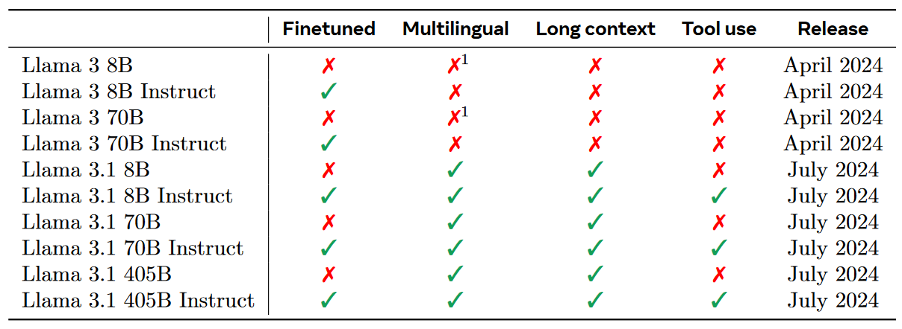
Llama 3+
Different models:
Source: AI@Meta 2024: The Llama 3 Herd of Models
…Llama 3.2 – Multimodal, and small text-only models!

Slide 14
Comparison between GPT-4 and Llama 3.1+
Aspect | GPT-4 | Llama 3.1
Emphasis | Enhance multitask performance with strong focus on scale and depth | Focus on efficiency, performance optimization, and accessibility for open research
Dataset | Large-scale diverse dataset sourced from the internet | Curated high-quality dataset balancing diversity and quality
Model Size | >1T parameters | Up to 405B parameters
Design Philosophy | Maximizing capability and performance through scale | Achieving high efficiency and scalability

Slide 15
How to train an LLM
Obtain training data (Lecture 5)
Choose network architecture (Lectures 3 and 6)
Choose network size
→ Scaling laws (today)
Choose hyperparameters
Learning rate, batch size, dropout, …
Hyperparameter optimization (today)
Perform learning until ….?
Stopping criteria (today)

Slide 16
Outline
Computational cost of training
Scaling laws
Hyperparameter optimization
Stopping criteria
Training optimizations
Knowledge distillation
Mixture of experts
Training stories
Discussion
Group work

Slide 17
Key terminology
Batch Size: The number of training instances for which the loss is computed simultaneously.
Larger batches promote better generalization.
However, excessively large batches can be computationally expensive.
Epoch: A complete pass through the entire training dataset during the training process.
Learning Rate: A scalar factor that determines the size of updates to model parameters during optimization.
Dropout: The proportion of nodes or weights randomly removed during training to prevent overfitting.

Slide 18
COMPUTE REQUIREMENTS
Basic equation: Cost to train a transformer (decoder) model:
C ≈ τ T = 6ND
Source: Quentin et al., 2023

Slide 19
COMPUTE REQUIREMENTS
C ≈ τ T = 6ND
where:
C: No. of floating-point operations (FLOPs) to train the model:
C = Cforward + Cbackward
Cforward ≈ 2ND; Cbackward ≈ 4ND
2ND: 2 comes from the multiply-accumulate operation used in matrix multiplication
4ND: backward pass approximately twice the compute of the forward pass
In the backward pass at each layer, gradients have to be calculated for the weights at that layer and for the previous layers output, so that the gradient of the previous layers’s weights can be calculated
τ is throughput of hardware: (No. GPUs) x (FLOPs/GPU)
T is the time spent training the model, in seconds
N is the number of parameters in the model
D is the dataset size (in tokens)

Slide 20
COMPUTE UNITS
C can be measured in different units:
FLOP-seconds which is [Floating Point Ops / Second]
We also use multiples GFLOP-seconds, TFLOP-seconds etc. Other multiples like PFLOP-days are used in papers
1 PFLOP-day = 10¹⁵ · 24 · 3600 FLOP-seconds Actual FLOPs are always lower than the advertised theoretical FLOPs
GPU-hours
GPU model is also required, since they have different compute capacities

Slide 21
PARAMETER VS DATASET
Model performance depends on number of parameters N, but also on number of training tokens D
We need to decide about N and D, so that we get the best performance withing the compute budget.
The optimal tradeoff between P and D is: D = 20N
This was reported for Chinchilla models
Hoffmann et al., 2022
Rule of thumb: First determine the upmost inference cost, and then train the biggest model within that boundary
Different ways to determine N: based on available data, compute budget or inference time

Slide 22
MEMORY REQUIREMENTS
Common questions:
How big is this model in bytes? Will it fit/train in my GPUs?
Model size components:
Model parameters Optimizer states Gradients Activations

Slide 23
NUMBER REPRESENTATIONS
Pure fp32: single precision floating point number as defined by
^{IEEE 754} standard, takes 32 bits or 4 bytes
fp16: half precision float number as defined by occupying 16 bits or 2 bytes
IEEE_754-2008 ,
bf16 or brain floating point 16, developed by Google Brain project, occupying 16 bits or 2 bytes
int8: integer from -128 to 127, occupying 8 bits or 1 byte

Slide 24
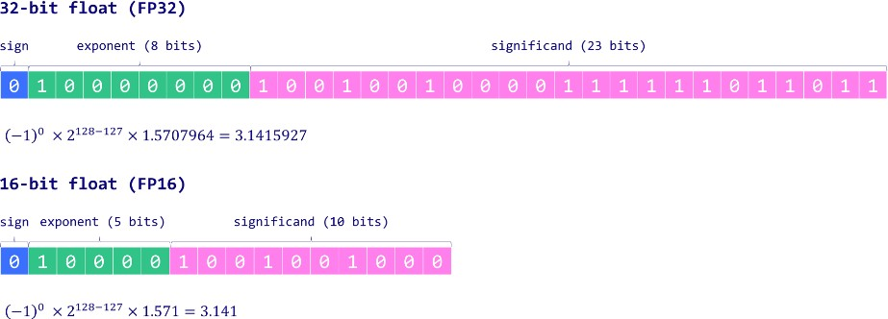
FP32/FP16
Source: Maxime Labonne
You can represent every float like this:
(−1)^{S} · 2^{e−bias} · 1.m
see Lecture 8…

Slide 25
Space requirements
Model parameter size depends on chosen representation:
Pure fp32: Mem_{model} = 4 bytes/param · N_{params} fp16 or bf16: Mem_{model} = 2 bytes/param · N_{params} int8: Mem_{model} = 1 byte/param · N_{params}
Optimizer states, e.g., AdamW: Mem_{AdamW} = 8 bytes/param · N_{params}
₋ Momentum: 4 bytes/param
- Variance: 4 bytes/param
Gradients: They are usually stored in the same datatype as the model parameters.

Slide 26
Example numbers
Typical FLOPs capacity for different Devices at FP32 precision (1GFLOP = 1 Billion FLOPs = 1E+9 FLOPs) 1. 💻 A Modern mid-size laptop ~ 100 GFLOPs 2. 📱 Apple iPhone 14 Pro ~ 2000 GFLOPs 3. 🎮 Sony PlayStation 5 ~ 10000 GFLOPs
4. 🖥️ Nvidia A100 GPU ~ 10,000 GFLOPs
5. 🖥️ Nvidia H100 NVL GPU ~ 134,000 GFLOPs
Using the 6ND formula for Training computations:
The original Transformer model (for English to German task) would have consumed 39 PFLOPs (E15) for 1 Epoch, assuming 10 Epochs we get 390 PFLOPs. (=45 days training time on a Midsize Laptop)
GPT-1 would have consumed 420 PFLOPs for 1 Epoch, assuming 100 Epochs we get 42 EFLOPs (E18). (=13 years training time on a Midsize Laptop)
GPT-2 would have consumed 250 EFLOPs for 1 Epoch, assuming 20 Epochs we get 5 ZFLOPs (E21). (= 1600 years training time on a Midsize Laptop)
The more recent PALM model would have consumed 2.5 YFLOPs (E24) assuming Epoch = 1. (= 800,000 years training time on a Midsize Laptop!)
https://medium.com/@georgeanil/visualizing-size-of-large-language-models-ec576caa5557

Slide 27
Task: Compute estimation
GPT-4 (??)
1.8 T parameters
13 T tokens
Estimated FLOPs needed = ?
H100 = 134 TFLOPs
Assuming 100k H100 GPUs:
-> Duration: ?

Slide 28
Outline
Computational cost
Scaling laws
Hyperparameter optimization
Stopping criteria
Training optimizations
Knowledge distillation
Mixture of experts
Training stories
Discussion
Group work

Slide 29
SCALING LAWS
Kaplan et al. (2020)
Performance depends strongly on scale, weakly on model shape Scale means: parameters N, data D, and compute C Shape means: depth and width
Smooth power laws
Performance has power-law relation with each factor N, D, C
When not bottlenecked by the other two
Trend spanning more than six orders of magnitude
Universality of limits
Performance enters regime of diminishing returns if N or D
held fixed while the other increases

Slide 30
SCALING LAWS
Universality of training
Training curves follow predictable power-laws
Their parameters are roughly independent of model size
It is possible to predict by extrapolating the early part of the training curve
Transfer improves with test performance
When evaluating on text with different distribution from training text, results are strongly correlated to those on the validation set
Transfer to different distribution incurs a constant penalty but improves in line with performance on training set
Sample efficiency
Large models are more sample-efficient than small models They reach same performance with fewer optimization steps

Slide 31
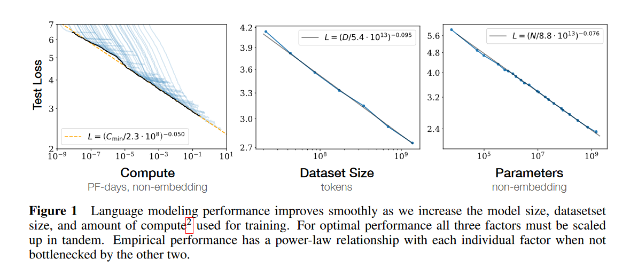

Slide 32
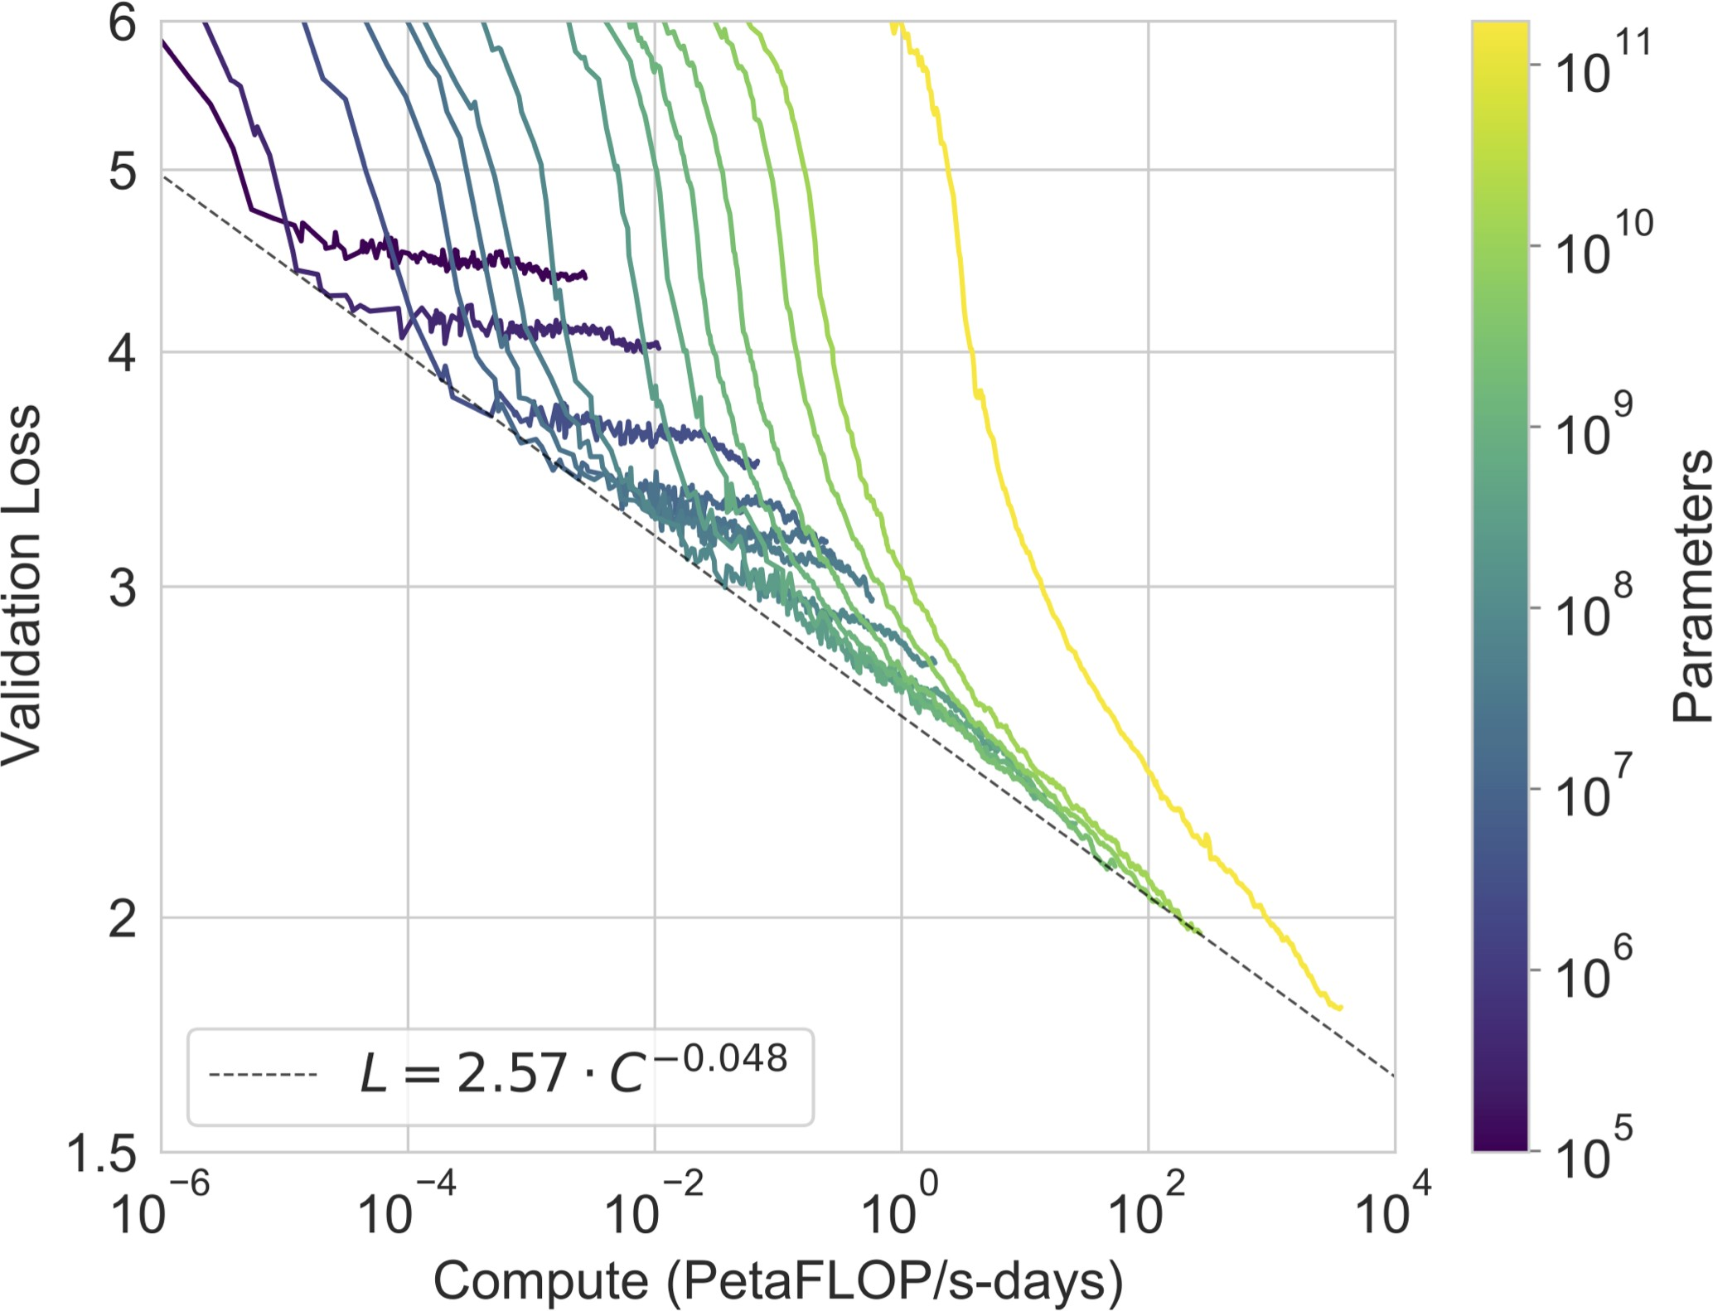
POWER LAW (GPT3 PAPER)

Slide 33
SCALING LAWS
Convergence is inefficient
When C is fixed but N and D are not, optimal performance is achived by training very large models and stopping significantly short of convergence
Optimal batch size
“Optimal batch size: The ideal batch size for training these models is roughly a power of the loss only, and continues to be determinable by measuring the gradient noise scale [MKAT18]; it is roughly 1-2 million tokens at convergence for the largest models we can train.”
gradient noise scale = a measure of the signal-to-noise ratio of gradient across training examples
Larger language models will perform better and be more sample efficient than current models.

Slide 34
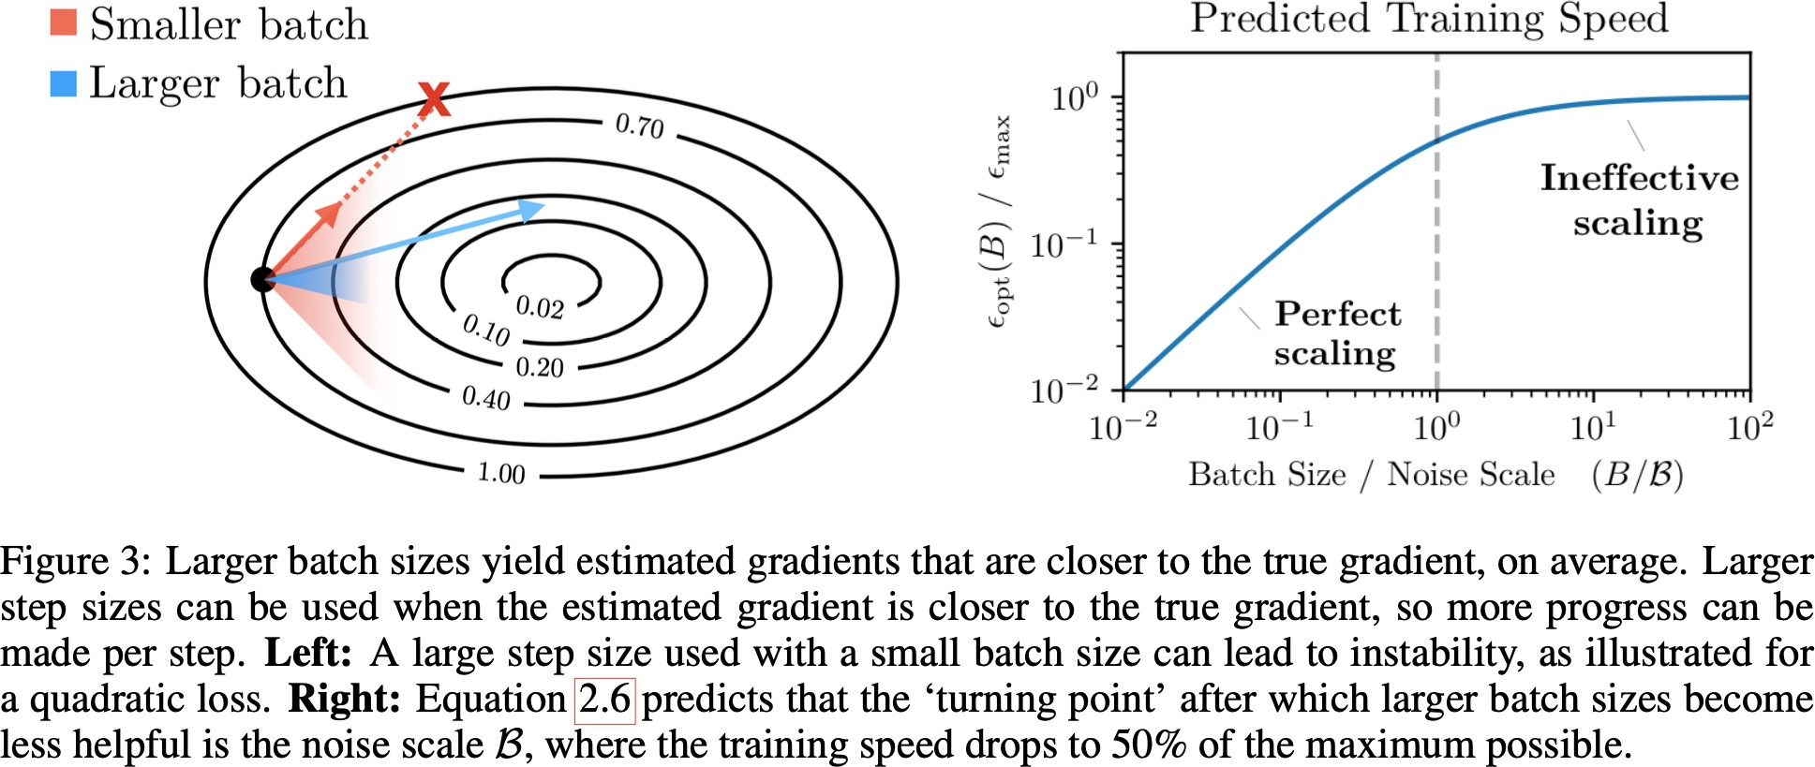
OPTIMAL BATCH SIZE
Estimate gradient as accurately as possible → large batch Increase training speed as much as possible → large step size
Based on the estimated gradient, choose a step size such that the cost of the landing position does not deviate too much from the cost of the ideal landing position → small step size

Slide 35
OPTIMAL BATCH SIZE
Exploit stochasticity (epoch batches would not be a good thing even if we could compute them efficiently) → small step size

Slide 36
SCALING LAW FOR NEXT WORD PREDICTION
L(N, D) = 1.61 + ^{406.4} + ^{410.7}
_{N}0.34 _{D}0.28
L(N, D) is cross entropy on new text

Slide 37
COMPUTE-OPTIMAL LLMs
Given a fixed FLOPs budget, how should we trade-off model size and
text size to optimize performance?
Hoffmann et al., 2022
Find N and D so that FLOPs(N, D) = C and L(N, D) is minimal Empirically estimated N and D based on 400 models.
Ranging from 70 M to 16 B parameters Trained on 5 B to 400 B tokens
Different results from those of Results verified using Chinchilla
Chinchilla has 70 B parameters and is trained on 1.4 T tokens 4x less parameters and 4x more tokens than Gopher Chinchilla outruns Gopher and has reduced memory footprint and inference cost
Kaplan et al., 2020

Slide 38
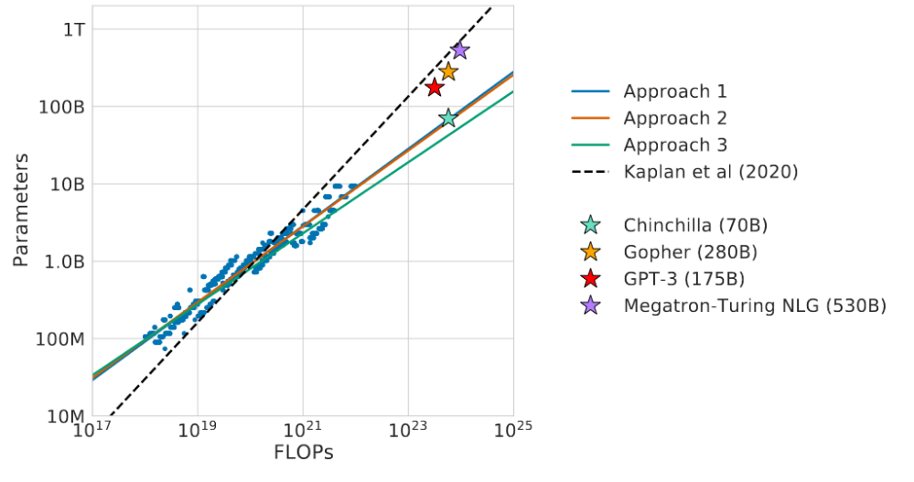
COMPUTE-OPTIMAL LLMs: ARE GPT3 ETC TOO LARGE?
Specifically, given a 10x increased computational budget, they suggests that the size of the model should increase 5.5x while the number of training tokens should only increase 1.8x. Instead, we find that model size and the number of training tokens should be scaled in equal proportions.
Source: Hoffmann et al., 202222

Slide 39
Outline
Computational cost
Scaling laws
Hyperparameter optimization
Stopping criteria
Training optimizations
Knowledge distillation
Mixture of experts
Training stories
Discussion
Group work

Slide 40
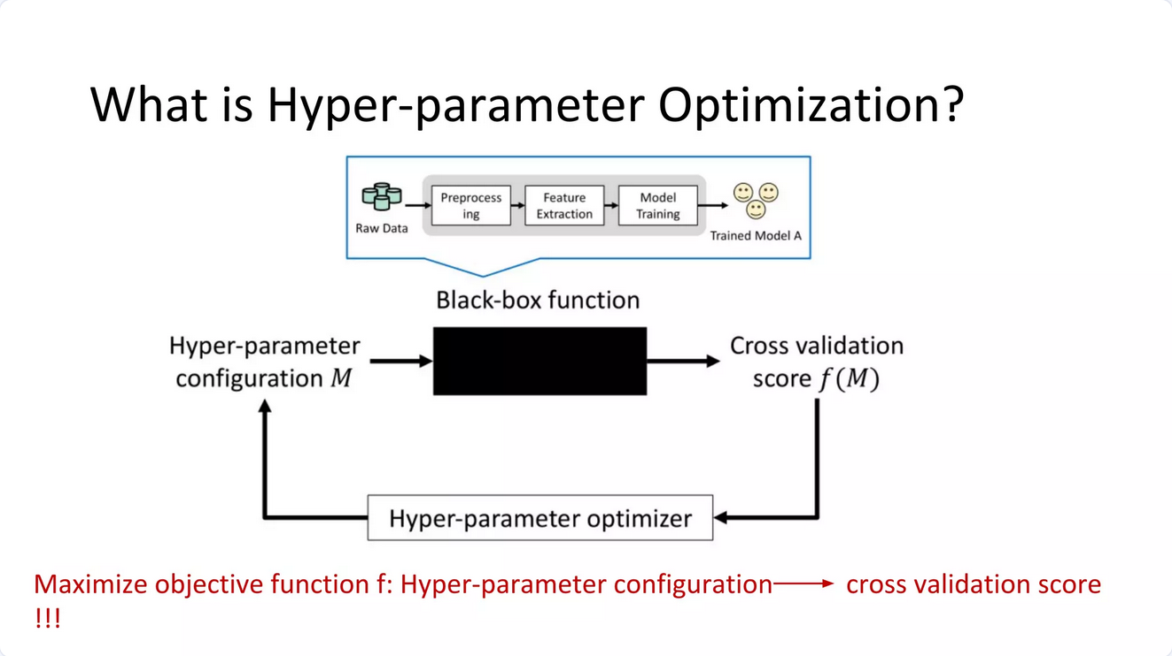

Slide 41
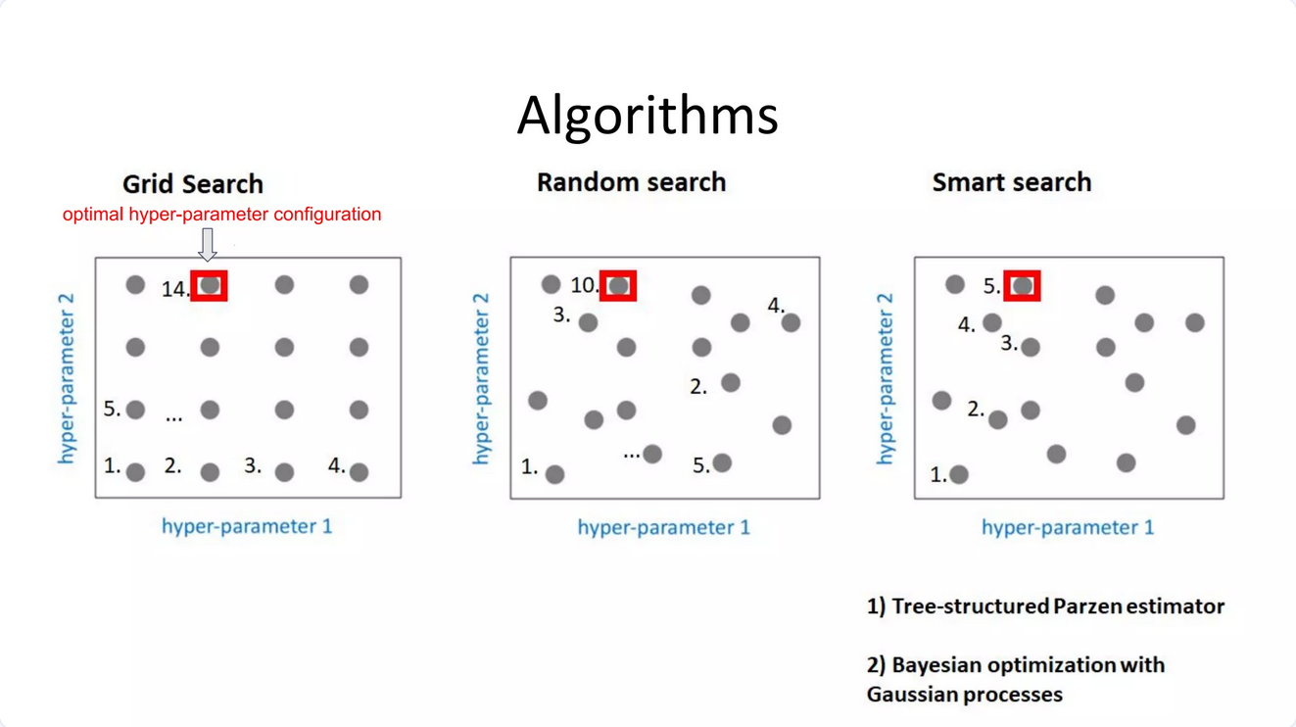
build a probability model of the objective function and use it to select the most promising hyperparameters to evaluate in the true objective function.

Slide 42
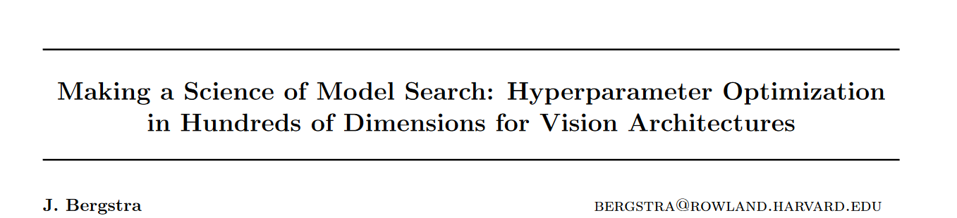
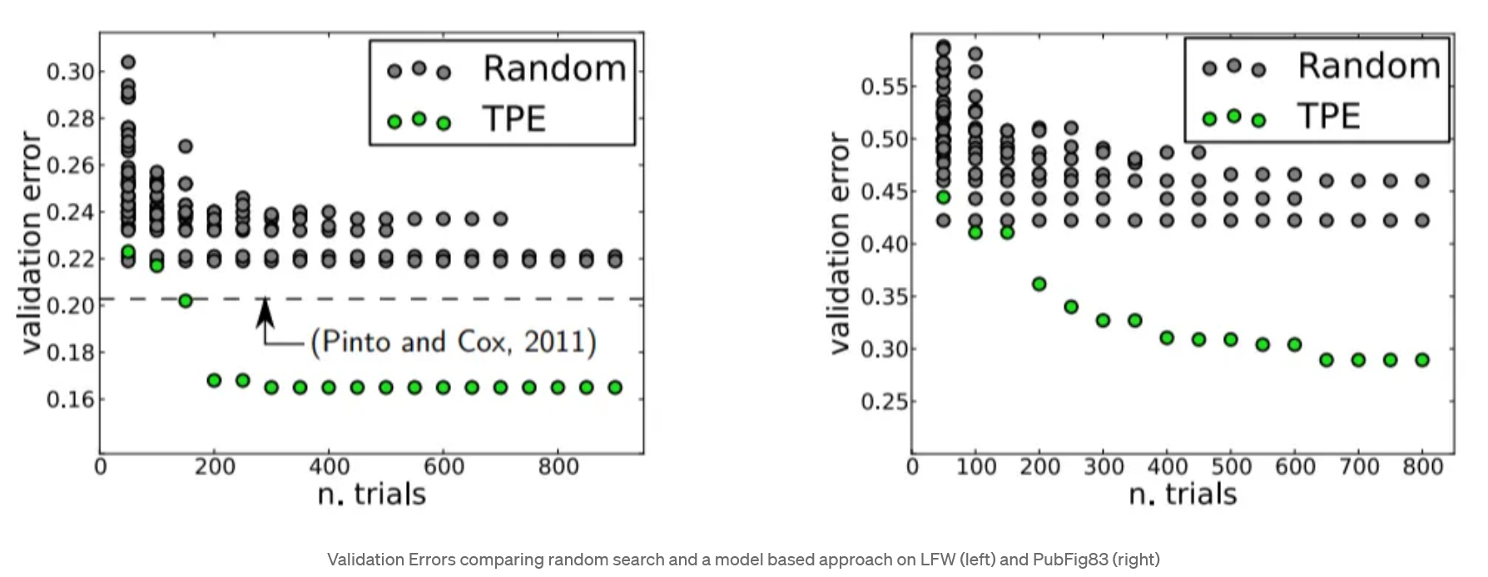

Slide 43
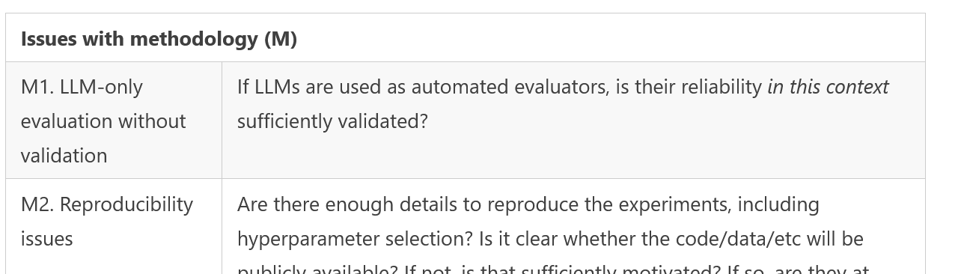
Practical points
Python library hyperopt
Hyperparameter search extremely expensive
Many works: Just follow previous work
Model comparisons:
Effort on hyperparameter search a way to “cheat” advantages
ACL reviewer guidelines:

Slide 44
Outline
Computational cost
Scaling laws
Hyperparameter optimization
Stopping criteria
Training optimizations
Knowledge distillation
Mixture of experts
Training stories
Discussion
Group work

Slide 45
ML fundamentals: Dataset splits
Train/validation/test
80%/10%/10% or 33%/33%/33%
Evaluate on data not seen during training!
Validation: For determining hyperparameters
Test: For deciding when to stop training

Slide 46
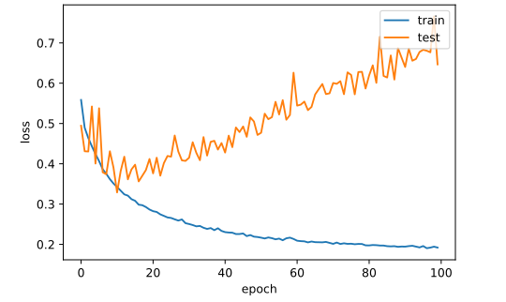
Train vs. test loss
Training loss decreases forever (memorization)
When test loss increases, the model starts overfitting

Slide 47
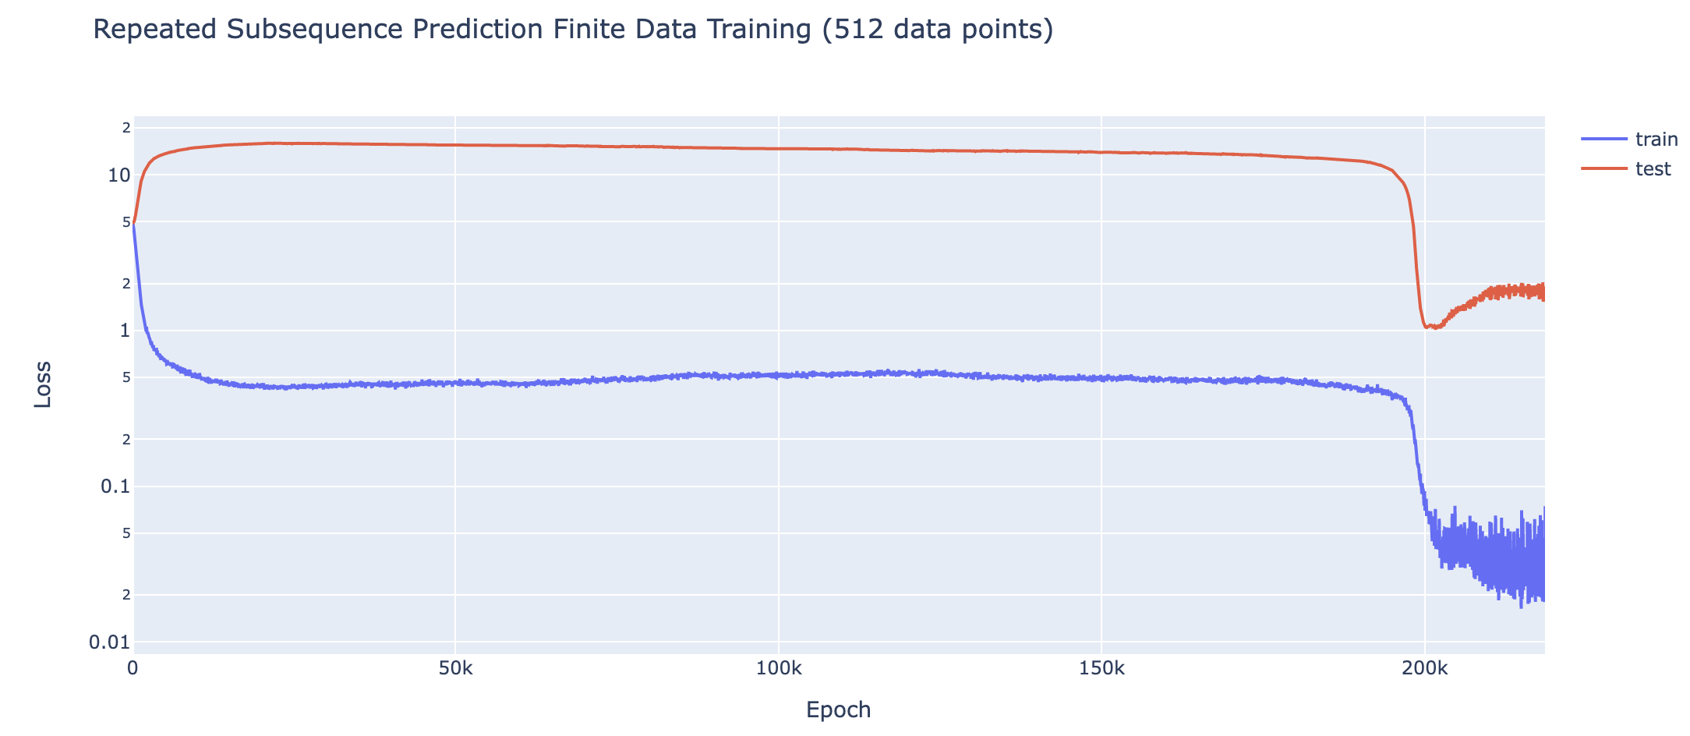
Grokking

Slide 48
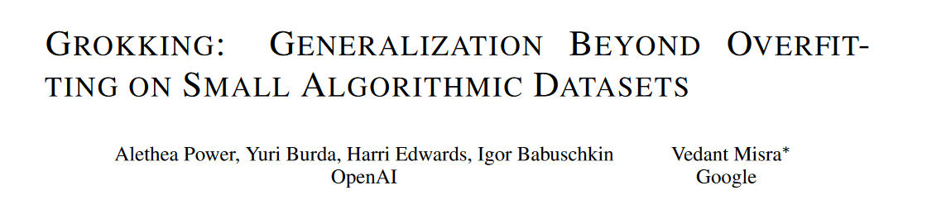
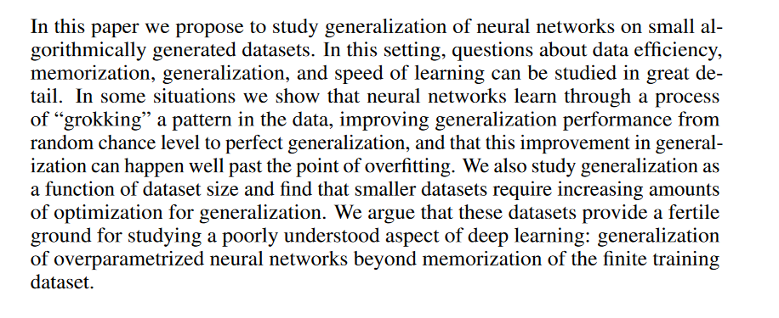
Possibly related to transition from memorization to generalization
Related to overparametrization (N>>D)
Active area of research
→ Do not stop immediately when validation loss increaseses

Slide 49
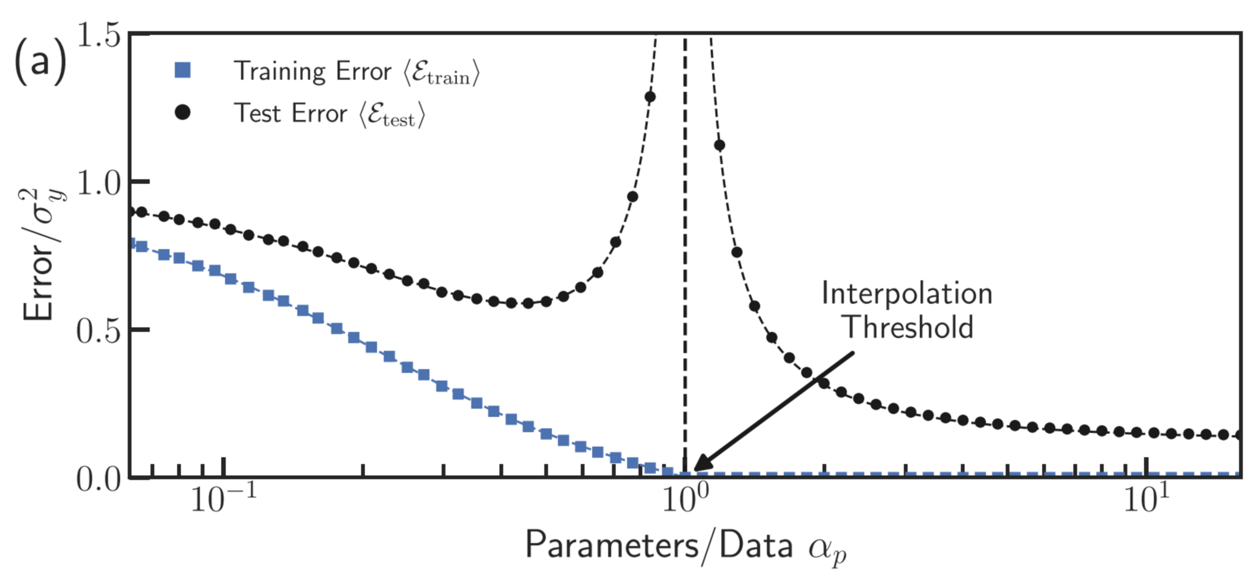
Variant: Double descent
Transition from under-parameterized to over-parameterized model

Slide 50
Outline
Computational cost
Scaling laws
Hyperparameter optimization
Stopping criteria
Training optimizations
Knowledge distillation
Mixture of experts
Training stories
Discussion
Group work

Slide 51
Training optimizations
Quantization (next lecture)
Do not start from scratch
Fine-tuning (next lecture)
Knowledge distillation
Mixture of experts

Slide 52
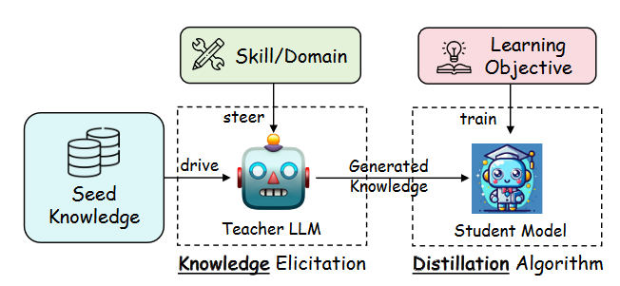
Knowledge distillation settings
Purposes:
Replication
Compression
Improvement
https://arxiv.org/pdf/2402.13116

Slide 53
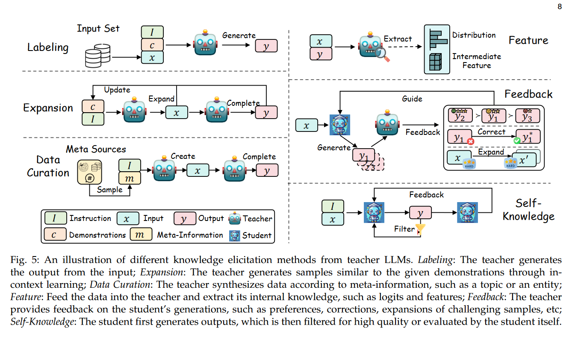

Slide 54
Why does distillation work?
Overparameterized teacher model (compression)
When training directly on a dataset, the model learns from one-hot or hard labels (e.g., "cat" = 1, "dog" = 0). These labels provide limited information. During distillation, the student can learn from the soft predictions of the teacher (the probabilities assigned to each class). These probabilities encode additional information about the relationships between classes.
E.g., if the teacher predicts P(cat)=0.8, P(dog)=0.15, P(rabbit)=0.05, the student learns that "dog" is more similar to "cat" than "rabbit," a nuance unavailable in hard labels.
The teacher’s soft predictions act as a form of regularization for the student. The teacher smooths out noisy patterns in the data by distilling robust and generalizable patterns into its outputs. As a result, the student avoids overfitting to noisy or spurious correlations in the training data.

Slide 55
Outline
Computational cost
Scaling laws
Hyperparameter optimization
Stopping criteria
Training optimizations
Knowledge distillation
Mixture of experts
Training stories
Discussion
Group work

Slide 56
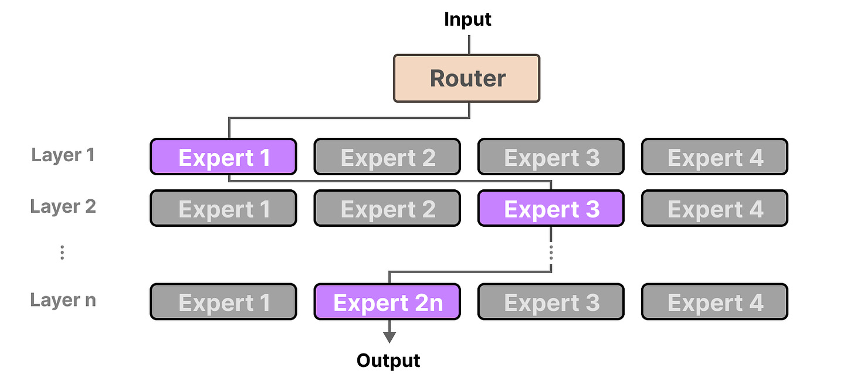
Mixture of experts (MoE)
https://newsletter.maartengrootendorst.com/p/a-visual-guide-to-mixture-of-experts

Slide 57
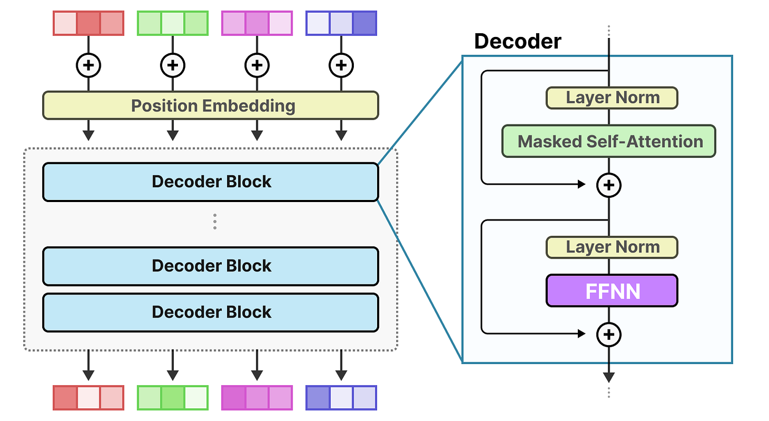
Dense feed-forward neural net

Slide 58
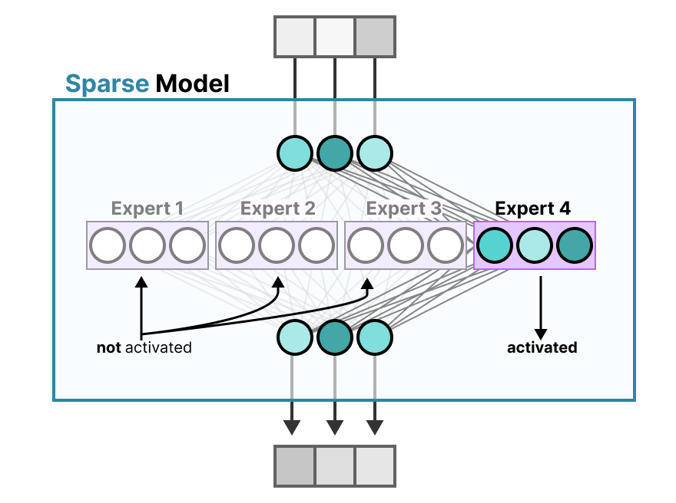

Slide 59
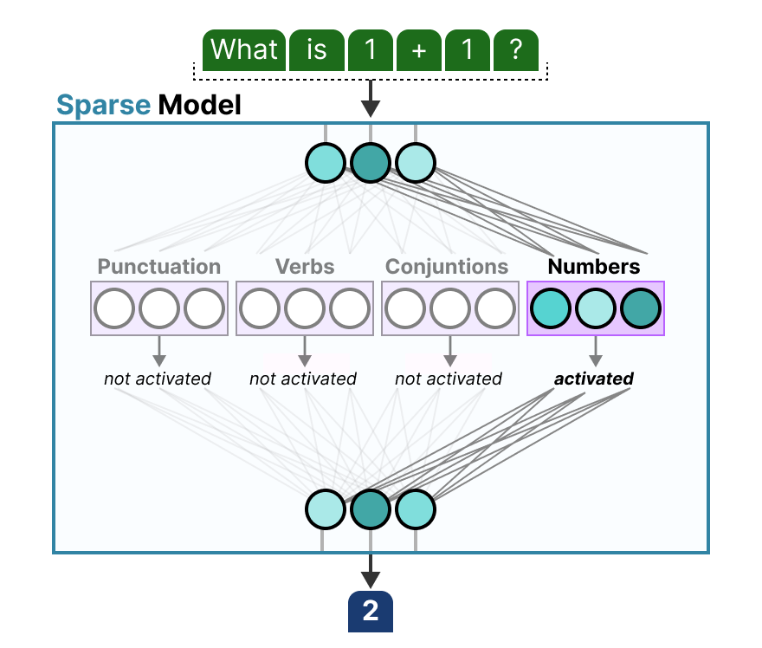

Slide 60
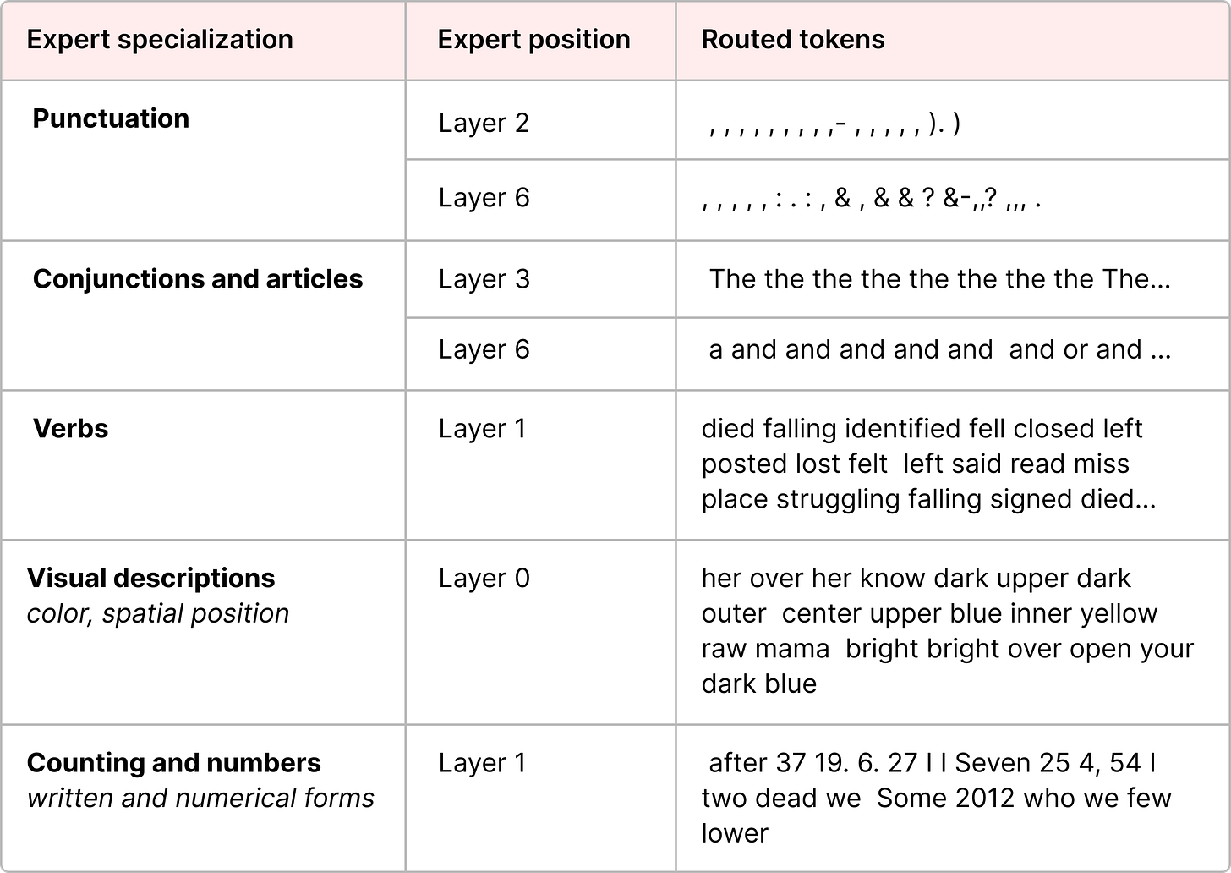
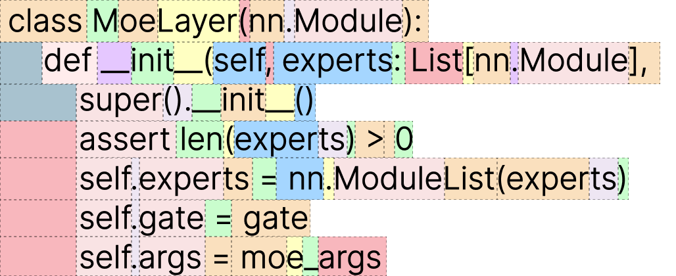

Slide 61
MoE - components
Router – small dense NN
Expert – larger dense NN
Typically not just one, but several experts selected
Training: Need to train router and experts
Need to ensure that not always the same expert is selected (trained)
E.g., by adding some noise
Or defining max capacity

Slide 62
MoE - potential
Still need to load all parameters (space)
But might need only a fraction during inference (time)
Popular model: Mixtral 8x7B

Slide 63
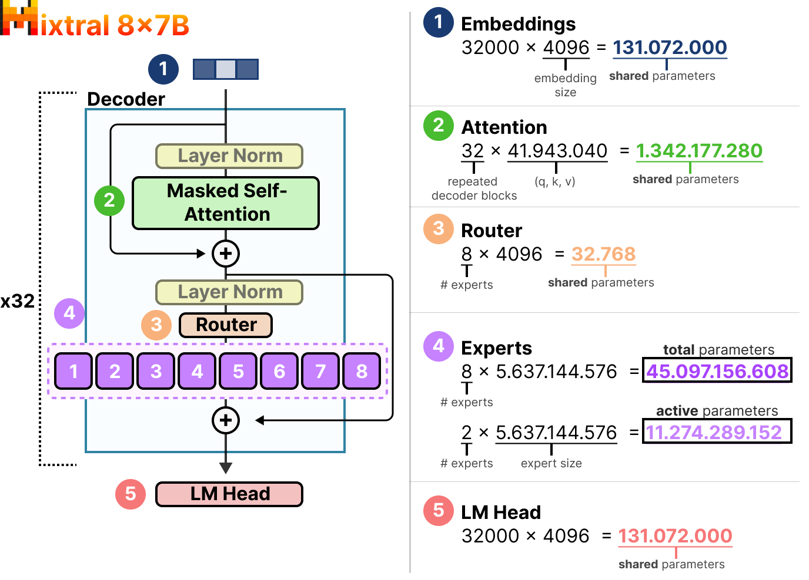

Slide 64
Outline
Computational cost
Scaling laws
Hyperparameter optimization
Stopping criteria
Training optimizations
Knowledge distillation
Mixture of experts
Training stories
Discussion
Group work

Slide 65
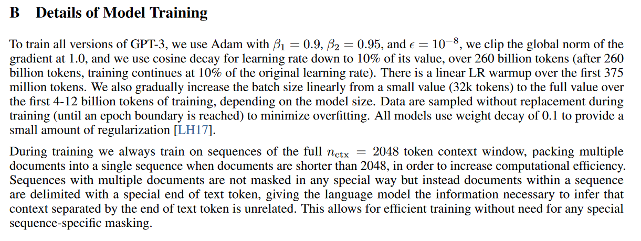
GPT-3
???
https://arxiv.org/pdf/2005.14165

Slide 66
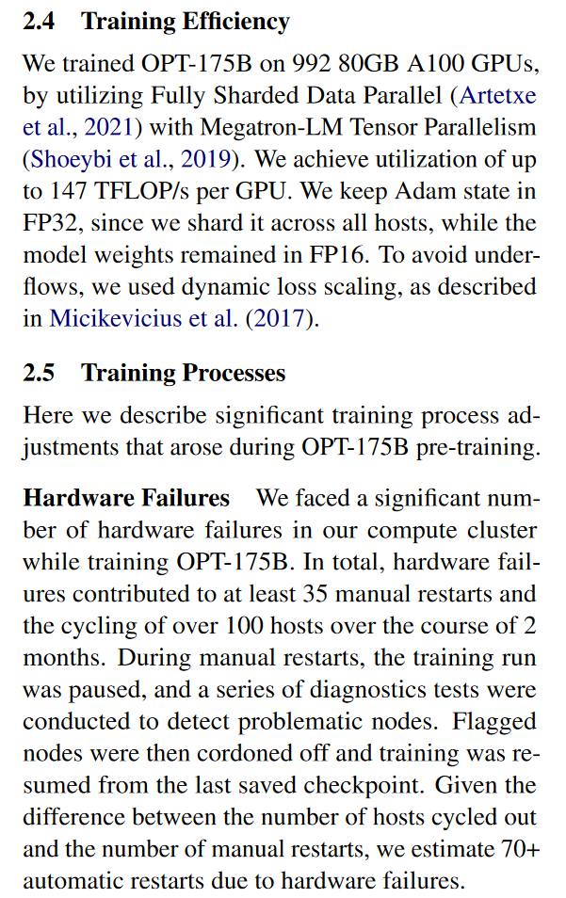
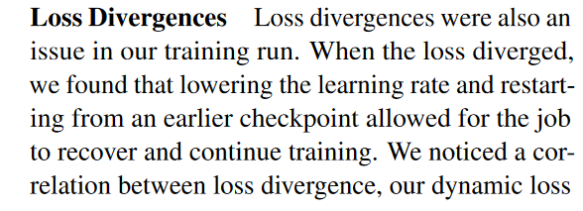
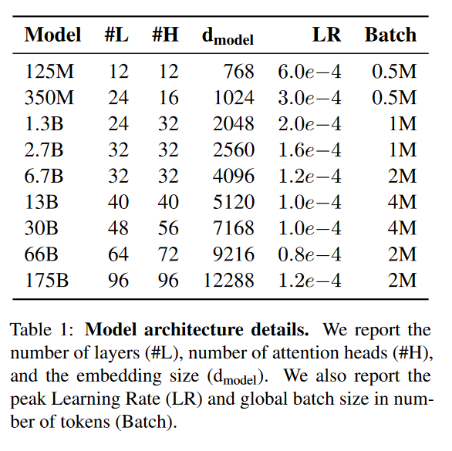
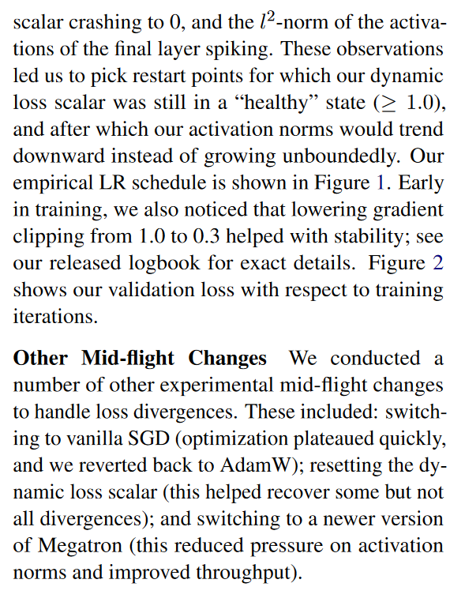
OPT
https://arxiv.org/pdf/2205.01068

Slide 67
Group work
Discuss the following questions with your neighbor:
What is the relation between parameters, data, training time, and LLM performance?
What are grokking and double descent? Why do they happen?
Why is setting hyperparameters so challenging? What are possible strategies?

Slide 68
Take home – Lecture 7
Model performance depends on all of parameters, data, training time, with diminishing returns
Hyperparameters are important, and messy
Training LLMs is extremely expensive → A range of optimizations exist
Lab today:
LLM Architectures

