Slide 1


Peer observation:
Learn, grow and succeed together!
Pauline Thamm
Tutor from TEAM TUTORING hybrid
TU Dresden
Notes:
Welcome to the short keynote speech on the topic of learning, growing and succeeding together. Peer observation makes it possible. My name is Pauline Thamm. I am in my 9th semester of teacher training at vocational schools for health and care, as well as ethics and philosophy. I myself was a tutor at my faculty for several years and have been active with the TUTORING hybrid team since June 2023.

Slide 2


Peer observation makes it possible!
Your advantages:
Increased expertise beyond the specialist field
Professional and personal development during your studies
Collegial exchange and support programme
valuable experience for your career in a leadership role as a
tutor or teacher
Notes:
Before I explain what a job shadowing is in general, I would like to tell you the advantages of why this offer is particularly interesting for you. On the one hand, you will gain expertise beyond the subject-specific. In particular, skills such as communication, collaboration, creativity and problem-solving strategies are all skills that are important in today's working world. And these are also discussed here. You will also gain valuable experience for your career in a leadership role, as a tutor or in your own teaching. This special offer provides you with professional and personal development alongside your studies, which we can achieve through regular reflection meetings with you. Likewise, the internship offers a platform for peer exchange, as well as a support offer, since we can support you specifically in the form of your strengths and weaknesses and also offer an exchange to talk about problems and find alternative courses of action.

Slide 3
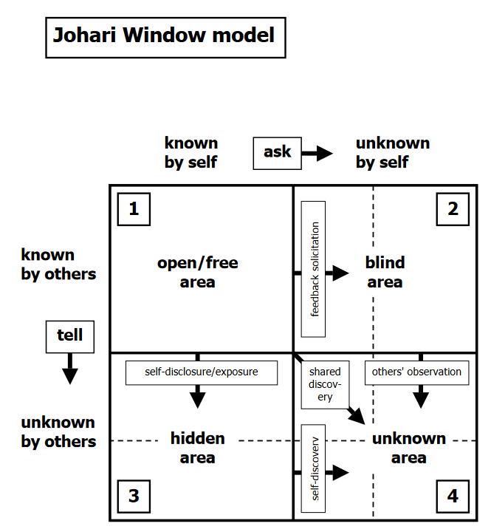
Why should we sit in on tutorials or exercises?
Provides insights into the teaching activities of the tutor
Provides the opportunity to identify proven teaching strategies
Provides an opportunity to reflect on pedagogical approaches and suggest improvements or adjustments to minimise the "blind spot" [1].
[1] Luft, J. & Ingham, H.: The Johari window, a graphic model of interpersonal awareness. In: Proceedings of the western training laboratory in group development, Los Angeles: UCLA, 1955.
Notes:
I would now like to give you a brief overview, from a scientific perspective, of why we should let students observe tutorials or exercises. The Johari window that you can see here is mainly used to illustrate the so-called ‘blind spot’ that everyone has in their self-awareness. The blind spot refers to the part of the self that a person cannot see or perceive. It is only through objective observation by an outsider that this blind spot becomes transparent and visible, which we enable in our observation. The Johari Window is a communication model that is designed to graphically represent the differences between the areas of self-perception and external perception. It is divided into four areas: the public, the secret, the unknown and the blind spot. This blind spot can be reduced by means of the collegial feedback provided during the observation. The others, for example, say what they perceive in me, in my actions, my behaviour, and I discover good sides of myself that I didn't know about before or perhaps constructive sides that I would now like to work on. So the feedback in the collegial observation is a gift to you. But it also serves for self-revelation in the collaboration. And it is also important for being able to take others into consideration. For example, if I know that I am standing in front of a seminar group and I am always totally nervous and start to stutter, then it is sometimes good to reveal this in self-awareness and deal with it openly and to say right at the start: ‘Those who know me are aware that I am nervous before such a big presentation. Nevertheless, I do my best.’ Exactly, and here we again summarise the reasons why we do this and offer it. It also provides insights into the tutor's teaching activities. It also offers the opportunity to identify proven teaching strategies and to reflect on pedagogical approaches and to suggest improvements or adjustments in order to reduce precisely this blind spot that I have just explained.

Slide 4

What is peer observation?
One person takes part in your tutorial as a guest and then gives feedback
feedback on the observed lesson.
Each tutor who is observed determines what is to be observed.
should be observed.
Only the selected aspects of the short survey are the subject of
of the observation and the subsequent feedback discussion.
The guest and the tutor reflect "at eye level" on the teaching activity in the tutorial, using a criteria-led protocol.
Through dialogue, we develop new insights and thus expand your personal professionalism in tutoring.
Notes:
Im Bild ersetzen: Erkenntnis → Insight
Now that we have learned about interesting and scientific reasons for sitting in on a tutorial, I would like to briefly present how a sit-in can work for us. A person participates in a tutorial as a guest and then provides feedback on the observed session. Each tutor who is being observed determines what should be observed. Only the selected aspects of the short survey are then the subject of this observation and the subsequent feedback discussion. The guest and the tutor then reflect on an equal footing on the teaching activity in the tutorial on the basis of a criteria-led protocol. In dialogue, we then develop new insights and thus expand your personal professionalism in tutoring.

Slide 5
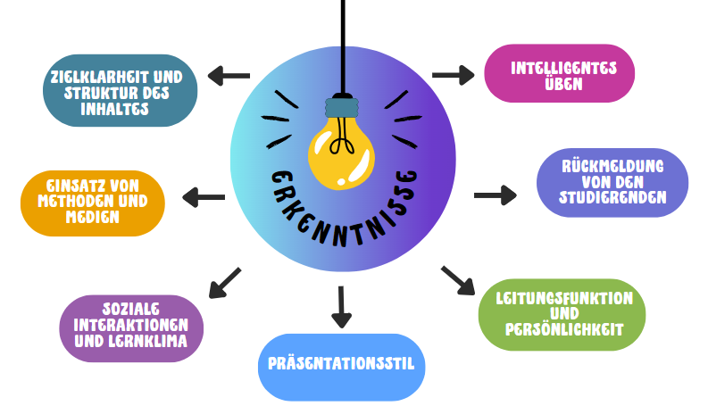
Possible focal points of observation
Notes:
Bild:
mitte: Insight
Clarity of purpose and structure of the content
Use of methods and media
Social interactions and learning climate
Presentation style
Leadership and personality
Feedback from the students
Intelligent practicing
Why did we just incorporate this little exercise? I want to show you that we can select a wide range of categories during our observation to support you in your self-awareness and how others perceive you, and thus minimise this blind spot in science so that the blind spot can be recognised and strengths, weaknesses and potential can be developed. Some examples from Mentimeter will also appear here again.
What is the purpose of each category?
In ‘Clarity of purpose and structure of content’, we look at the structure of your tutorial and how you manage the time. Are the individual processes or phases logically linked and are they based on learning objectives, skills or simply performance expectations that you have of the participants? For example: ‘The participants should practice the topic you have chosen by completing the exercises.’ Your tutorial should therefore have a convincing, self-contained sequence of individual teaching steps. This also means that there should be no gaps, but rather that the transitions between the individual phases – let's say you start by teaching theory, then you incorporate a practice phase and at the end everything is reflected on in practice – that these are designed and also logically linked.
What is the next category? Use of media, methods and social forms. The question is to what extent the sensibly selected social forms are carried out correctly, for example, individual work, partner work or group work forms. Under no circumstances should it be the task of the tutors to ask the participants everything during the tutorial. The tutor should not tell the participants anything that they can only learn by working on it themselves. The guiding principle is: ‘Encourage participation and minimise lecturing’. What we assess or observe is the orientation of the learning and working methods, the sensible choice and variety of methods, and the use of social forms that are appropriate to the topic and the desired goals. But also whether you have used media, for example worksheets, tasks, exercises, presentations, that are simply integrated in a purposeful way and are of a good scope.
Intelligent practice
In this category, we focus on activating prior knowledge, differentiating the difficulty of tasks and providing comprehensible explanations of exercises, tasks or subject knowledge for participants. When doing exercises, you provide comprehensible help, let your students explain results and show several solutions or strategies. You also make sure that the participants can contribute accordingly and that there is time for possible discussions, open questions or queries. This category is particularly interesting if you are guiding arithmetic exercises.
In the category ‘feedback from students’, we observe the targeted use of feedback options. So you get feedback from your participants regarding your tutorial, for example, orally or personally, anonymously or in writing. Here it is observed whether you grasp the current learning level of the participants, i.e. how they are doing in your tutorial, whether they understand everything, but also whether you offer different methods or possibilities for testing here. There are many different possibilities, for example the ‘TU Dresden vote’ option, the ‘easy feedback’ platform, Kahoot, Mentimeter, as well as other methods such as a ‘target query’, a position line, the well-known sandwich method or a traffic light feedback.
In the category of ‘leadership and personality’, we observe your behaviour as a tutor in front of students. This should be characterised by confidence, natural openness, willingness to work, friendliness, collegiality, patience and flexibility. So how do you act in front of the participants?
In the last category, the presentation style, we observe what particularities, weaknesses and strengths are recognisable in terms of speaking speed, volume, voice modulation, as well as facial expressions and gestures, but also movement in space, as well as non-verbal and verbal expressiveness.

Slide 6
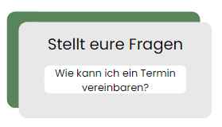
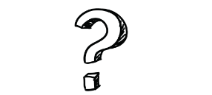

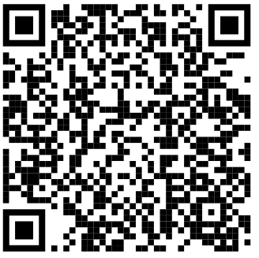
TUTORING: Didactic ideas online and offline for tutors 2024 - OPAL (sachsen.de)
Notes:
Bild:
Ask your questions
How can I make an appointment?
Link (bin aber unsicher, ob das der gleiche Link bleibt?):
TUTORING: Didactic ideas online and offline for tutors 2024 - OPAL (sachsen.de)
Maybe a few questions are still unanswered at this point. If you are interested in this offer and would like to put into practice what you have just heard, then register here via our QR code for the ‘Collegial Work Observation’ course. We will then contact you as soon as possible and arrange an appointment. During the first appointment, we will sit quietly at the back of your tutorial and observe, followed by a reflection discussion. This can be quite individual. Usually it is 60 minutes, but of course it can extend from 30 to 90 minutes or 120 minutes, depending on how many observation points are to be observed. Because the more points are selected, the more speaking time you will need in the end, depending on your and our perception. But on average 60 minutes, so two appointments. This can be directly after the tutorial or on another selected day.

